Slide 1
Insight into Structural Phase Transitions from Density Functional Theory
Adrienn Ruzsinszky
Department of Physics
Temple University
Philadelphia
SUPPORTED BY DOE
ES2014, Denton, Texas, 2014

Slide 2
What kinds of phase transitions exist?
Under pressure Si displays 11 phases with an increase in coordination number and a transition from semiconductor to metal
Silica exists in various crystalline polymorphs and in glassy phase
H₂O ice is one of the most abundant planet forming materials and its phase diagram is of fundamental scientific interest. It is crucial for modeling the interiors of icy planetary giants
Molecular crystals for drug design exist in different polymorphs with very small energy difference
M. T. Yin and M. L. Cohen, Phys. Rev. Lett. 45, 1004 (1980)
N. R. Keskar and J. R. Chelikowsky, Phys. Rev. B 46, 1 (1992)
J. B. Neaton, N. W Ashcroft, Nature ,400, 141, (1999)
K.A. Johnson, N. W. Ashcroft, Nature, 403, 632 (2000)
B. Militzer and H. F. Wilson, Phys. Rev. Lett. 105, 195701 (2010)
M.Ji, K. Umemoto, C-Zh. Wang, K-M. Ho, and R. M. Wentzcovitch, Phys. Rev. B 84, 220105(R) (2011)

Slide 3
Motivation:
to understand long-standing and fundamental problems in solid-state physics and materials science
reconcile theory with experiment
give more insight in materials problems from the DFT aspect
experimental realization of some phase transitions is extremely difficult (structural phase transition of hydrogen from a proton-paired insulator into a monatomic metal ~342 GPa)
Simple: the prediction of the most stable crystal structure, the static properties such as the equilibrium lattice constant, cohesive energy, and bulk modulus.
Complex: Common materials problems like adsorption on surfaces or structural phase transitions.

Slide 4
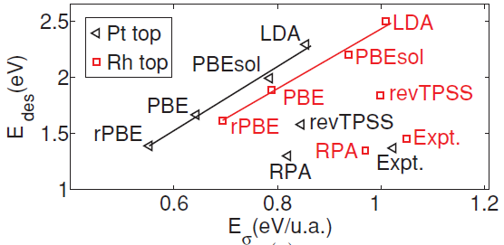
In Complex materials problem we often face dilemmas when testing density functional approximations:
Adsorption on surfaces: adsorption energy vs. site preference
Structural phase transitions: energy-geometry dilemma
J. Sun, M. Marsman, A. Ruzsinszky, G. Kresse and J.P. Perdew, Phys. Rev. B 83, 121410(R) (2011).
Can a meta-GGA predict good results for the equilibrium lattice properties of two polymorphs of a solid, as well as the phase transition parameters such as energy difference and transition pressure, simultaneously?

Slide 5
Structural transitions of solids under pressure
Often we need to calculate small energy differences accurately. For the lattice constant of a solid, this small energy difference is associated with a small change of external potential, so errors in approximate functionals tend to cancel out. Thus even LDA can predict useful lattice constants.
For the structural phase transitions, this small energy difference is associated with a large change of external potential. Less error cancellation is expected, making the prediction of the transition pressure challenging.

Slide 6
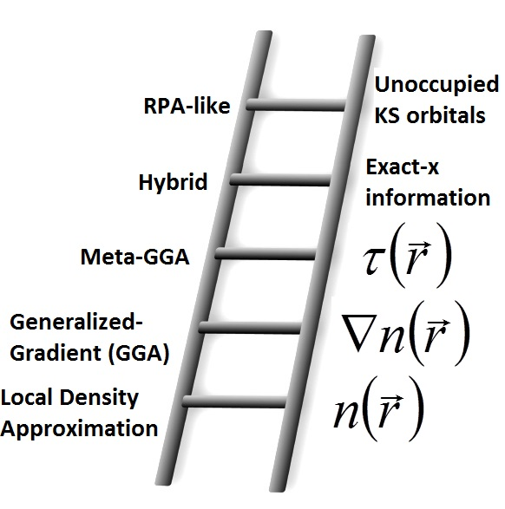
The computationally efficient semilocal density functional approximations for the xc energy
require a single integration over the 3D space.
Meta-GGA’s have more ingredients, and can satisfy more exact constraints, than GGA’s.
Thus meta-GGA’s can achieve higher simultaneous accuracy for molecules, clusters, solids, surfaces, and molecules bound to surfaces. It seems that they can also achieve higher accuracy for weak bonds.
But the existing nonempirical meta-GGA’s (e.g., TPSS and revTPSS) are not better than GGA’s for weak bonds.
JP. Perdew and K. Schmidt, in Density Functional Theory and its Application to Materials, edited by V. van Doren, C. Van Alsenoy and P. Geerlings, (AIP, Melville, NY, 2001)
J. Tao, J.P. Perdew, V.N. Staroverov and G. E. Scuseria, Phys. Rev. Lett. 91, 146401 (2003).
J.P. Perdew, A. Ruzsinszky, G.I. Csonka, L.A. Constantin and J. Sun, Phys. Rev. Lett. 103, 026403 (2009).

Slide 7
D.R. Hamann 1996 showed that the PBE GGA was much better than LDA for the transition pressures of silicon and silicon dioxide under pressure. This work motivated many solid state physicists to switch from LDA to GGA.
J.W. Wilkins and collaborators found that the TPSS meta-GGA was considerably worse than the PBE GGA for these transition pressures:
R.G. Hennig, A. Wadehra, K.P. Driver, W.D. Parker, C.J. Umrigar and J.W. Wilkins, Phys. Rev. B 82, 014101 (2010)
E.R. Batista, J. Heyd, R.G. Hennig, B.P. Uberuaga, R.L. Martin, G.E. Scuseria, C.J. Umrigar and J.W. Wilkins, Phys. Rev.B 74, 121102 (R) (2006)
K.P. Driver, R.E. Cohen, Z. Wu, B. Militzer, P.López. Ríos, M.D. Towler, R.J. Needs and J.W. Wilkins, Proc. Nat. Acad. Sci. (USA) 107, 9519 (2010)
This suggested to us that TPSS and revTPSS were not optimal meta-GGAs.
D.R. Hamann, Phys. Rev. Lett. 76, 660 (1996).

Slide 8
With three ingredients even for spin-unpolarized densities, the meta-GGA form offers rich possibilities to satisfy known exact constraints on the density functional for the exchange-correlation energy, and to achieve high accuracy with or without empiricism.
Our latest meta-GGAs (MGGA_MS family) already seem to be reliably accurate for many purposes, but we are working to improve them further.
J. Sun, B.Xiao and A. Ruzsinszky, J. Chem. Phys. 137, 051101 (2012)

Slide 9
The third-order Birch-Murnaghan equation of state:
E
Structure A
E₀: equilibrium energy
V₀: equilibrium volume
B₀: bulk modulus
Structure B
B₀’: the pressure derivative of the bulk modulus
V_{A}
V_{B}
V
F. D. Murnaghan, Proc. Natl. Acad. Sci. 30, 244 (1944)
The largest error in the theoretical transition pressure arises because the EOS of one phase displays an erroneous rigid vertical shift with respect to that of the other.

Slide 10
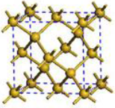
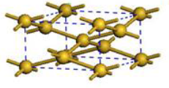
The phase transition under pressure in Si
insulator-to-metal transformation
The obtained energy–volume curves were fitted to the analytic third-order Birch-Murnaghan equation of state for E(V), the total energy of the unit cell of volume V, which may include the ZPE and finite temperature correction.

Slide 11
The structural and phase transition parameters of the D-Si (LP) and β-tin Si (HP) phases. We define and
Properties | LDA | PBE | TPSS | revTPSS | regTPSS | MGGA_MS0 | HSE06 | RPA | Expt.
D-Si
V₀ (Å³/atom) | 19.71 | 20.40 | 20.25 | 20.10 | 20.04 | 20.13 | 20.05 | 20.02 | 20.0
β-tin
V₀ (Å³/atom) | 14.81 | 15.30 | 15.02 | 14.85 | 15.06 | 15.09 | 14.81 | 15.24 | —
Phase transition properties
ΔE₀ (eV/atom) | 0.206 | 0.290 | 0.265 | 0.160 | 0.285 | 0.517 | 0.398 | 0.37 | —
ΔV₀ (Å³/atom) | 4.90 | 5.10 | 5.24 | 5.25 | 4.98 | 5.04 | 5.35 | 4.78 | —
P_{t} (GPa) | 5.7 | 8.4 | 7.3 | 3.7 | 8.0 | 17.3 | 13.3 | 12.2 | 10~14
R.G. Hennig, A. Wadehra, K.P. Driver, W.D. Parker, C.J. Umrigar and J.W. Wilkins, Phys. Rev. B 82, 014101 (2010)
J.Z. Hu, L.D. Merkle, C.S. Menoni and I.L. Spain, Phys. Rev. B 34, 4679 (1986)
E.R. Batista, J. Heyd, R.G. Hennig, B.P. Uberuaga, R.L. Martin, G.E. Scuseria, C.J. Umrigar and J.W. Wilkins, Phys. Rev.B 74, 121102 (R) (2006)
R. Maezono, N.D. Drummond, A. Ma and R.J. Needs, Phys. Rev. B 82, 184108 (2010)
B. Xiao, J. Sun, A. Ruzsinszky, J. Feng and J.P. Perdew, Phys. Rev. B., 86, 094109 (2012)
B. Xiao, J. Sun, A. Ruzsinszky, J. Feng, R. Haunschild, G.E. Scuseria, and J.P. Perdew, Phys. Rev. B 88, 184103 (2013)

Slide 12
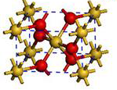
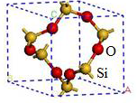
The phase transition under pressure in SiO₂
insulator-to-insulator phase transition

Slide 13
The structural and phase transition parameters of the α-quartz(LP) and stishovite(HP) phases.
Properties | LDA | PBE | TPSS | revTPSS | regTPSS | MGGA_MS0 | HSE06 | RPA | Expt.
α-quartz
V₀ (Å³/SiO₂) | 36.95 | 39.41 | 39.17 | 39.15 | 39.00 | 38.37 | 38.28 | 37.75 | 37.73
stishovite
V₀ (Å³/SiO₂) | 22.96 | 24.04 | 23.68 | 23.68 | 23.59 | 23.42 | 23.22 | 23.66 | 23.30
Phase transition properties
ΔE₀ (eV/SiO₂) | -0.031 | 0.532 | 0.384 | 0.189 | 0.167 | 0.467 | 0.484 | 0.39 | 0.51~0.54
ΔV₀ (Å³/SiO₂) | 13.99 | 15.37 | 15.46 | 15.47 | 15.41 | 14.96 | 15.06 | 14.09 | 14.43
P_{t} (GPa) | -0.37 | 6.94 | 3.84 | 2.66 | 2.48 | 6.16 | 6.24 | 5.6 | 7.46
J. L. Holm, O. J. Kleppa, and E. F. Westrum, Jr., Geochim. Cosmochim. Acta 31, 2289 (1967)
M. Akaogi and A. Navrotsky, Phys. Earth Planet. Inter. 36, 124 (1984)
B. Xiao, J. Sun, A. Ruzsinszky, J. Feng and J.P. Perdew, Phys. Rev. B., 86, 094109 (2012)
A. Ruzsinszky, J.P. Perdew and G.I. Csonka, J. Chem. Theory. Comput. 6, 127 (2010)
A. Ruzsinszky, J. P. Perdew, and G. I. Csonka, J. Chem. Phys. 134, 114110 (2011)
B. Xiao, J. Sun, A. Ruzsinszky, J. Feng, R. Haunschild, G.E. Scuseria, and J.P. Perdew, Phys. Rev. B 88, 184103 (2013)

Slide 14
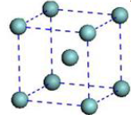
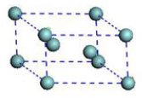
The phase transition under pressure in Zr
metal-to-metal phase transition

Slide 15
The structural and phase transition parameters of the ω-Zr (LP) and β-Zr(HP) phases.
Properties | LDA | PBE | TPSS | revTPSS | regTPSS | MGGA_MS0 | HSE06 | Expt.
ω-Zr (hcp)
V₀ (Å³/atom) | 21.54 | 22.86 | 22.61 | 22.49 | 22.40 | 22.66 | 22.96 | 23.09ª
β-Zr (bcc)
V₀ (Å³/atom) | 20.86 | 22.56 | 22.26 | 22.08 | 22.05 | 22.21 | 22.89 | 22.82
Phase transition parameters
ΔE₀ (eV/atom) | 0.059 | 0.084 | 0.087 | 0.087 | 0.088 | 0.113 | 0.200 | —
ΔV₀ (Å³/atom) | 0.690 | 0.300 | 0.352 | 0.410 | 0.362 | 0.459 | 0.065 | 0.270
P_{t} (GPa) | 9.17 | 23.21 | 22.56 | 21.78 | 26.62 | 31.25 | — | 30±2
B. Xiao, J. Sun, A. Ruzsinszky, J. Feng, R. Haunschild, G.E. Scuseria, and J.P. Perdew, Phys. Rev. B 88, 184103 (2013)

Slide 16
This ‘MGGA_MS” exists in three similar versions:
MGGA_MS0 (no empirical parameter):
Sun et all., J. Chem. Phys. 137, 051101 (2012)
MGGA_MS1 and MGGA_MS2 (1 or 2 empirical parameters):
Sun at all. J. Chem. Phys. 138, 044113 (2013)
Sun at all. Phys. Rev. Lett. 111, 106401 (2013)
MGGA_MS2 has two non-empirical parameters μ^{GE} and c (from the slowly-varying electron gas and the hydrogen atom), plus two empirical parameters κ and b (fitted to AE6 atomization energies and BH6 barrier heights).
We hope to purge the empirical parameters in the future, replacing them by additional constraints:
tight Lieb-Oxford bound for
M.M. Odashima and K. Capelle, J. Chem. Phys. 127, 054106 (2007)
non-uniform density scaling
M. Levy, Phys. Rev. A 43, 4637 (1991)
L. Chiodo, L.A. Constantin, E. Fabiano and F. D Sala, 108, 126402 (2012)
J.M. del Campo, J.L. Gazquez, S.B. Trickey, and A. Vela, Chem. Phys. Lett. 543, 179 (2012)

Slide 17
The electronic band gaps
The band-gaps of the D-Si, α-quartz and stishovite structures estimated from the calculated band-structure DOS by semilocal and non-local functionals. Notice that the band gap of Si is indirect [Г= (0, 0, 0) to X = (2π/a) (1, 1, 0)]; α-quartz also has an indirect band gap [K= ((2π/a) (1/√3, 1/3, 0) to Г]; the band gap of stishovite is direct at the Г point.
Structure | LDA | PBE | TPSS | revTPSS | regTPSS | MGGA_MS0 | HSE06 | GW0 | Expt.
D-Si | 0.49 | 0.62 | 0.38 | 0.25 | 0.25 | 0.17 | 1.14 | 1.22 | 1.17
α-quartz | 5.68 | 5.70 | 5.94 | 5.50 | 5.52 | 5.60 | 7.50 | 9.40 | 8.90
Stishovite | 5.90 | 5.13 | 5.56 | 5.17 | 5.17 | 4.25 | 8.06 | 8.90 | 5~6 8.75
L. Schimka, J. Harl and G. Kresse, J. Chem. Phys. 134, 024116 (2011)
G. Kresse, M. Marsman, L.E. Hintzsche and E. Flage-Larsen, Phys. Rev. B 85, 045205 (2012)
R.B. Laughlin, Phys. Rev. B 22, 3021 (1980)
G. Wiech, Solid State Commun. 52, 807 (1984)
A.N. Trukhin, T.I. Dyuzheva, L.M. Lityagina and N.A. Bendeliani, Solid State Commun. 131, 1(2004)

Slide 18
Contrary to suggestions by Wilkins et al, the underestimation of the fundamental band gap in GGA and meta-GGA has nothing to do with the accuracy of these functionals for the transition pressures.
„HSE06 (Heyd-Scuseria-Ernzerhof) is fully nonlocal and predicts more realistic fundamental gaps. HSE06 is better than the semilocal functionals for the transition pressures of Si and SiO₂, but seriously overestimates the transition pressure in Zr.”
B. Xiao, J. Sun, A. Ruzsinszky, J. Feng, R. Haunschild, G.E. Scuseria, and J.P. Perdew, Phys. Rev. B 88, 184103 (2013)

Slide 19
The equilibrium cell volumes
Equilibrium volumes of the Si, SiO₂ and Zr structures computed by DFT+D2 and optB86b-vdW methods, which introduce long-range van der Waals attraction. For the SiO₂ system, the unit is Å³/SiO₂; for the other two systems it is Å³/atom. LP and HP indicate the low-pressure and high-pressure structures.
Structures | PBE+D2 | TPSS+D2 | optB86b-vdW | MGGA_ MS0 | RPA | Expt
D-Si (LP) | 19.81 | 19.44 | 19.98 | 20.13 | 20.02 | 20.00
β-tin Si (HP) | 15.03 | 14.46 | 15.21 | 15.09 | 15.24 | —
α-quartz (LP) | 38.75 | 37.02 | 34.56 | 38.37 | 37.75 | 37.73
Stishovite (HP) | 23.83 | 23.49 | 23.29 | 23.42 | 23.66 | 23.30
ω-Zr (LP) | 23.17 | 22.90 | 21.46 | 22.66 | — | 23.09
β-Zr (HP) | 22.53 | 22.19 | 21.13 | 22.21 | — | 22.82
MAE | 0.38 | 0.51 | 1.09 | 0.35 | — | —
B. Xiao, J. Sun, A. Ruzsinszky, J. Feng, J.P. Perdew, Phys. Rev. B 86,094109, (2012)
R.G. Hennig, A. Wadehra, K.P. Driver, W.D. Parker, C.J. Umrigar and J.W. Wilkins, Phys. Rev. B 82, 014101 (2010)
Y.J.Hao, L.Zhang, X.R Chen, Y.H.Li and H.L He, J. Phys.: Condens. Matter. 20, 235230 (2008)
B.B.Karki, M.C.Warren, L.Stixrude, G.J Ackland and J. Crain, Phys.Rev. B 55, 3465, (1997)

Slide 20
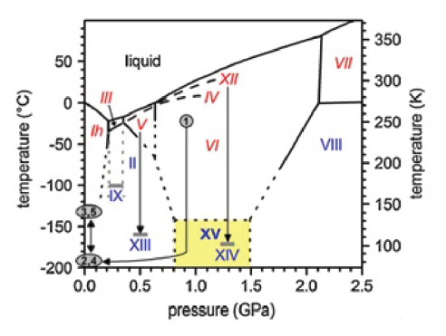
The phase transitions and sublimation energies in ice
The sublimation energies (meV) of 3 ice phases (the zero-point energy is omitted).
Ice | LSDA | PBE | revTPSS | TPSS+D2 | revTPSS+ vdW | MGGA _MS2 | optB88 + vdW | Expt.
Ih | 943 | 636 | 570 | 720 | 644 | 602 | 696 | 610
II | 896 | 567 | 504 | 690 | 630 | 586 | 699 | 609
VIII | 813 | 459 | 423 | 675 | 569 | 532 | 670 | 577
MARE % | 47.5 | 10.5 | 16.7 | 16.1 | 3.5 | 4.3 | 15
B. Santra, J. Klimeš, D. Alfѐ, A. Tkatchenko, B. Slater, A. Michaelides, R. Car, and M. Scheffler, Phys. Rev. Lett. 107,
185701 (2011)
E.D. Murray and G. Galli, Phys. Rev. Lett. 108, 105501 (2012)
Y. Fang, B. Xiao, J. Tao, J. Sun and JP. Perdew, Phys. Rev. B 87, 214101 (2013)

Slide 21
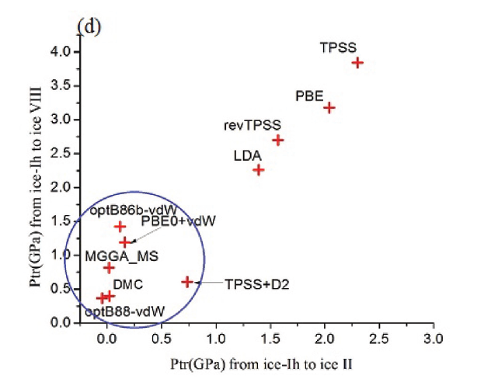
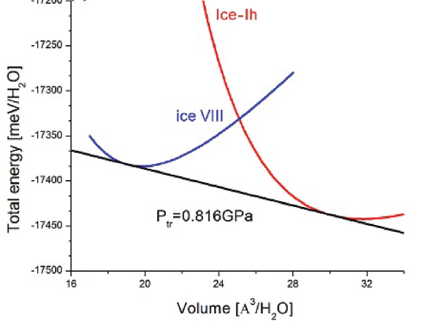
Transition pressure (p_{tr}) from Ice Ih to HP Ice VIII plotted versus transition pressure from Ice Ih to LP Ice II
B. Santra, J. Klimeš, D. Alfѐ, A. Tkatchenko, B. Slater, A. Michaelides, R. Car, and M. Scheffler, Phys. Rev. Lett. 107, 185701 (2011)
Y. Fang, B. Xiao, J. Tao, J. Sun and JP. Perdew, Phys. Rev. B 87, 214101 (2013)

Slide 22
The key new message from the results:
By using the right dimensionless ingredient (α), a meta GGA can recognize and give a different GGA-level description to each of three kinds of bonding regions in a molecule or solid:
1) Covalent bonds
2) Metallic bonds
3) Weak or vdW bonds
Well-designed meta-GGAs appear to maximize the ratio
ACCURACY/(COMPUTATIONAL COST)

Slide 23
Meta-GGA made simple (MGGA_MS)
= reduced density gradient.
use α to interpolate between GGA’s for α=1 and α=0
and to extrapolate monotonically to
dimensionless deviation from the single orbital shape

Slide 24
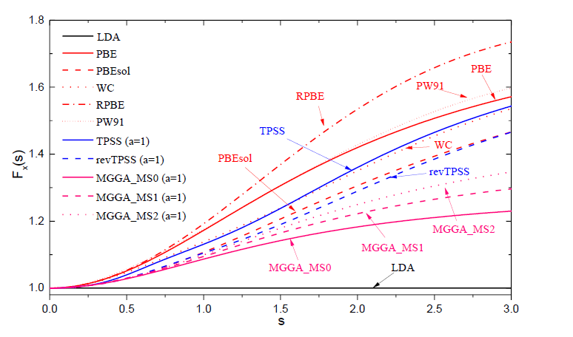
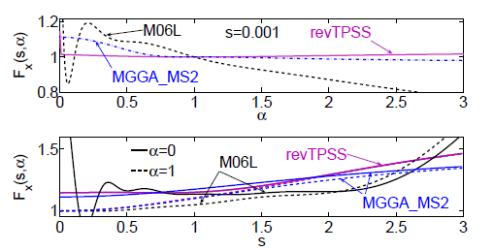
The enhancement factor of the MGGA_MS family of meta-GGA’s.
The left figure shows the F_{x} and the right figure shows the α and s dependence of F_{x} respectively
The main difference between the MGGA_MS family of density functionals and other tested functionals lies in the exchange enhancement factor F_{x}(s,α), where the weaker s-dependence in MGGA_MS is countered by a stronger α dependence. F_{x} is monotonically decreasing with α in MGGA_MS (but not in revTPSS).
This is the key to a good description of weak bonds.
Our recent works has revealed the significance of α for identifying different bonds in molecules and solids

Slide 25
First step: An artificial order-of limits problem arises in the TPSS and revTPSS meta-GGA’s due to use of BOTH z and α
For the fix-up of the order-of limits anomaly, see:
A. Ruzsinszky, J. Sun, B. Xiao and G.I. Csonka, J. Chem. Theory. Comput. 8, 2078 (2012)
Our newer meta-GGAs use only alpha, and so avoid this problem.

Slide 26
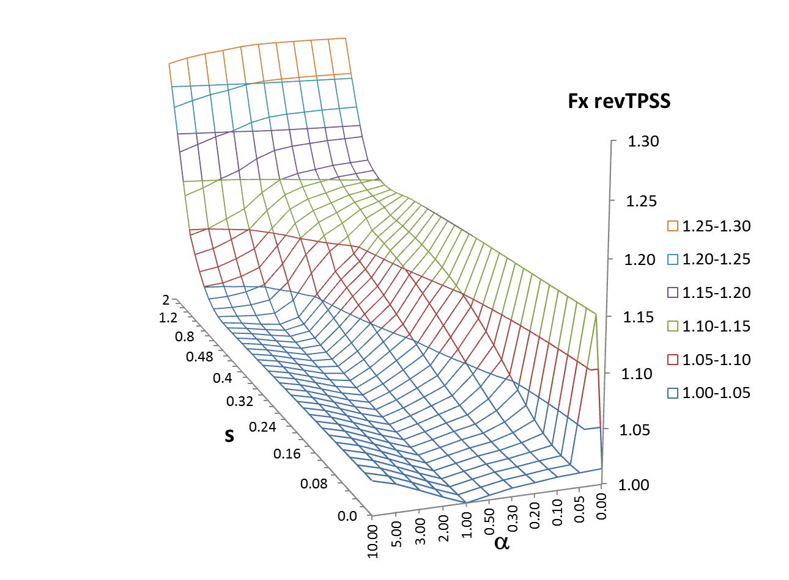
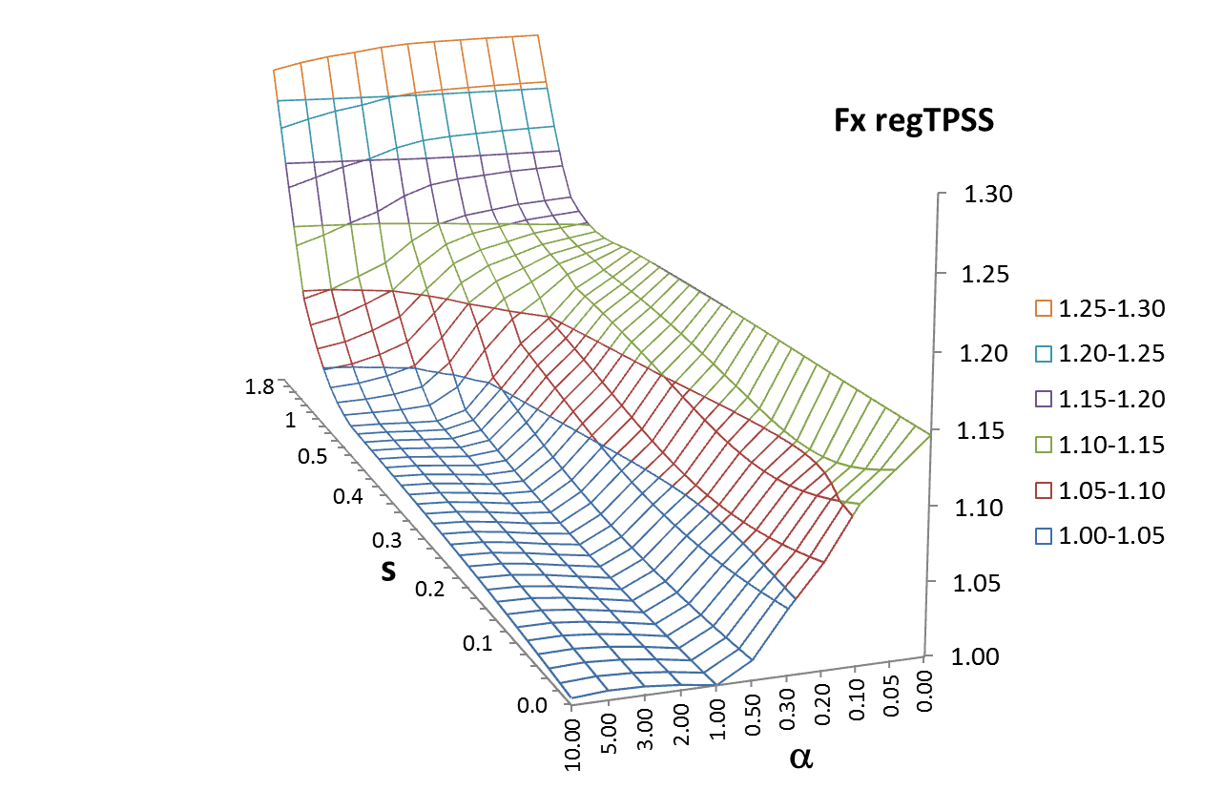
Properties | TPSS | revTPSS | regTPSS | MGGA_MS0 | MGGA_MS2 | HSE06 | Expt
Phase transition properties of D-Si and β-tin
ΔE₀ (eV/atom) | 0.265 0.266 | 0.160 | 0.285 | 0.517 | 0.429 | 0.398 0.390 0.447 | —
ΔV₀ (Å³/atom) | 5.24 | 5.25 | 4.98 | 5.04 | 4.98 | 5.35 | —
P_{t} (GPa) | 7.3 | 3.7 | 8.0 | 17.3 | 13.9 | 13.3 12.4 | 10~14 11~15

Slide 27
The exchange enhancement factor for MGGA_MS0. Focus on the front plane in which s=0, as at a typical bond center. In GGA, the enhancement factor in this plane would equal 1. In the revTPSS meta-GGA, it would be nearly equal to 1 except very close to alpha=0.

Slide 28
Second step: Arguments of the meta-GGA exchange enhancement factor
=reduced or dimensionless density gradient
? = z, t⁻¹ or α
=reduced variable for the KE density
where
where
where
Which is the best?

Slide 29
Previous semilocal approximations (e.g., revTPSS) can usefully describe covalent, ionic, metallic, and some hydrogen bonds. But they are not reliable for weak or vdW bonds (important for soft or biological matter).
Of course, no semilocal approximation can describe the long-range-part of the vdW interaction.
But the empirical meta-GGA’s from the Truhlar group give a useful description of the intermediate-range or equilibrium part in molecules. Can we see how to do the same with non-empirical or minimally-empirical meta-GGA’s, that are also useful for solids?

Slide 30
(used in TPSS and rev-TPSS)
G.K.H. Madsen.; L. Ferrighi.; and B. Hammer,. J. Phys.Chem. Lett., 1, 515 (2010)
Y. Zhao, and D.G. Truhlar, J. Chem.Phys. 125, 194101 (2006)
(used in BECKE and TRUHLAR functionals)
Regions of one- and two-electron density:
(single bonds)
2) Regions of uniform density:
(metallic bonds)
3) Regions of density overlap between closed shells:
(weak bonds)
z cannot distinguish between regions 2) and 3).
as
t⁻¹ cannot clearly distinguish between regions 1) and 2).
Only α can recognize these three regions and treat them differently.
A.D. Becke and K.E. Edgecombe, J. Chem. Phys. 92, 5397 (1990)

Slide 31
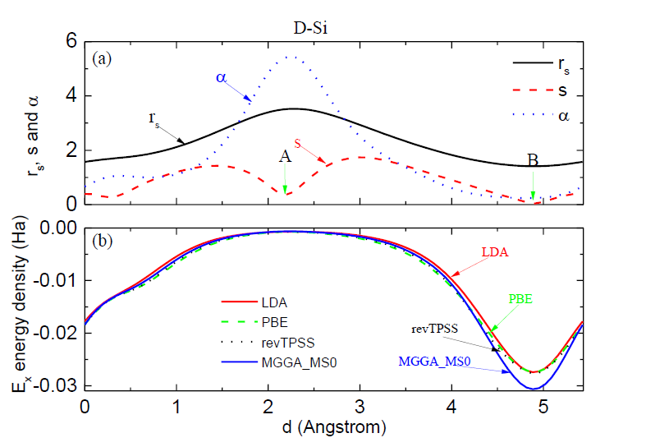
Plots of r_{s}, s and α along the line through the bond in the low-pressure phases of Si and the exchange energy density
A and B indicate the interstitial and single bond regions

Slide 32
Plots along the bond axis between two argon atoms separated by 7 Angstroms

Slide 33
Alternative descriptions of VDW in Density Functional Theory better describe the long-range part:
Langreth-type fully nonlocal functionals or double integrals over 3d space (good for vdW but not so good for other bonds).
(B) Pair-wise atom-atom interaction models for the long-range correction to a semilocal functional, e.g., Grimme’s DFT-D correction
(highly parametrized.)
Both are inaccurate for pairs of large fullerenes and for large nano-sheets or long nano-tubes.
Dion, M.; Rydberg, H.; Schroeder, E.; Langreth, D. C.;Lundqvist, B. I. Phys. ReV. Lett., 92, 246401 (2004)
O. A. Vydrov and T. Van Voorhis, Phys. Rev. A. 81,062708 (2010)
A.D. Becke and E.R. Johnson, J. Chem. Phys. 122, 154104 (2005)
Tkatchenko and M. Scheffler, Phys. Rev. Lett. 102, 073005 (2009)
Y. Andersson, D. C. Langreth, and B. I. Lundqvist, Phys. Rev. Lett. 76, 102 (1996)
J. F. Dobson and B. P. Dinte, Phys. Rev. Lett. 76, 1780 (1996)
J. Tao, J.P. Perdew, and A. Ruzsinszky, Phys. Rev. B 81, 233102 (2010)
S. Grimme, J. Comp. Chem. 25, 1463 (2004)
A.Ruzsinszky at all. Phys. Rev. Lett. 109, 233203 (2012)
J.F. Dobson, A. White and A. Rubio, Phys. Rev. Lett. 96, 073201 (2006)

Slide 34
We have found that all versions of MGGA_MS
are better than TPSS and revTPSS meta-GGA, or even PBE GGA, for the structural phase transition pressures of
Si (insulator to metal)
SiO₂ (insulator to insulator)
Zr (metal to metal).
We can understand this in terms of the two new MGGA_MS features in the alpha-dependence of the exchange enhancement factor.

Slide 35
Possible future refinements of the META-GGA MADE SIMPLE:
Make a “FULLY-CONSTRAINED META-GGA” based on α
Add a Langreth-type correction only for the most long-ranged part of the vdW interaction.
Make a Perdew-Zunger-like self-interaction correction to describe “STRONGLY-CORRELATED” SYSTEMS.

Slide 36
Conclusions
The proper meta-GGA dimensionless ingredient to recognize all degrees of orbital overlap is
using α, we can describe all bonds, even weak ones, with useful accuracy, with few empirical parameters (or perhaps none).
We have also found that MGGA_MS is accurate for solid transition pressures, while other meta-GGAs like revTPSS are not.

