Slide 1
Coupled cluster methods in the condensed phase
Garnet Kin-Lic Chan
California Institute of Technology

Slide 2
Molecular simulations are precise
in small molecules, theory can rival or replace expt
Butadiene: C₄H₆ optical excitation
Watson and Chan, JCTC, 8, 4013 (2012)
higher level correlation treatment
increase basis size
theory: 6.11 +/- 0.02 eV
expt 6.01 +/- 0.05 eV
theory and expt agree perfectly within error bars (2σ)

Slide 3
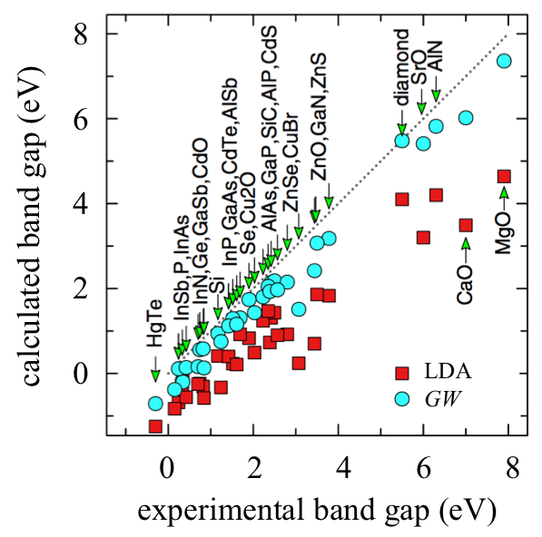
Materials simulations are not!
in materials, simulations are more of a “suggestion”
Are systematic, precise, predictive simulations of materials, as
currently exist in molecules, possible?

Slide 4
How to obtain high precision?
QED: fine-structure constant
experiment (2011)
theory (2012)
up to 10th order Feynman diagrams
in principle, this approach can be used in materials!

Slide 5
Coupled cluster theory
quant. chem. has systematic machinery to resum diagrams
P
H
H
P
P
H
P
H
H
P
CCSD sums all (products of)
diagrams with 2p-2h
intermediate lines
CCSDT sums all (products of)
diagrams with 3p-3h
intermediate lines
all rings, ladders, additional
lowest order Parquet terms
CCSD(T): gold standard
of molecular QC

Slide 6
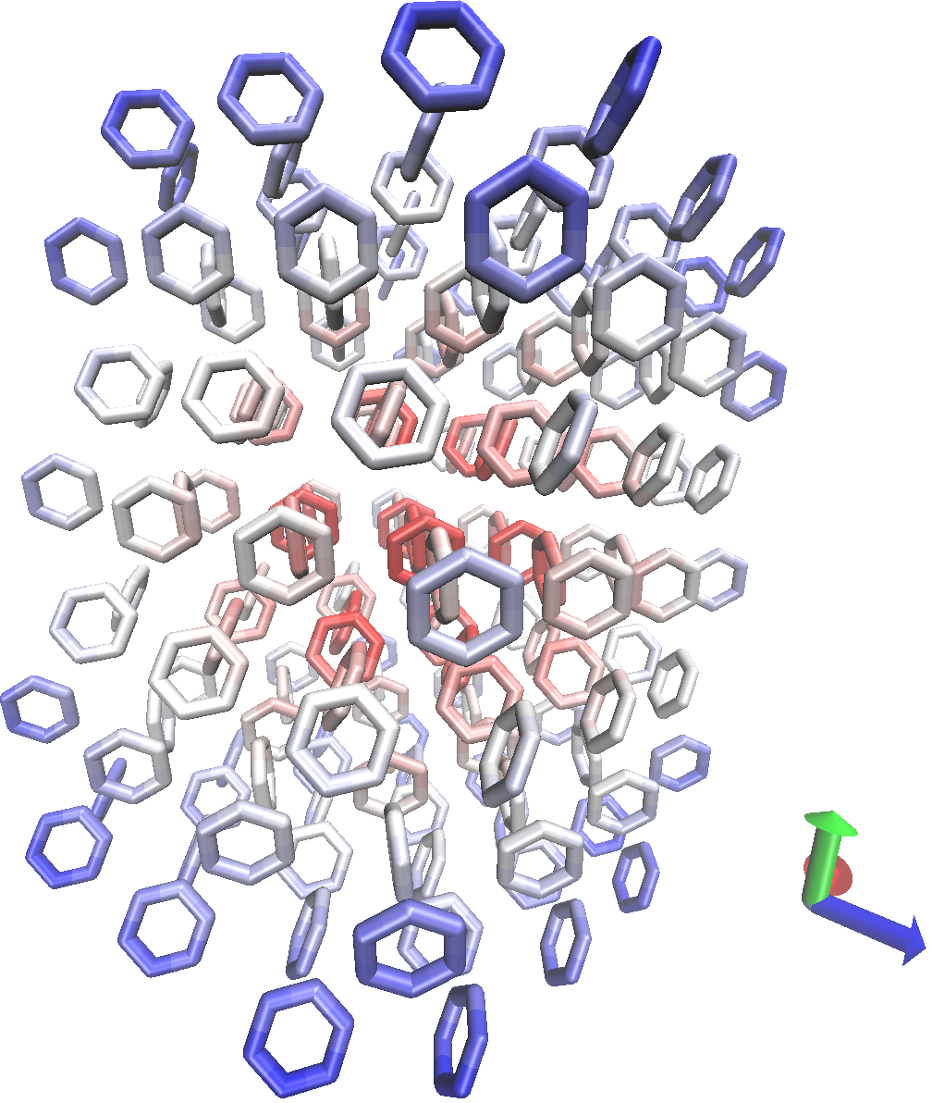
Coupled cluster in solids: total energies
how well can we determine
lattice energy of benzene crystal?
sum over all dimers,
trimers etc. ...
OSV-L-CCSD(T) with CCSDT(Q) / DMRG corrn.
aug-cc-pVTZ basis with F12 geminals
lattice energy 55.97 ± 0.76 ± 0.1 kJ/mol
Yang, Hu, Usvyat, Matthews,
Schuetz, Chan, Science (2014)
better than 1 kJ/mol accuracy –
similar to best calcs in molecules

Slide 7
Coupled cluster in solids: spectra
what is the spectral function of the
uniform electron gas?
equation of motion CC (EOM-CC): systematic
diagrammatic approximations to Green’s function
compare to: GW, DMRG (where possible)

Slide 8
14e, 19 orbital UEG
k = (0, 0, 0) r_{s}=4
McClain, Lischner, Watson, Matthews,
Ronca, Louie, Berkelbach, Chan, PRB (2016)
EOM-CCSDT, DMRG
perfect agreement
GW completely
depends on
starting point
(CC completely
invariant)
GW + C
predicts
spurious peaks

Slide 9
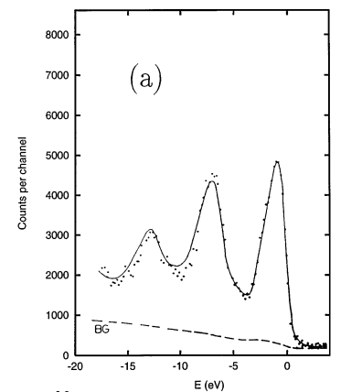
114e, 485 orbital UEG
k = (0, 0, 0) r_{s}=4
Na photoelectron spectrum
(EOM) coupled cluster: quantitative treatment of core
excitations in metallic sodium!

Slide 10
brief interlude

Slide 11
Coupled cluster theory appears promising
for condensed phase simulations
These methods have existed for molecules
for a long time
Why have they not been explored in crystals?
The main barrier is the lack of technical
infrastructure to develop quantum
chemistry in the condensed phase!

Slide 12
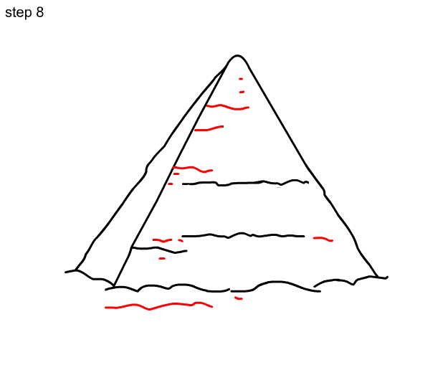
Standing on the shoulders of giants
correlation methods
integral transformations / RI / CD
Hartree-Fock
integrals
basis sets
basis functions

Slide 13
The PBC module of PySCF
scaling the pyramid so you don’t have to
PBC integral transformations / RI / CD
PBC Hartree-Fock
PBC integrals
PBC basis sets
PBC basis functions

Slide 14
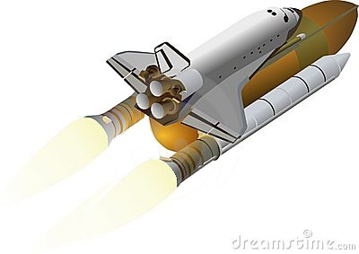


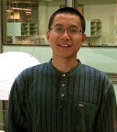
PySCF
Performance
Complexity
Features
pyscf.org
Qiming Sun, lead developer

Slide 15
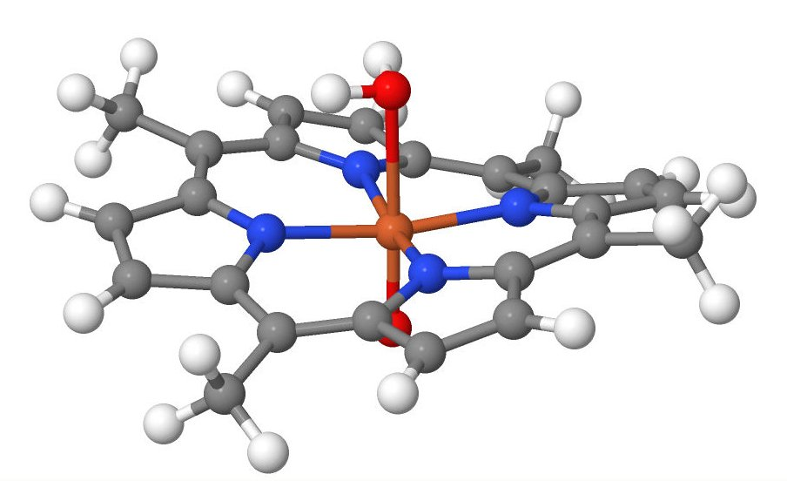
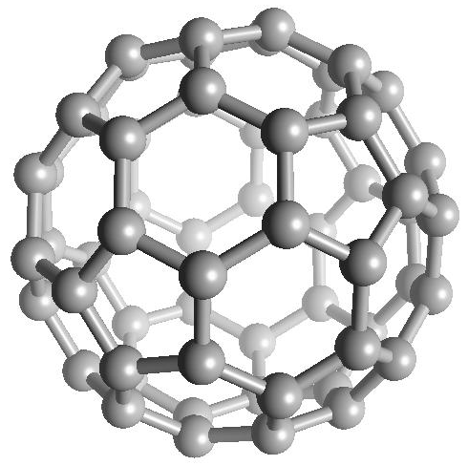
PySCF: molecular code performance
HF/DFT up to 5000 fns
CC up to 1500 fns
CASSCF up to 3000 fns
HF, DFT, TD-DFT, MP2, CCSD(T),
EOM-CCSD, CASSCF, NEVPT2,
FCI, DMRG, DMRG-PT2
relativistic 2C/4C HF/DFT
gradients: HF/DFT/MP2/CCSD(T)
NMR, properties, solvation ...
and much more ...

Slide 16
PySCF: extreme simplicity
PySCF = mainly Python + a little C + 3 external libraries
(hdf5, libcint, libxc)
total lines of code
 | Python | C
Overall | 60.3 k | 26.2 k
DFT | 4.1 k | 7.3 k (LebedevGrid 5k)
MCSCF | 5.9 k | 50
CCSD | 0.7 k | 0

Slide 17
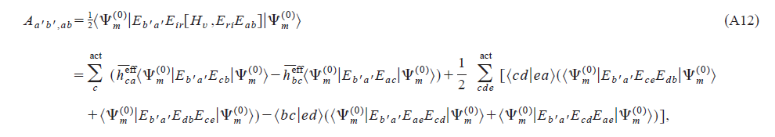
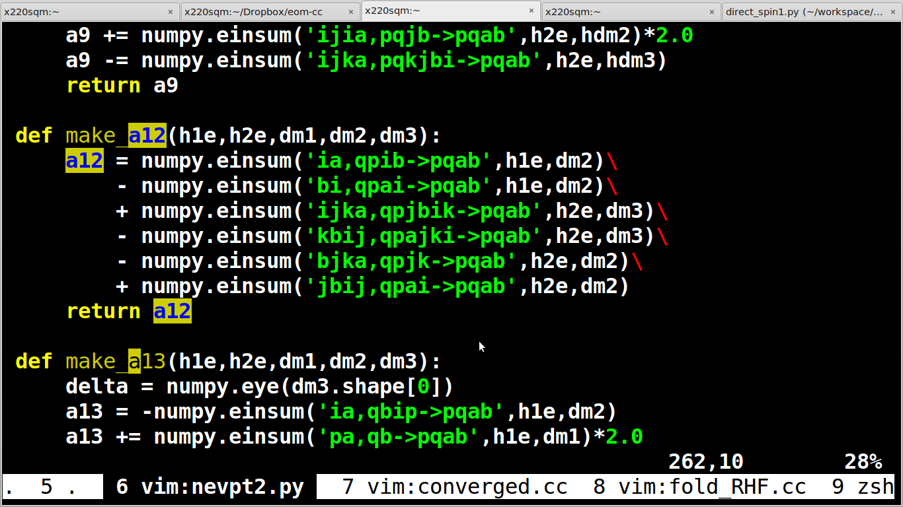
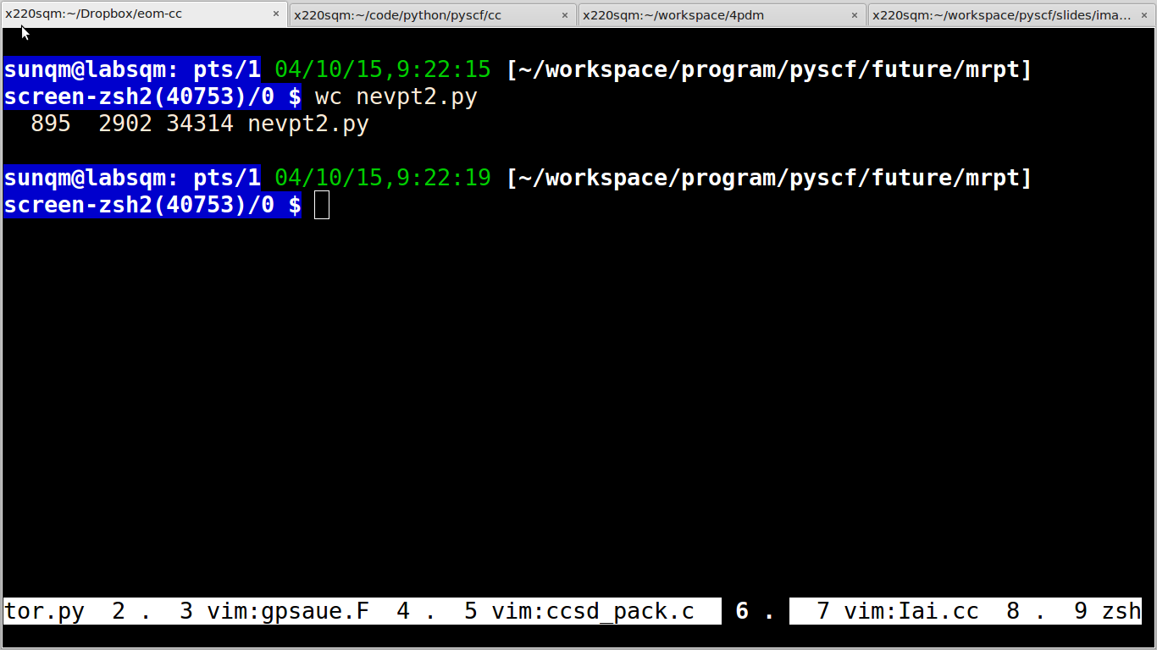
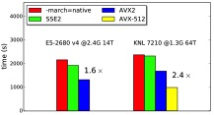
Simple code + hand-tuned performance
NEVPT2
everything is einsum
high-performance integral and tensor contraction kernels
AVX2/AVX-512
integral kernel
TBLIS tensor
contraction
(Devin
Matthews)

Slide 18
Use same code for molecule and solid
import pyscf.gto
from pyscf import mp, cc, mcscf
mol = pyscf.gto.M(...)
eri = ao2mo.get_ao_eri(mol)
mf = scf.RHF(mol).run()
print mp.MP2(mf).kernel()[0]
print cc.CCSD(mf).kernel()[0]
mc = mcscf.CASSCF(mf, 8, 8)
print mc.kernel()[0]
td = tddft.TDHF(mf)
print td.kernel()[0]
import pyscf.pbc.gto
from pyscf import mp, cc, mcscf
cell = pyscf.pbc.gto.M(...)
eri = ao2mo.get_ao_eri(cell)
mf = scf.RHF(cell).run()
print mp.MP2(mf).kernel()[0]
print cc.CCSD(mf).kernel()[0]
mc = mcscf.CASSCF(mf, 8, 8)
print mc.kernel()[0]
td = tddft.TDHF(mf)
print td.kernel()[0]
Exactly the same implementation!
Notes:
The difference is the initialization, cell or mole

Slide 19
back to coupled
cluster calculations
in the condensed phase

Slide 20
Ground-state CCSD: covalent solids
TZVP basis 4x4x4 mesh (energy) 3x3x3 mesh (props)
McClain, Berkelbach, Sun, Chan, JCTC (2017)
Booth, Grueneis, Kresse, Alavi, Nature (2013)
VASP

Slide 21
EOM-CCSD: Si band structure
failure of LDA for Si bandgap - poster child of “bandgap” problem
success of GW for this led to its acceptance
IP/EA-EOM CCSD / (TZVP) 4x4x4 k-pt mesh
 | LDA | GW | CCSD | Expt
direct | 2.49 | 3.4 | 3.2 | 3.1—3.4
indirect | 0.54 | 1.20 | 1.19 | 1.17
EOM-CCSD bandgaps are good!

Slide 22
EOM-CCSD: Si band structure
3x3x3 shifted k-pt mesh

Slide 23
Semiconducting bandgaps
EOM-CCSD better than G0W0, similar to GW0

Slide 24
The story of diamond
C bandgap (pre-2010)
DZVP
expt | 5.48 eV
DFT/HSE | 5.49 eV
G0W0 | 5.50 eV
GW0 | 5.68 eV
CCSD (2017) | 5.37 eV
TZVP
bandgap appears under control
2010: Giuistino et al: ZPE correction ~ 0.6 eV (others 0.4-0.6 eV)
true bandgap ~ 6 eV, underestimated by all methods by 0.5 eV!

Slide 25
Systematically achieving high precision
CC: in principle, add next order terms, CCSD→CCSDT!
but, full T term is too expensive.
g.s. approximate T by (T). This is the “gold-standard”.
Is there a (T)
correction for spectra?
EOM-CCSD*
Stanton, Gauss (1996)
EOM-CCSD*:
correction is
in wrong direction!

Slide 26
The shame of EOM-CCSD* (GW100 set)
EOM-CCSD* is a terrible (T) correction: worse than EOM-CCSD!

Slide 27
Formulating (T) correctly for spectra
g.s. CCSD(T): right EOM eigenvector as approx to left.
insert same approx for IP/EA-EOM-CCSD* ...
MAE: EOM-CCSD* 149 meV→ EOM-CCSD4 55 meV!

Slide 28
Converging diamond with “triples”
McClain, Chan
in preparation
estimated TZVP gap: 6.1 eV
exptal gap – ZPE : 6.0-6.1 eV
towards fully converged excitation energies in solids!

Slide 29
Beyond energies and spectra
CC theory is a systematic framework to generate
and resum zero-temperature diagrams
but diagrams can be re-interpreted as finite-temperature
diagrams, or diagrams on Keldysh contour
opens route to CC for systematic treatment
of finite-temperature and non-equilibrium phenomena
White and Chan, in preparation

Slide 30
Semiconducting bandgaps
EOM-CCSD better than G0W0, similar to GW0

Slide 31
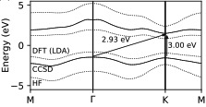
Transition metal dichalcogenides
similar gaps to G0W0
*with SOC correction
main uncertainty - TDL extrapolation from: 7x7 EOM-CCSD
expt: MoS₂ gap:
direct → indirect
under small strain
theory: direct, indirect gaps
almost degenerate
Pulkin, Chan, in preparation

Slide 32
Nickel oxide

Slide 33
Finite temperature CC

Slide 34
Conclusions
Accessible infrastructure exists to develop
quantum chemistry in the condensed phase
Coupled cluster, with the correct “triples” will
provide gold standard for condensed phase spectra
Coupled cluster techniques may be generalized to
beyond electronic structure and spectra

