Slide 1

Competing phases and functional properties from first principles
Karin M. Rabe
John Bonini* (senior PhD student)
Se Young Park (former postdoc, now at Seoul National U)
Yubo Li*, Michele Kotiuga*, Sobhit Singh*, Xiaohui Liu (postdocs)
Work supported by ONR and NSF-DMREF
Notes:
Materials design

Slide 2
Perovskites ABO₃: incredible variety and
richness of behavior
High-symmetry parent phase =
cubic perovskite structure
Structural frustration – tolerance factor
a₀

Slide 3

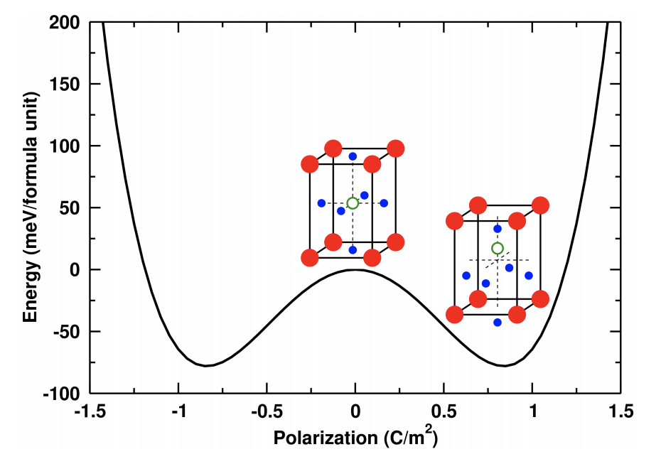
perovskites: incredible variety and
richness of behavior
High-symmetry parent phase =
cubic perovskite structure
Structural frustration – tolerance factor
Instability to uniform cation displacement generates ferroelectricity in BaTiO₃ and PbTiO₃: “soft mode”
First-principles calculation
of zone center phonons in
cubic structure
freeze in unstable polar mode
to get double well potential
P_{s}
a₀

Slide 4
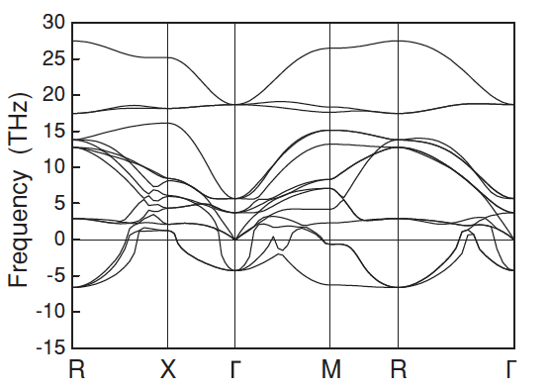
Full phonon dispersion maps all structural instabilities at 2nd order
CaTiO₃:
polar mode at Γ
oxygen octahedron rotations at M-R
H. Moriwake et al, PRB 84 104114 (2011)

Slide 5
Full phonon dispersion maps all structural instabilities at 2nd order
CaTiO₃:
polar mode at Γ
oxygen octahedron rotations at M-R
nonpolar Pnma ground state generated by octahedron rotations
polar R3c low energy state
different octahedron rotation pattern
+ polar distortion
H. Moriwake et al, PRB 84 104114 (2011)

Slide 6
Full phonon dispersion maps all structural instabilities at 2nd order
CaTiO₃:
polar mode at Γ
oxygen octahedron rotations at M-R
For perovskite octahedral rotations, Glazer notation a^{+/-}b^{+/-}c^{+/-}
⁺ is in-phase (M); ⁻ is alternating (R)
Pnma: a⁻a⁻c⁺
R3c: a⁻a⁻a⁻ + polar (111)
H. Moriwake et al, PRB 84 104114 (2011)

Slide 7
Full phonon dispersion maps all structural instabilities at 2nd order
Combine one or more unstable modes of the cubic structure to get rich variety of competing low-energy structures
Describe distorted perovskite structures by their “mode content”
CaTiO₃:
polar mode at Γ
oxygen octahedron rotations at M-R
For perovskite octahedral rotations, Glazer notation a^{+/-}b^{+/-}c^{+/-}
⁺ is in-phase (M); ⁻ is alternating (R)
Pnma: a⁻a⁻c⁺
R3c: a⁻a⁻a⁻ + polar (111)
H. Moriwake et al, PRB 84 104114 (2011)

Slide 8
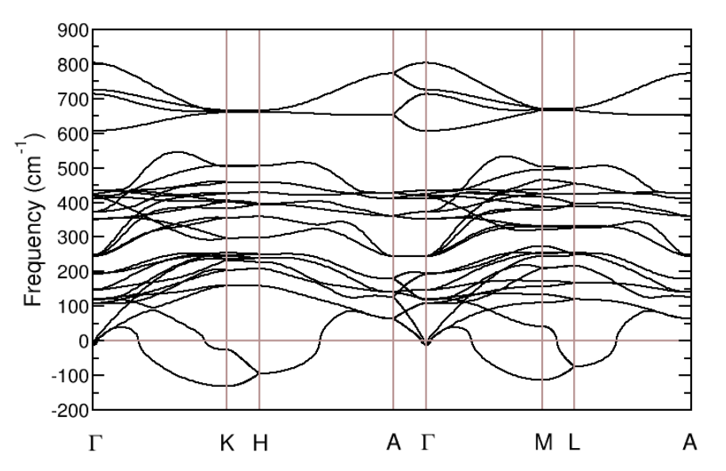
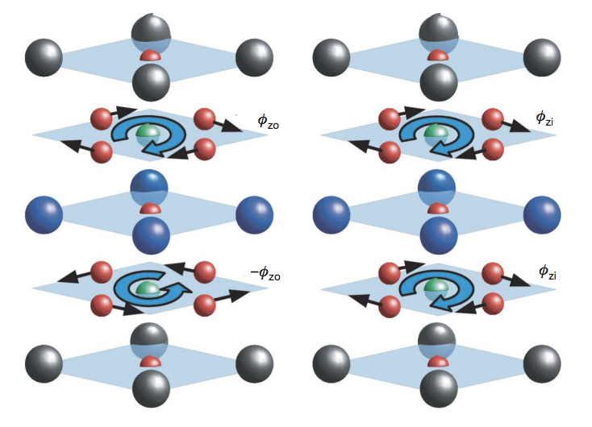
Polar instability is not a necessary condition for polar phase
IMPROPER FERROELECTRICS - no unstable polar mode
unstable zone boundary mode
higher order coupling to polar mode
improper ferroelectricity
YMnO₃: oxygen polyhedron tilting
two unstable zone boundary modes combine in
trilinear coupling to polar mode
hybrid improper ferroelectricity
PbTiO₃/SrTiO₃ superlattices (Bousquet et al 2008)
Ruddlesden-Popper layered perovskites Ca₃Ti₂O₇
Notes:
POLAR STATES HAVE ADDITIONAL DISTORTIONS
Started thinking about antiferroelectrics
One natural road to this is to have massive instabilty of the parent phase
Antiferroelectric ABC?

Slide 9

Open-shell transition-metal perovskites are subject to many additional energy-lowering symmetry-breaking orderings:
charge, orbital, magnetic
Charge-order-induced ferroelectricity in (La,Sr)VO₃ superlattices
(Park & KMR 2017)
Orbital ordering – Jahn Teller induced ferroelectricity in
PrVO₃/LaVO₃ superlattices (Ghosez et al 2015)
Spin-phonon coupling – instability induced by coupling of lattice mode to magnetic ordering
Hong, Stroppa, Iniguez, Picozzi, Vanderbilt PRB 95 054417 (2012)
AFM
FM
FM
EuTiO₃, SrMnO₃:
Epitaxial-strain-induced
ferromagnetic ferroelectrics
(Fennie 2006, Lee 2010)
AFM
epitaxial strain

Slide 10
Combine one or more unstable modes of the cubic structure to get rich variety of competing low-energy structures
Tuning by external fields, stress, composition to stabilize
non-bulk phases in bulk, thin films, and superlattices
Functional properties:
static tuning (composition, epitaxial stress) to phase boundary
dynamic tuning by applied field
temperature
Phase 1
Phase 2
Control parameter

Slide 11
IN THIS TALK: expanding horizons for systems with
complex energy landscapes and competing phases
Other classes of materials defined by non-perovskite high-symmetry parent phases
Other mechanisms for generating competing polar phases to produce ferroelectricity and antiferroelectricity
New types of ferroelectrics/antiferroelectrics
FIRST PRINCIPLES STRATEGIES FOR SEARCH
Notes:
WHAT’S NEW HERE?

Slide 12

SEARCH FOR COMPETING PHASES
Experimental synthesis and structure determination results in crystallographic database ICSD
One strategy: search ICSD for structures with a given stoichiometry & look for common high-symmetry parent
Notes:
Started thinking about antiferroelectrics
One natural road to this is to have massive instabilty of the parent phase

Slide 13
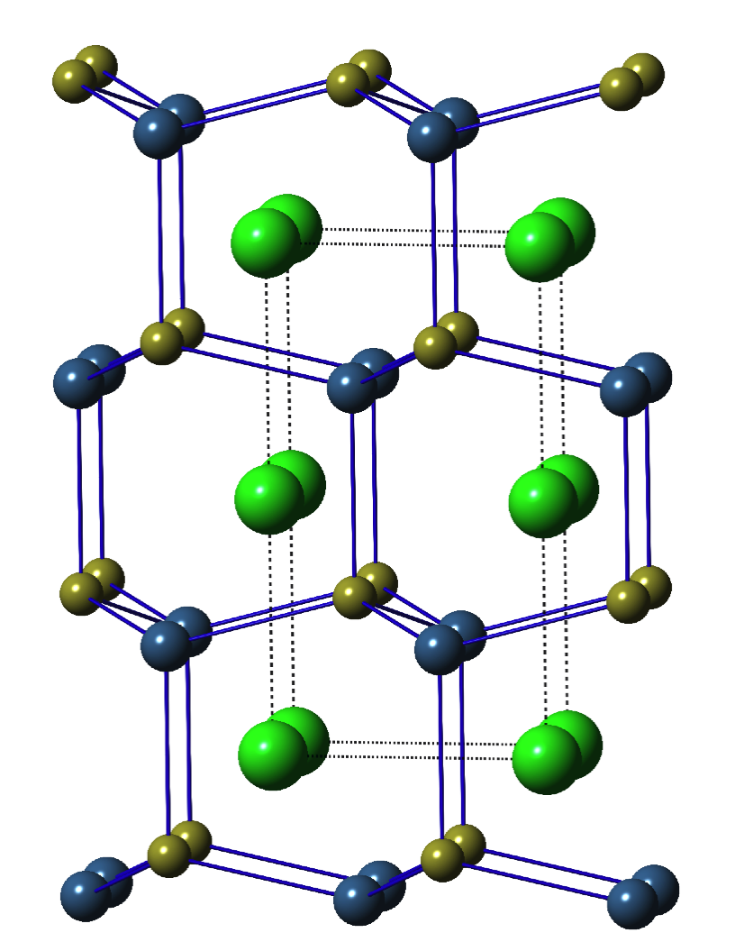
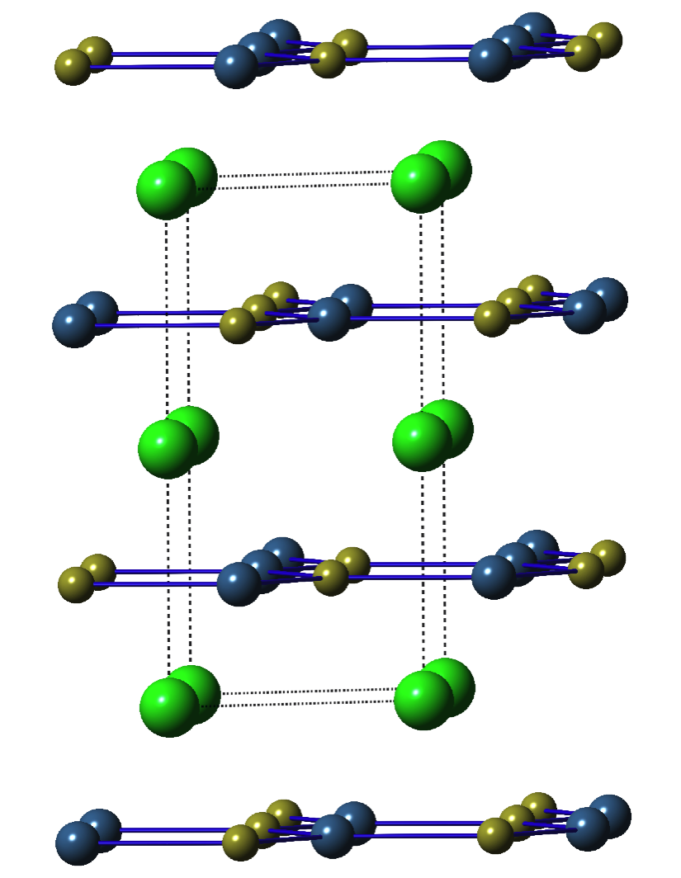
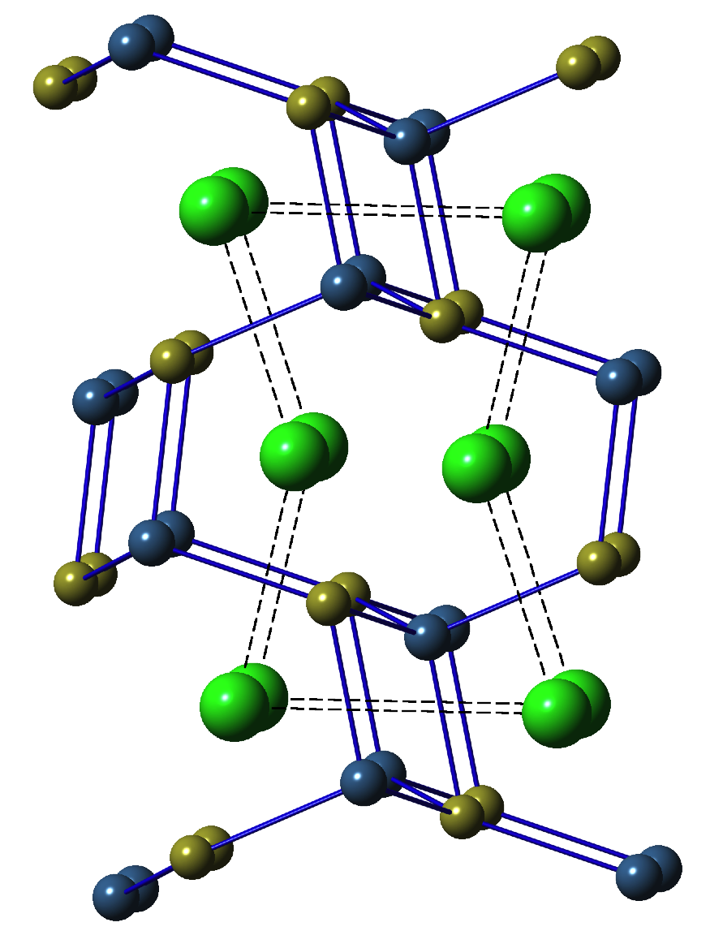
SEARCH FOR COMPETING PHASES
search ICSD for structures with a given stoichiometry and look for common high-symmetry parent
Discovery of hexagonal ABC ferroelectrics and antiferroelectrics with P63/mmm parent structure
Polar
Antipolar
P6₃mc LiGaGe
P6₃ /mmc
Pnma MgSrSi
Notes:
Started thinking about antiferroelectrics
One natural road to this is to have massive instabilty of the parent phase

Slide 14
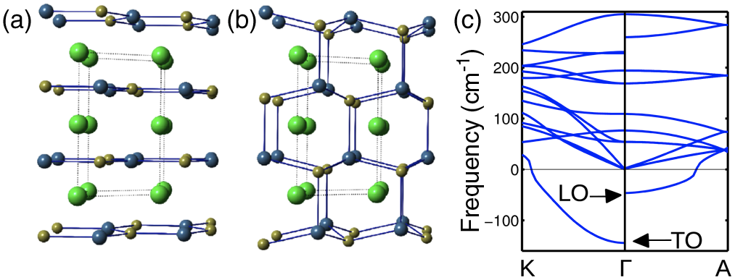
SEARCH FOR COMPETING PHASES
First-principles high-throughput search
Layers in hexagonal ABC structure are subject to buckling instabilities: look for unstable polar buckling mode
phonon dispersion of “hyperferroelectric” LiBeSb
Garrity, Rabe and Vanderbilt PRL 112, 127601 (2014)
Notes:
Let’s start by talking more about perovskites in terms of specifics of what we would look for WHEN LOOKING FOR POLAR PHASES
CaTiO3, (SrMnO3 is an example of something else)
HERE WE CAN FIND THE INSTABILITIES IN THE PHONON DISPERSION

Slide 15
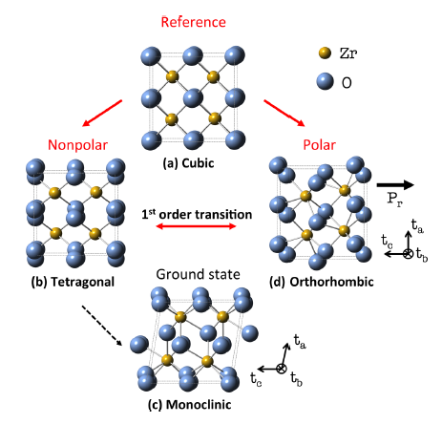
SEARCH FOR COMPETING PHASES
search ICSD for structures with a given stoichiometry and look for common high-symmetry parent
“Discovery” of AB₂ ferroelectrics and antiferroelectrics with fluorite parent structure: HfO₂ and ZrO₂
Notes:
Started thinking about antiferroelectrics
One natural road to this is to have massive instabilty of the parent phase

Slide 16
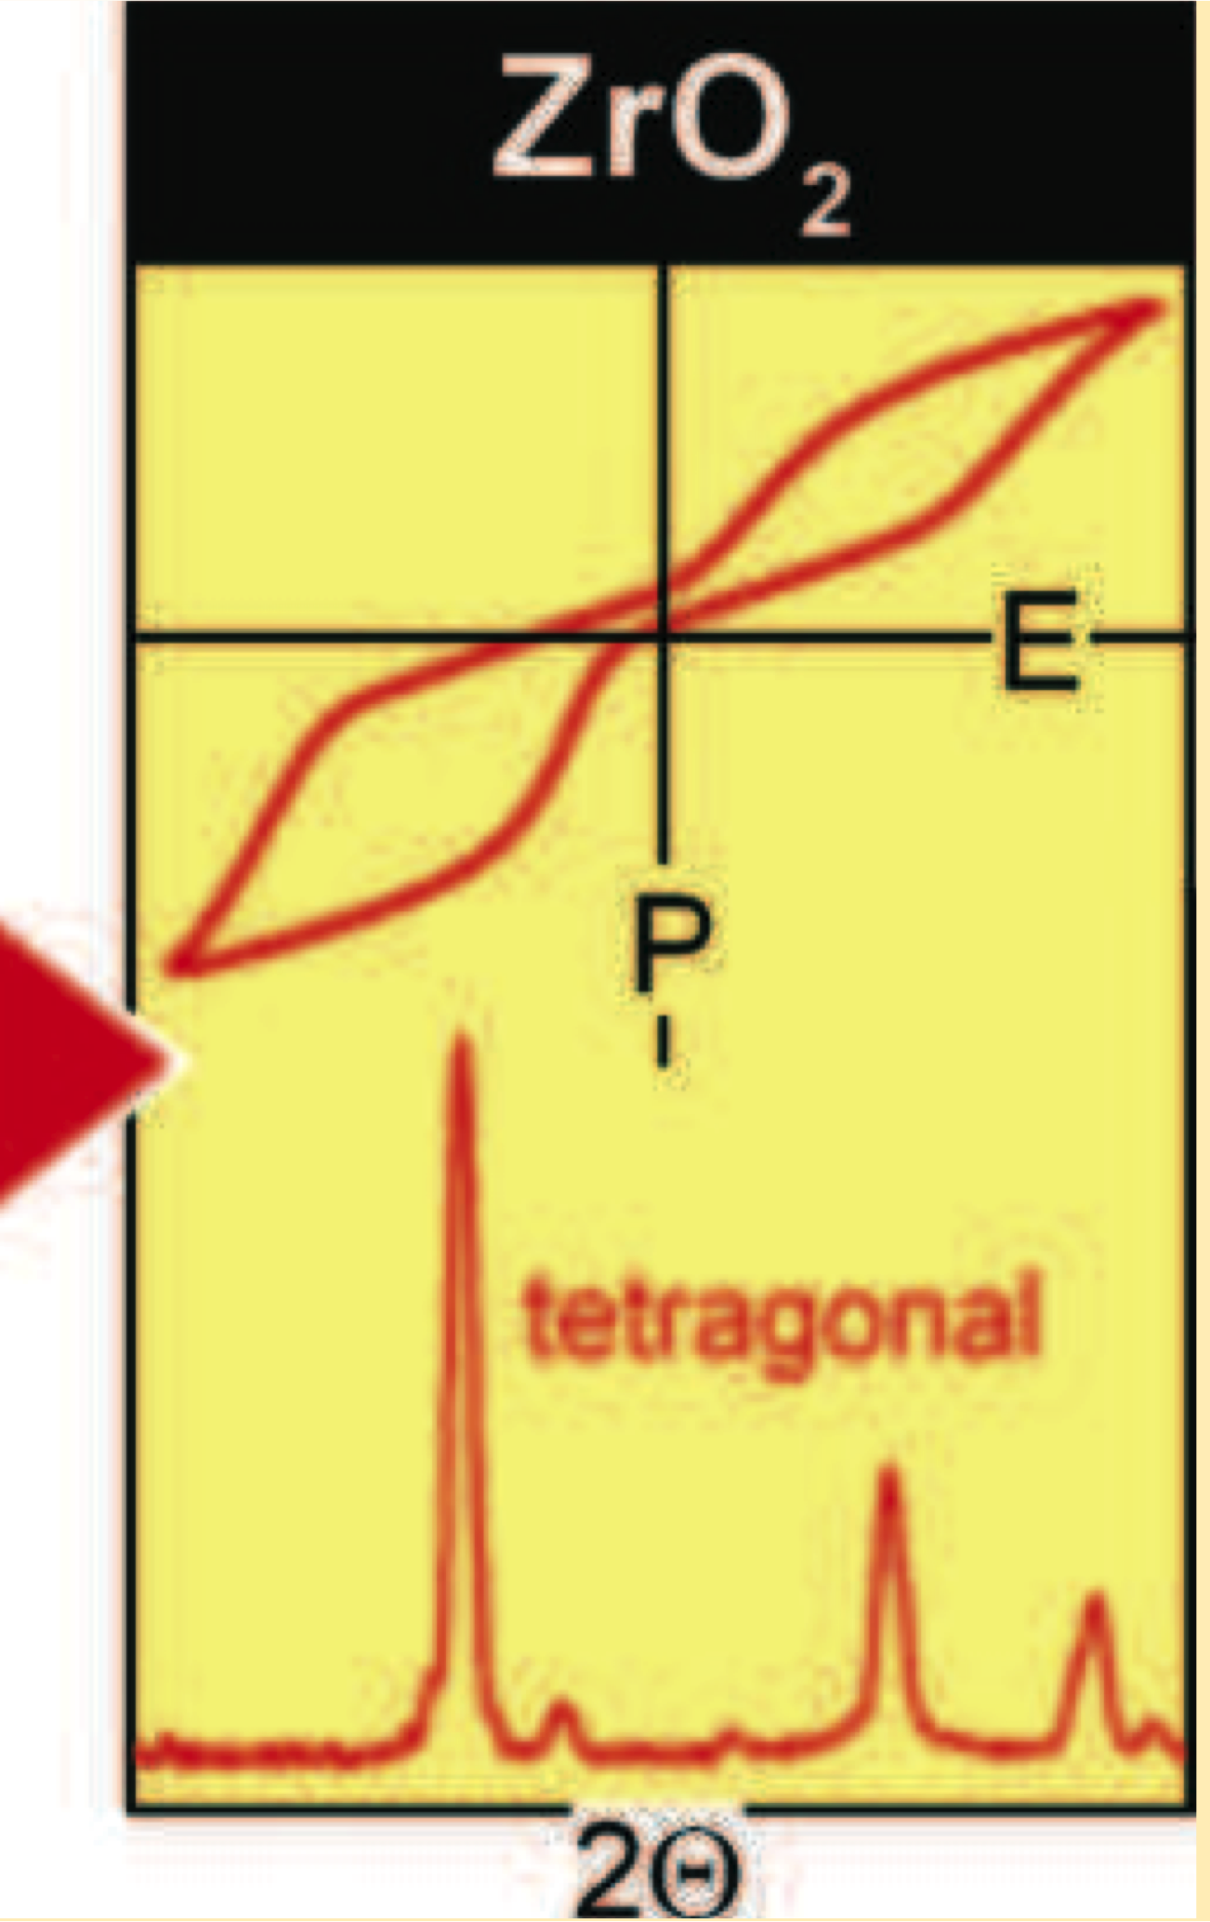
SEARCH FOR COMPETING PHASES
search ICSD for structures with a given stoichiometry and look for common high-symmetry parent
“Discovery” of AB₂ ferroelectrics and antiferroelectrics with fluorite parent structure: HfO₂ and ZrO₂
J. Muller, et al, Nano Lett 2012
Notes:
Started thinking about antiferroelectrics
One natural road to this is to have massive instabilty of the parent phase

Slide 17
Fluorite ferroelectrics and antiferroelectrics
Phonon dispersion Phonon dispersion
of cubic HfO₂ of nonpolar tetragonal HfO₂
No instability generating a polar phase

Slide 18
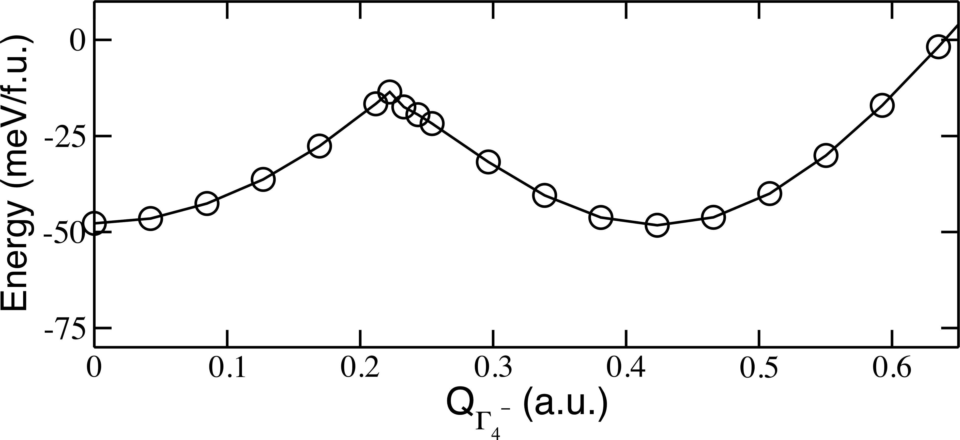
First principles calculation
Cubic
35 meV/f.u.
Energy (meV/f.u.)
Tetragonal
Orthorhombic
Q_{Γ4-} (a.u.)
ΔE ≈ 1 meV/f.u. !!
S. Reyes-Lillo, K. Garrity and KMR, “Antiferroelectricity in thin-film ZrO₂ from first principles,” PRB 90 104103 (2014)
Notes:
If we turn our attention to a computer experiment in which we freeze in the distortion mode that leads to the polar orthorhombic structure, we find that the energy difference between the nonpolar tetragonal and polar orthorhombic structures is very small, 1 mEv/f.u., and that the energy barrier of the first-order phase transition, where these two parabolas intersect, is only 35 meV/f.u..

Slide 19
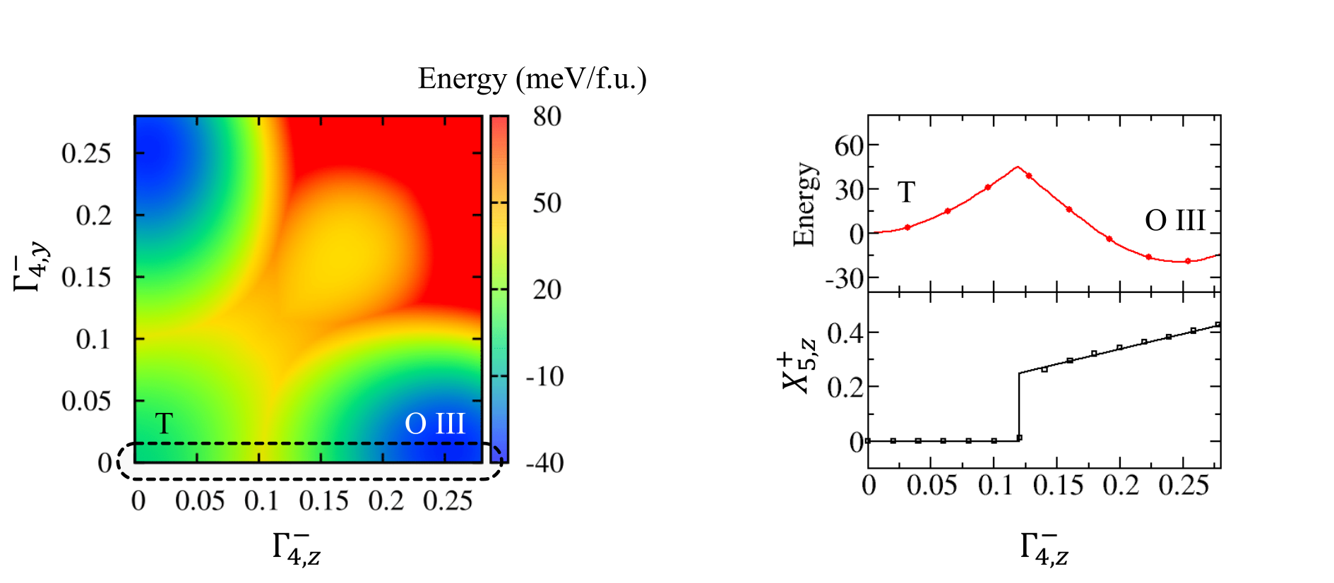
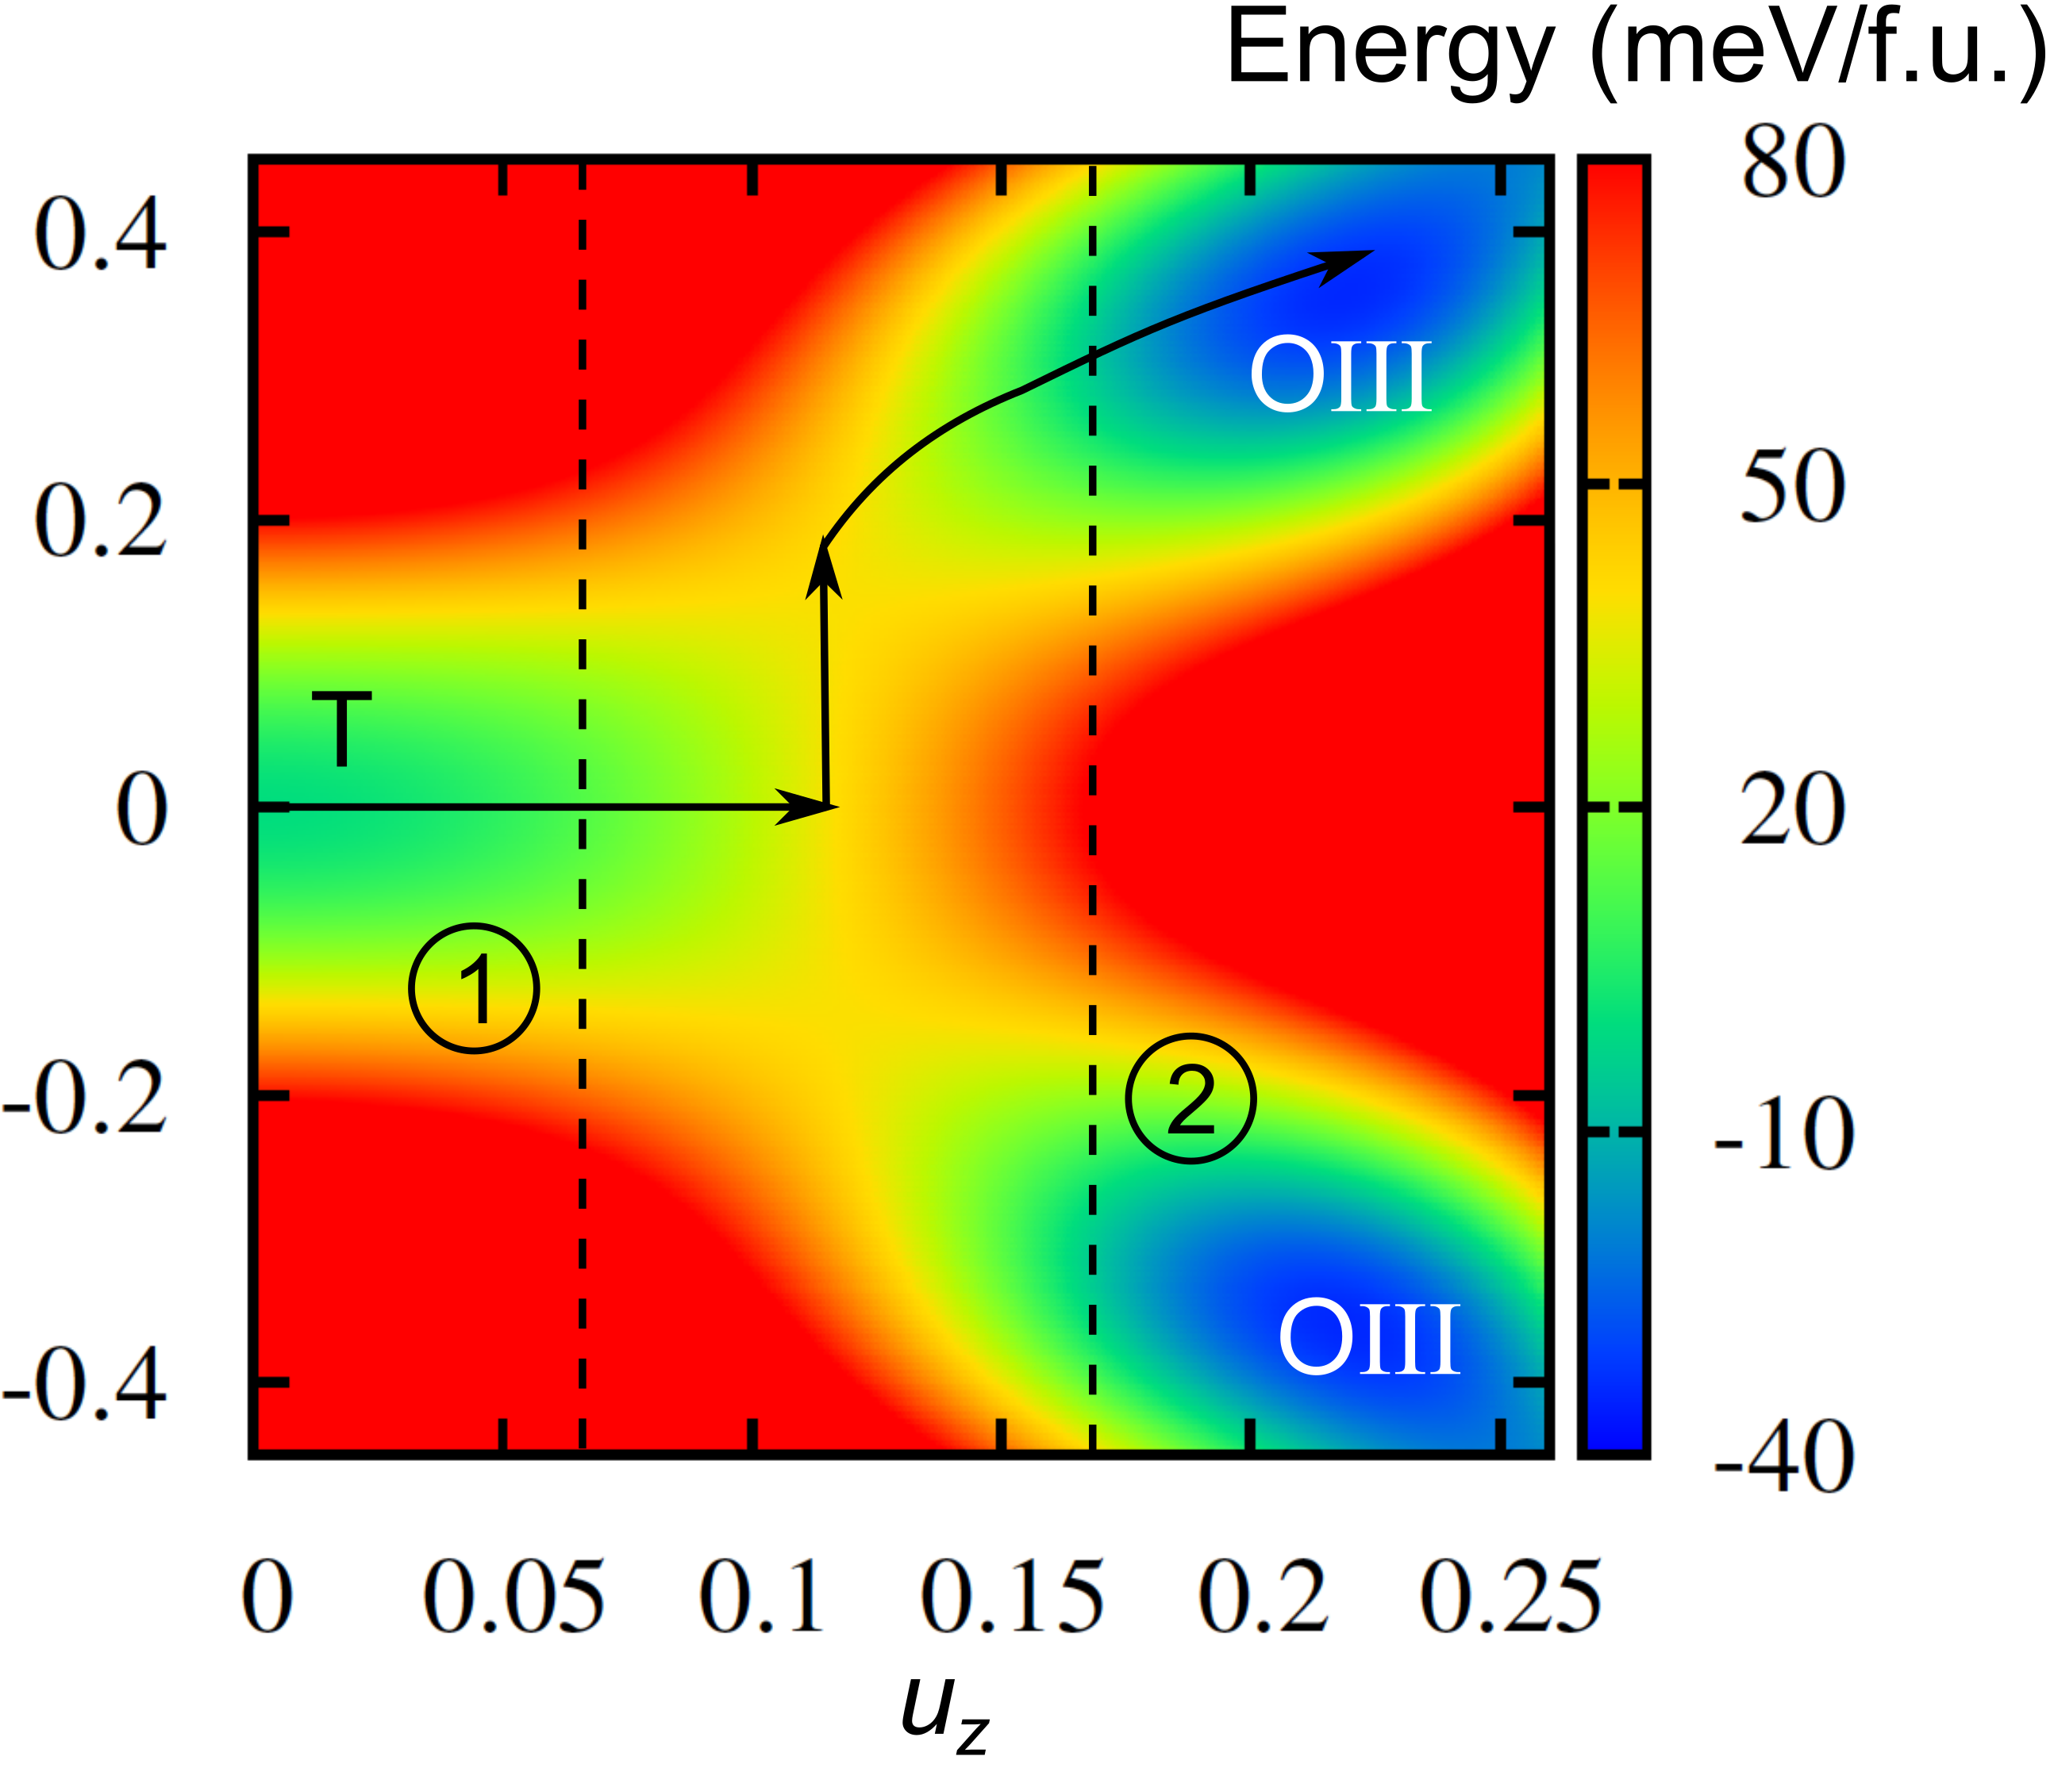
HfO₂: coupling between modes stabilizes OIII structure
Y. Qi and KMR, preprint

Slide 20
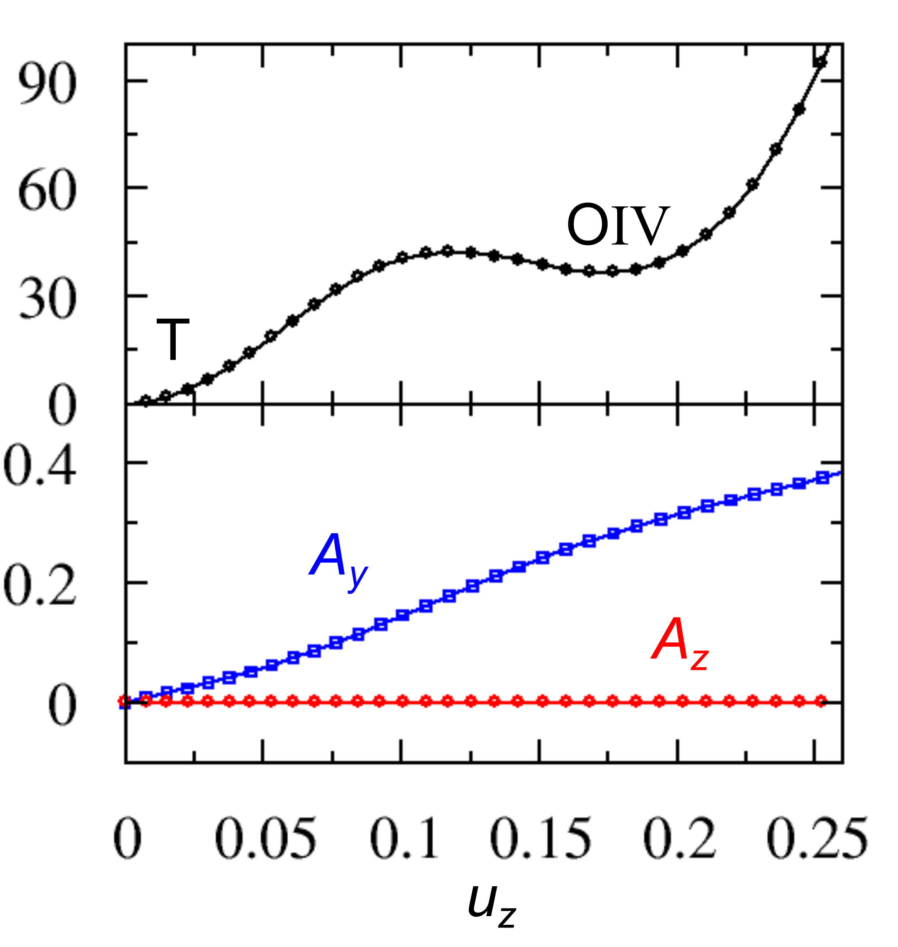
O IV
Y. Qi and KMR, preprint
HfO₂: COMPETING POLAR PHASES
O III AND O IV
in single crystal, strong dependence
on direction of applied E

Slide 21
IN THIS TALK: expanding horizons for systems with
complex energy landscapes and competing phases
Other classes of materials defined by non-perovskite high-symmetry parent phases
Other mechanisms for generating competing polar phases to produce ferroelectricity and antiferroelectricity
New types of ferroelectrics/antiferroelectrics
FIRST PRINCIPLES STRATEGIES FOR SEARCH
Notes:
WHAT’S NEW HERE?

Slide 22
New types of ferroelectrics/antiferroelectrics
“high mobility” ferroelectric:
Electrons introduced by doping have high mobility
Structure stays polar

Slide 23
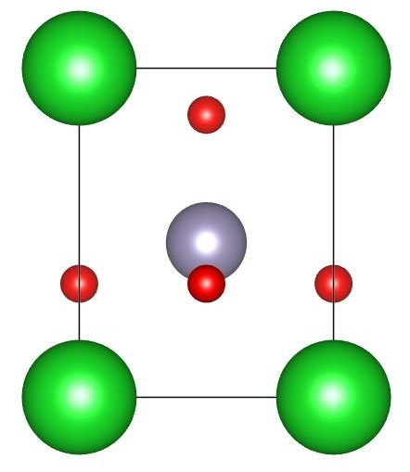
SUPERTETRAGONAL PHASE OF PEROVSKITES
Metastable P4mm phase with very high c/a (>1.2) and polarization
BiFeO₃
Epitaxial thin films +4% (001) compressive strain
PbTiO₃
Negative pressure
Tinte, Rabe and Vanderbilt, PRB 2003
Setter team: Nat Comm 2016
Epitaxial composite
Jim Scott team*: Science 361, 494 (2018)
Bi(Zn_{1/2}Ti_{1/2})O₃
Bulk
Suchomel, et al, Chem Mater 18, 4987 (2006)
Qi, Grinberg and Rappe, PRB 79, 094114 (2009)

Slide 24
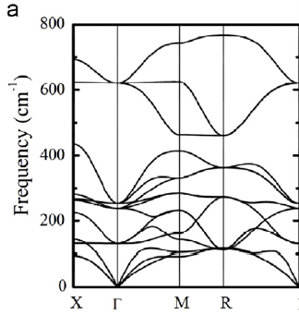
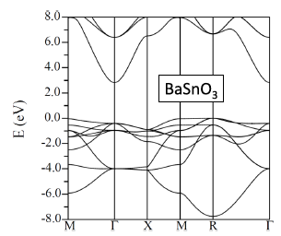
BaSnO₃ Cubic perovskite; lattice constant a = 4.116 A
“Tuning optical properties of transparent conducting barium
stannate by dimensional reduction,”
Li et al., APL MATERIALS 3, 011102 (2015)
Kim, Jo, Cheong
Journal of Solid State Chemistry 197 (2013) 134

Slide 25
BaSnO₃
First order transition to a super-tetragonal phase at +4% strain
X. H. Liu and KMR, in preparation (2019)

Slide 26
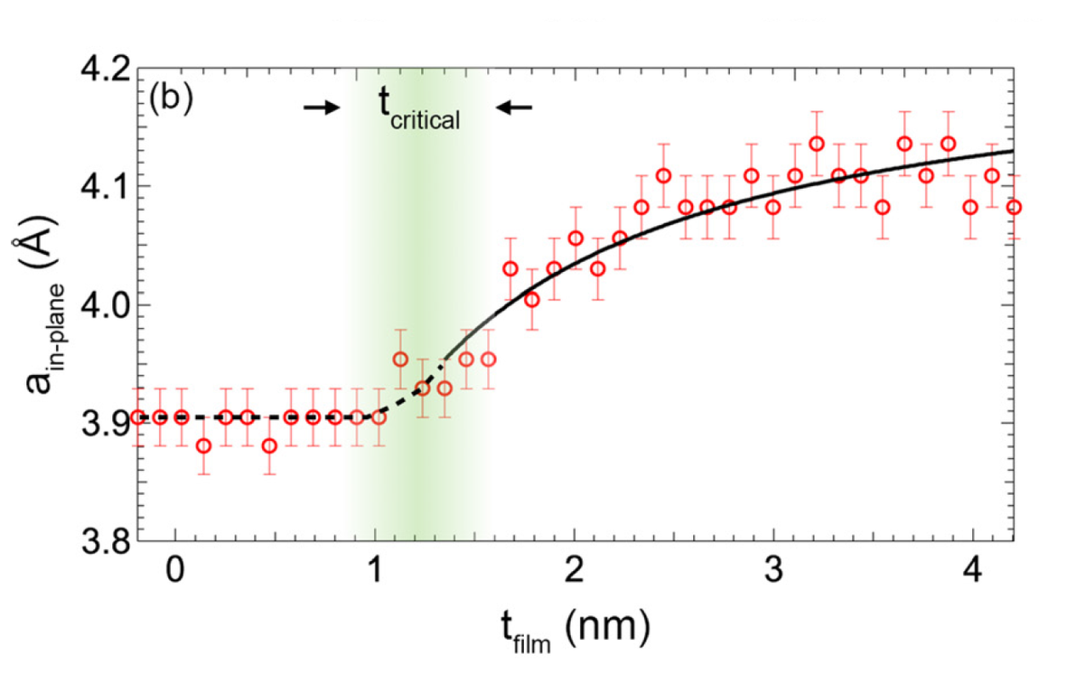
BaSnO3 thin film on SrTiO3: a high mobility ferroelectric?
3.96
A. Prakash, J. Dewey, H. Yun, J. S. Jeong, K. A. Mkhoyan, and B. Jalan, J. Vac. Sci. Technol. A 33, 060608 (2015).
0.73
5.13
0.15
0.80
5% strain -- 86 μC/cm²

Slide 27
SEARCH FOR POLAR PHASES
Khomskii principle: break inversion symmetry by combining two inversion-preserving orderings of high-symmetry reference phase (different inversion centers)
A-SITE SUPERLATTICE LAYERING
+ B-SITE LAYERED CHARGE ORDERING
switchable by applied E field -> ferroelectric
charge-order-driven ferroelectricity

Slide 28
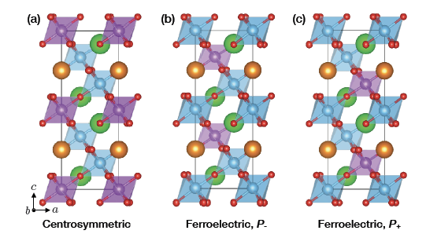
LaSr₂Fe₃O₉ with (111) layering
FE-CS energy difference is 0.54 meV/Fe (essentially zero)
Charge ordering is the same
Only the registry between the charge and superlattice ordering changes
[a⁻a⁻a⁻ oxygen octahedron rotations]
(Se Young Park and KMR, 2018)
Notes:
NEED TO LABEL COLORS IN FIGURE

Slide 29
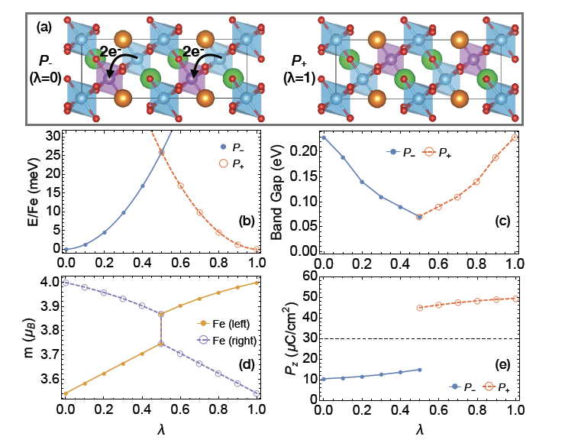

Slide 30
Two distinct polar phases compete
“DOUBLE FERROELECTRICITY”
Functional properties: Switch from one phase to the other by changing magnitude and/or direction of applied field

Slide 31
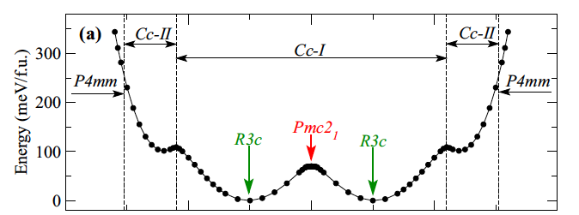
Electrical phase diagram of BiFeO₃ (Stengel and Iniguez, PRB 2015)
R3c phase competes with supertetragonal phase
(Cc-II due to additional octahedral rotations)
Notes:
SUPERLATTICES – competing phases in different layers complexify energy landscape
Multiple solutions for V(D)=0 with similar energy
[If the two phases are different enough, they don’t just meet in the middle but have two competing states where one layer dominates and the other accommodates]
MENTION JOHN’S TALK HERE

Slide 32
Two distinct polar phases compete
“DOUBLE FERROELECTRICITY”
Functional properties: Switch from one phase to the other by changing magnitude and/or direction of applied field
Peter Maksymovych at the 2019 Ferroelectrics Workshop
ferroelectric InP₂S₆
two distinct polar phases
switch between them by applying pressure

Slide 33
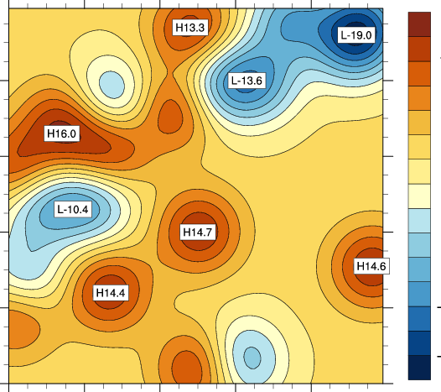
Mapping the energy landscape of distorted perovskites
(Rutgers PhD student John Bonini)
Air-drop into favorable regions and do first-principles relaxations to find locations and energies of local minima
3N dimensional configuration space
Reduce effective dimensionality:
amplitudes of symmetry-adapted modes of 5-atom cell as coordinates

Slide 34
Our strategy: sample the 25 or so most common distorted perovskite structures in ICSD
Cubic: Pm-3m
Polar: R3m, P4mm, Amm2
Glazer: a-a-c+(Pnma), a-a-a- (R3-c), a0a0c- (I4mcm),
a-a-c0 (Imma), a0a0c+ (P4/mbm), a0b-c+ (Cmcm),
a0b-c- (C2/m)
Glazer + polar instability: a-a-c+ + polar 110 (Pmc2_1)
a-a-c+ + polar 001 (Pna2_1), a-a-a- + polar 111 (R3c)
not all Glazer structures and certainly not all Glazer + polar are on the list of 25

Slide 35
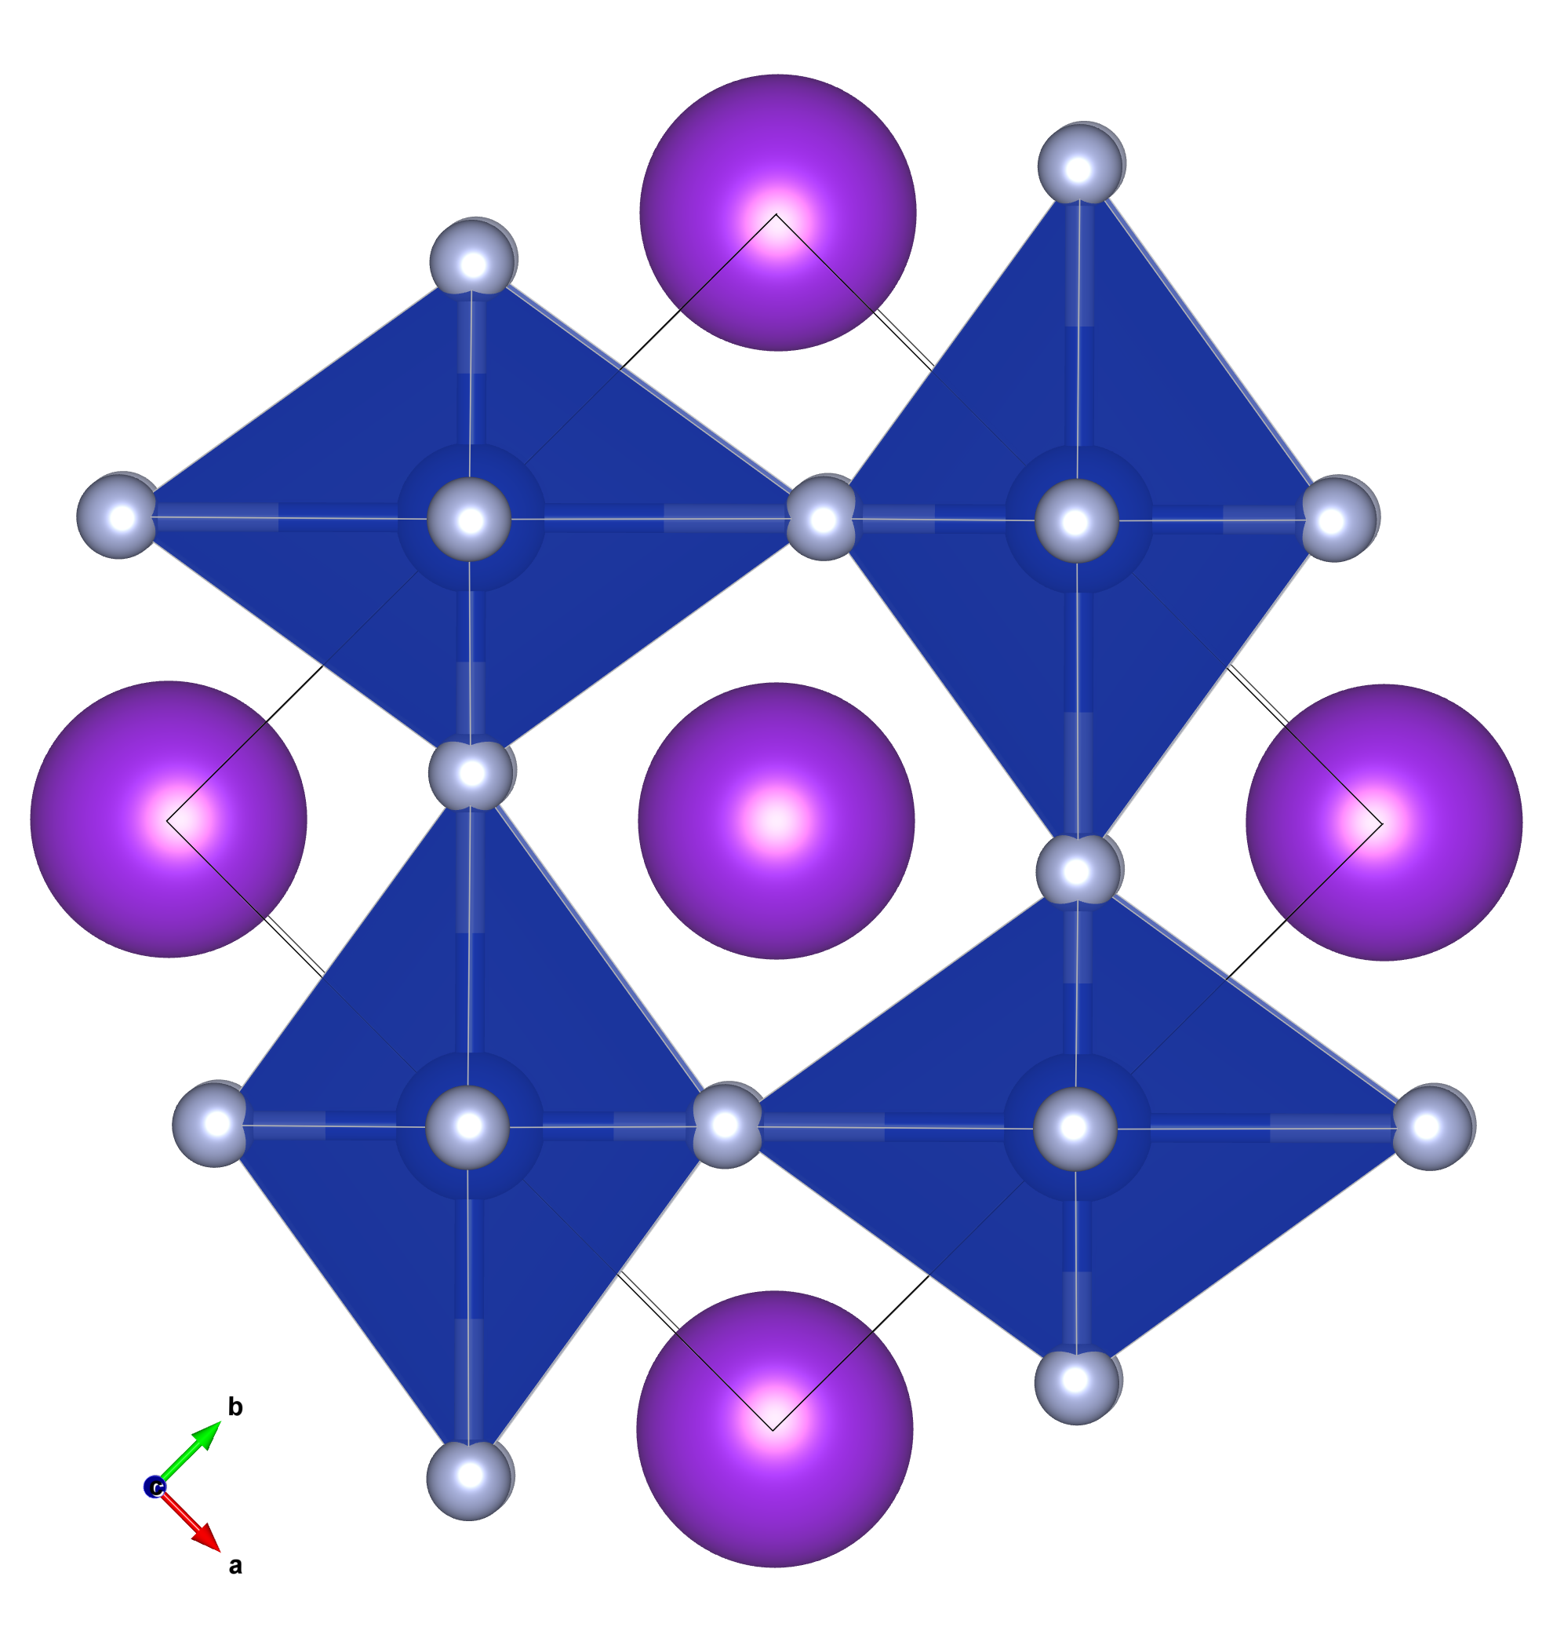
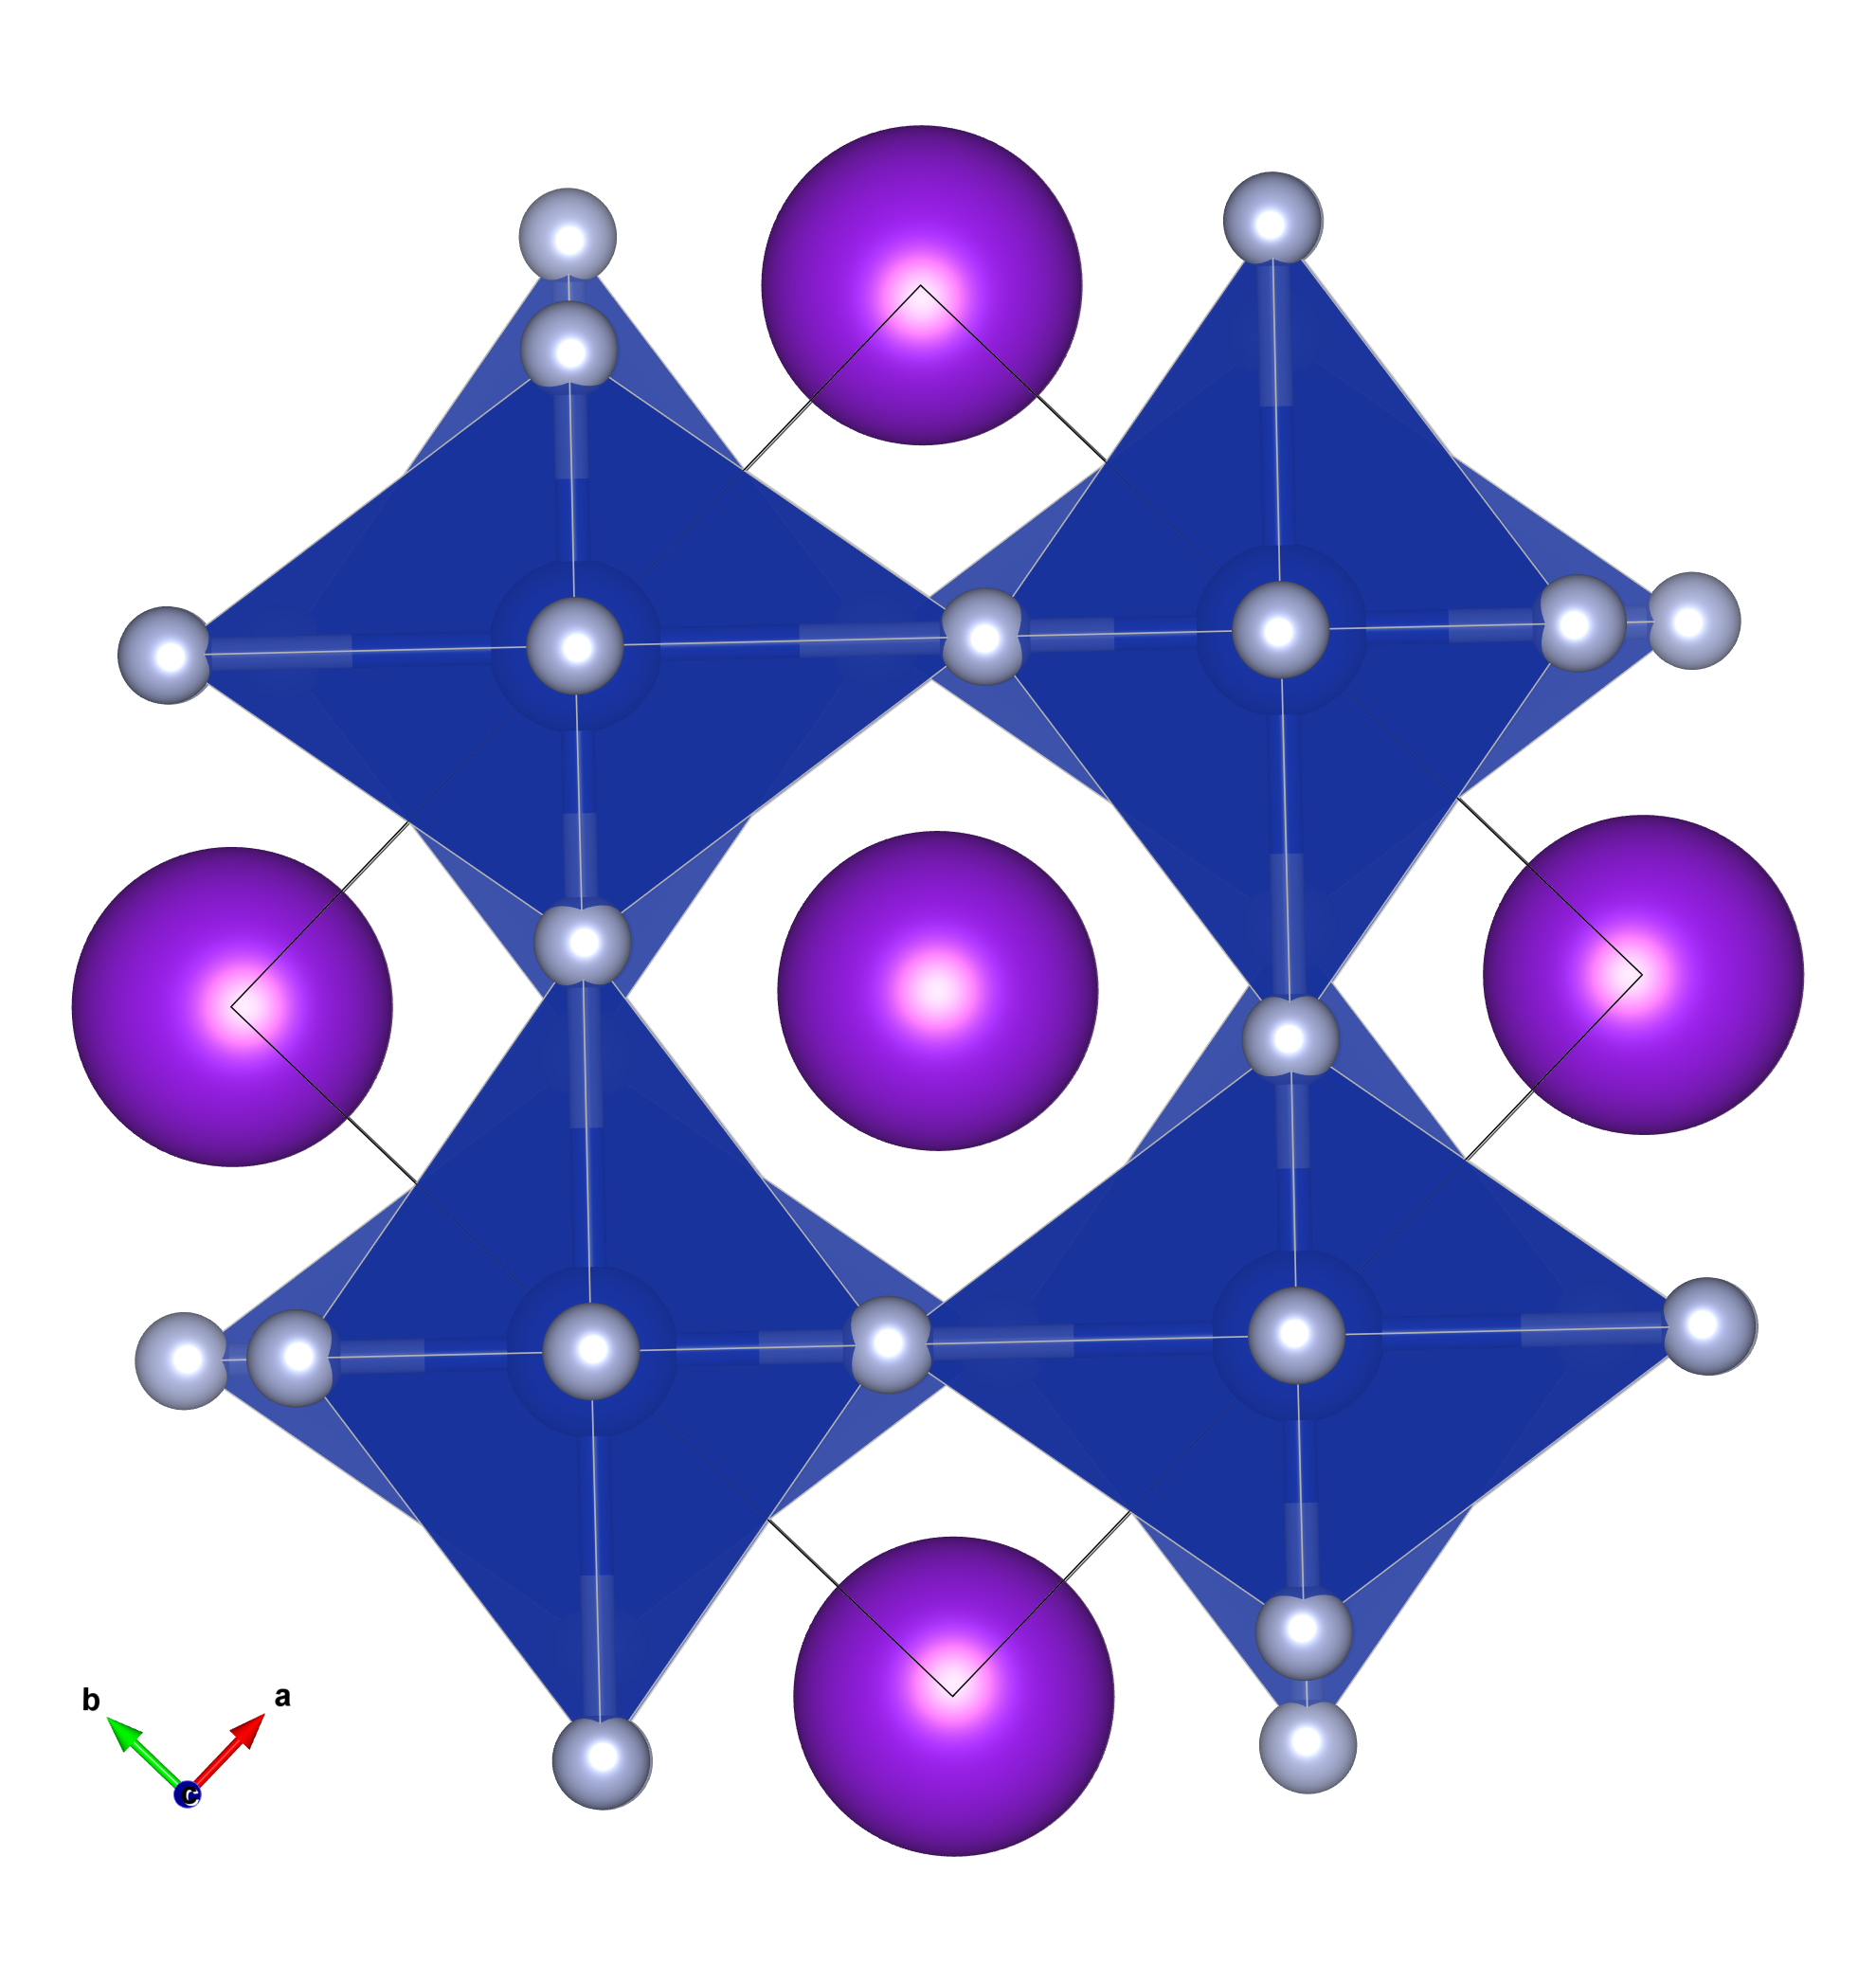
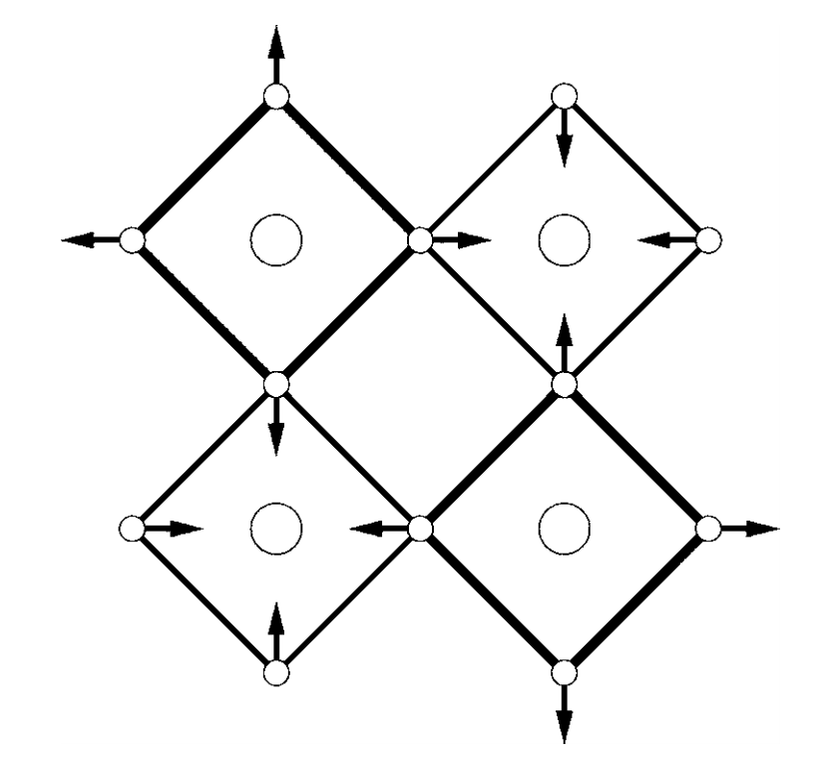
Our strategy: sample the 25 or so most common distorted perovskite structures in ICSD
other types of instabilities
Jahn-Teller distortion of octahedra (same) P4/mbm
Jahn-Teller distortion of octahedra (alternating) I4/mcm
3D checkerboard breathing mode Fm-3m

Slide 36
Our strategy: sample the 25 or so most common distorted perovskite structures in ICSD
More structures combining multiple modes
R-3: a-a-a- + checkerboard breathing
3D checkerboard breathing mode + polar
I4mmm: 3D checkerboard breathing mode + Jahn-Teller
Pbam: PbZrO₃

Slide 37
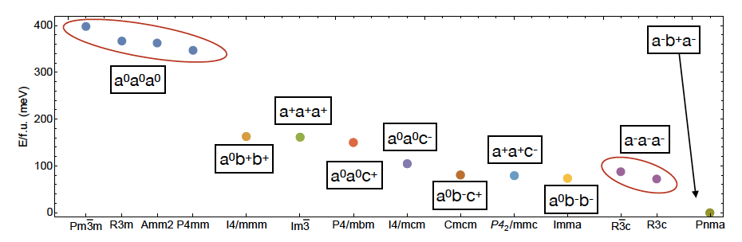
CaTiO₃ Glazer structures
a+a+a+, a+a+b0, a0a0c+, a+a+c- have polar instabilities
Jahn Teller and breathing: stable

Slide 38
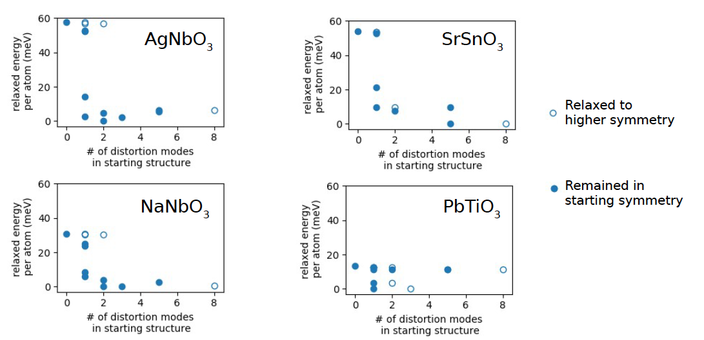

Slide 39
MESSAGES
FIRST PRINCIPLES IS A GREAT TOOL TO EXPLORE THE ENERGY LANDSCAPE OF COMPLEX OXIDES: competing polar phases and more – metals/insulators, ferromagnets/antiferromagnets…
first-principles phonon dispersion of high-symmetry parent phase
(perovskites, layered perovskites, ABC, fluorites, 2D systems…)
FINDING COMPETING POLAR PHASES FOR WHICH THERE IS NO TRACE IN THE PHONON DISPERSION OF PARENT PHASE
OIII AND OV PHASES OF HfO₂
SUPERTETRAGONAL PHASE IN PEROVSKITES
CHARGE-ORDER-DRIVEN FERROELECTRICITY
DOUBLE FERROELECTRICS – TWO DISTINCT POLAR PHASES
Energy landscapes: first-principles world vs the real world

