Slide 1

2012 Summer School on Computational Materials Science
Quantum Monte Carlo: Theory and Fundamentals
July 23–-27, 2012 • University of Illinois at Urbana–Champaign
http://www.mcc.uiuc.edu/summerschool/2012/
Introduction to Density Functional Theory
Ronald Cohen
Geophysical Laboratory
Carnegie Institution of Washington
cohen@gl.ciw.edu
QMC Summer School 2012 UIUC

Slide 2
Outline
Motivation: an example—Quartz and Stishovite, DFT versus QMC
What is DFT used for in QMC studies?
The steps for Diffusion Monte Carlo.
Density Functional Theory
  What is a functional?
  Hohenburg Kohn Theorems
  Kohn–Sham method
  Local Density Approximation (LDA)
  Total energy calculations
  Typical Errors
  What is known about exchange and correlation functionals?
  The exchange correlation hole and coupling constant integration
  LDA and GGA (more)
  Band theory
  Self-consistency
  Pseudopotentials versus all-electron

Slide 3
What is Density Functional Theory?
DFT is an exact many-body theory for the ground state properties of an electronic system.
  Atoms, molecules, surfaces, nanosystems, crystals
Although DFT is formally exact, the exact functional is unknown.
The exact functional probably does not have a closed form, and would be extremely non-local.
Nevertheless, very good approximations are known which work well for many systems.
In practice, DFT is good for structural stability, vibrational properties, elasticity, and equations of state.
There are known problems with DFT, and accuracy is limited--there is no way to increase convergence or some parameter to obtain a more exact result. In other words there are uncontrolled approximations in all known functionals.
Some systems are treated quite poorly by standard DFT.

Slide 4
Density functional theory (DFT)
All of the ground state properties of an electronic system are determined by the charge and spin densities.
DFT is an exact many-body theory, but the exact functional is unknown. However, exact sum-rules are known.
Solve the Kohn-Sham equations:
Why it works (usually) quite well:
known exactly
known for uniform electron gas and other model systems

Slide 5
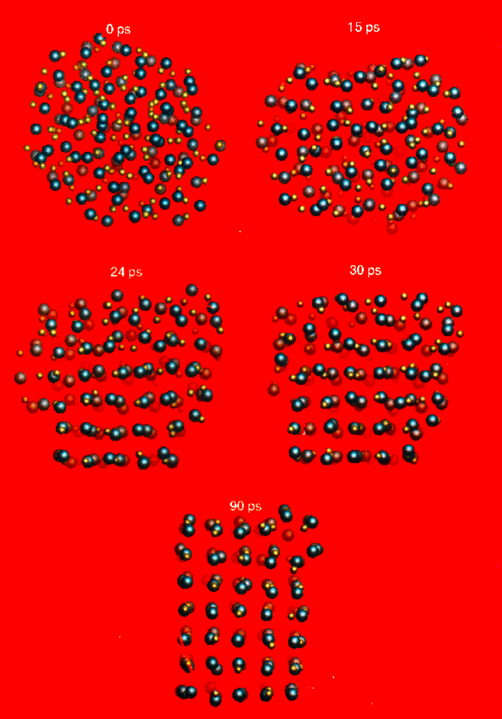
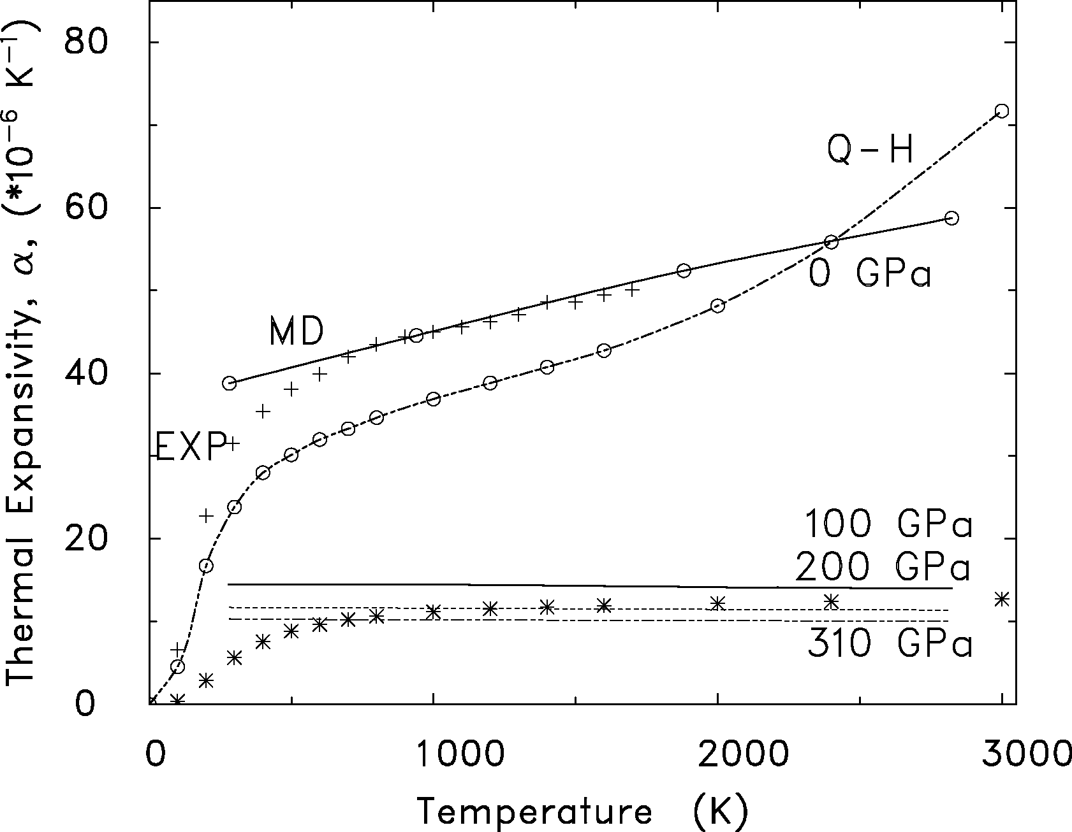
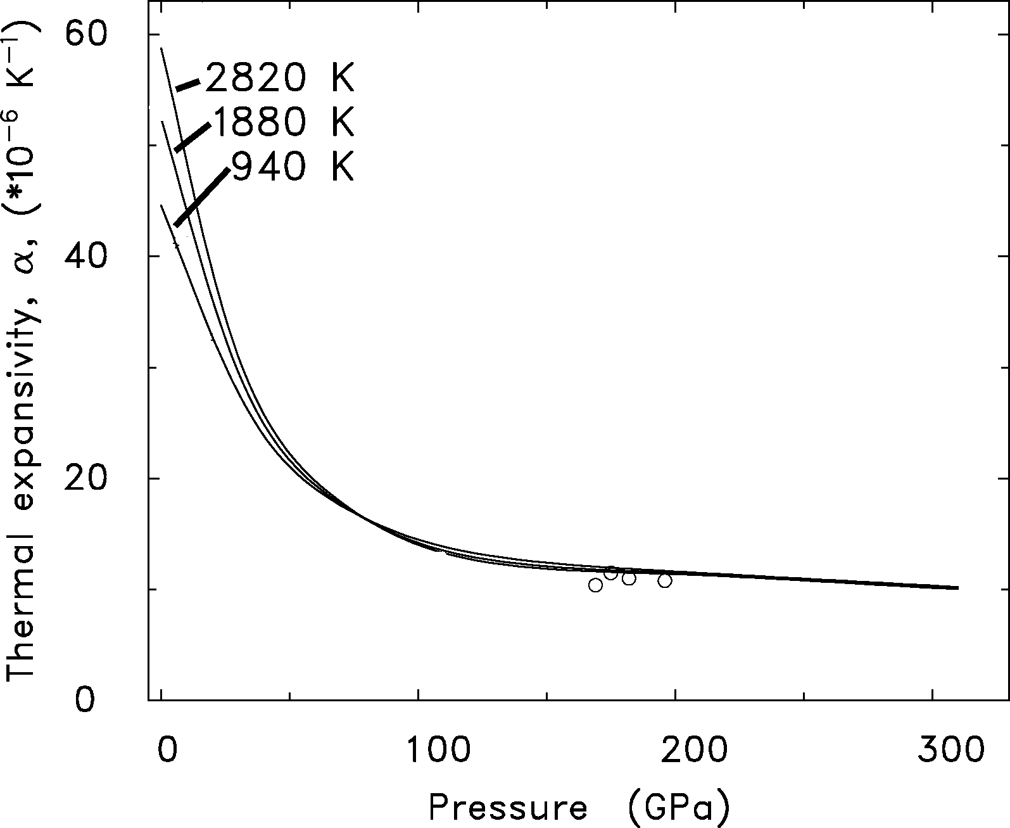
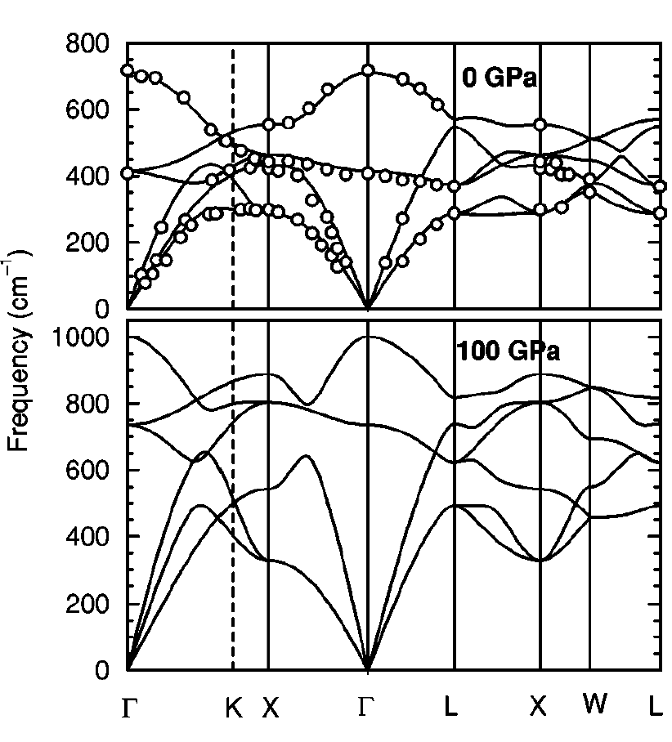
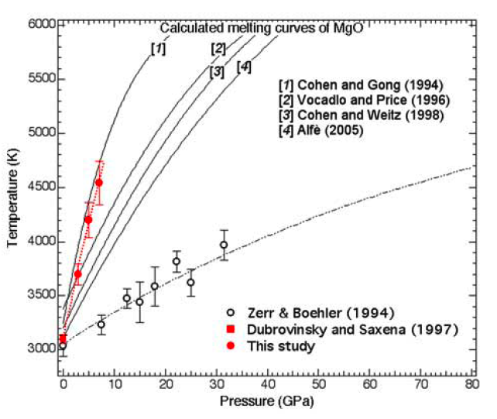
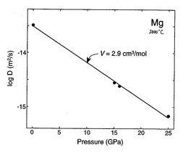
MgO
Inbar and Cohen 1995 (VIB-MD)
Inbar and Cohen 1995 (VIB-MD)
Duffy and Ahrens 1993
Isaak et al 1990. (PIB-QLD)
MgO thermal expansivity
MgO diffusion
MgO phonons
MgO melting curve
Experiments:
Van Orman et al.,
GRL 30,2003.
Prediction:
Ita and Cohen,PRL, GRL,
1997 V*=3.1 cm³/mole
Karki et al., PRB (2000)
Zhang and Fei, GRL (2008)
QMC Summer School 2012 UIUC
Notes:
These introductory slides are for DFT calculations, and are to show general success of DFT. You can use any or all of these if you want. Note all these slides were made with black backgrounds. If you import into a show with white backgrounds Powerpoint may do weird stuff with font colors, and you need top check for white on white.

Slide 6
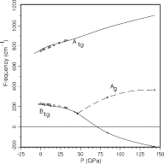
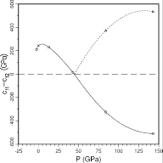
CaCl₂ transition in SiO₂
Prediction: C11-C12 decreases until phase transition to CaCl2 structure, then increases. Does go to zero at transition-> superplacticity
Prediction: A1g Raman mode in stishovite decreases until phase transition to CaCl2 structure, then increases. Does NOT go to zero at transition.
exp.
Predicted transition (Cohen, 1991) was found by Raman (Kingma et al., Nature 1995).
LAPW
QMC Summer School 2012 UIUC

Slide 7
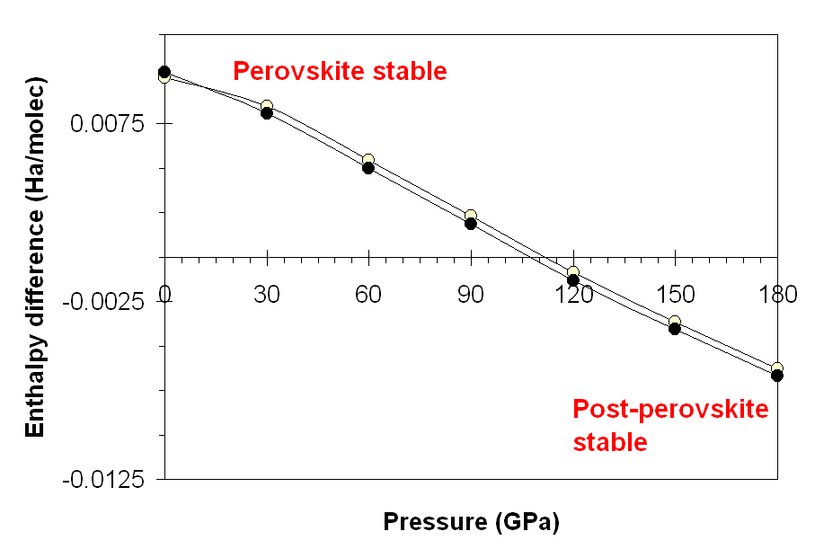
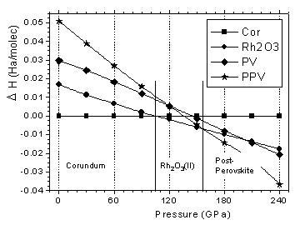
High pressure transitions for Al₂O₃
High P transition from corundum to Rh₂O₃(II) structure predicted first by ab initio ionic model (PIB) calculations (Cynn et al., 1990)
Rh₂O₃(II) transition predicted at 90 GPa from LAPW computations (Marton et al., 1994)
Rh₂O₃(II) transition found experimentally at 90 GPa (Funamori and Jeanloz, 1997).
Rh₂O₃(II) predicted to transform to post-perovskite phase (Cmcm) at 155 GPa, so alumina is soluble in post-perovskite phase (Caracas and Cohen, 2004).
Al₂O₃
Caracas and Cohen, 2004
MgSiO3

Slide 8
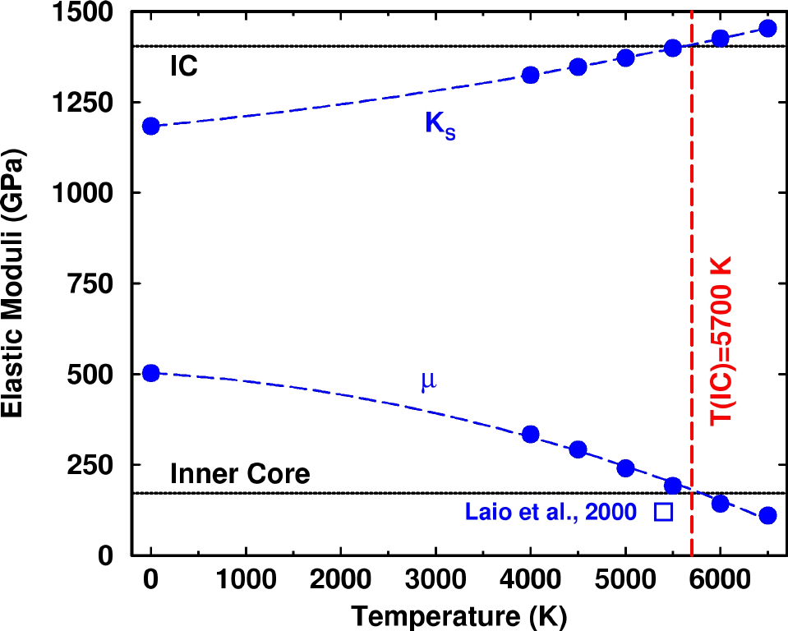
Temperature at the Center of the Earth from theoretical thermoelasticity of iron
Thermoelasticity of Fe computed at inner core density compared with moduli obtained for the inner core from free oscillation data give an estimate of the temperature of the inner core.
G. Steinle-Neumann, L. Stixrude, R. E. Cohen, and Oguz Gulseren, Nature 413, 57-60 (2001).

Slide 9
Successes and Failures of Conventional Band Theory within DFT
Generally excellent predictions of first- and second-order phase transitions
many thousands of successful studies

Slide 10
An example of a less successful case: SiO₂ quartz -> stishovite
The Local Density Approximation (LDA) predicts stishovite as the ground state structure.
The Generalized Gradient Approximation (GGA) makes quartz the ground state and gives a good transition pressure.
Bottom line: The result depends on the exchange correlation functional.
QMC Summer School 2012 UIUC

Slide 11
DFT generally works well, but can unexpectedly fail even in “simple” systems like silica
QMC Summer School 2012 UIUC
Notes:
Work of student Kevin Drive, Ohio State University, 2008.

Slide 12
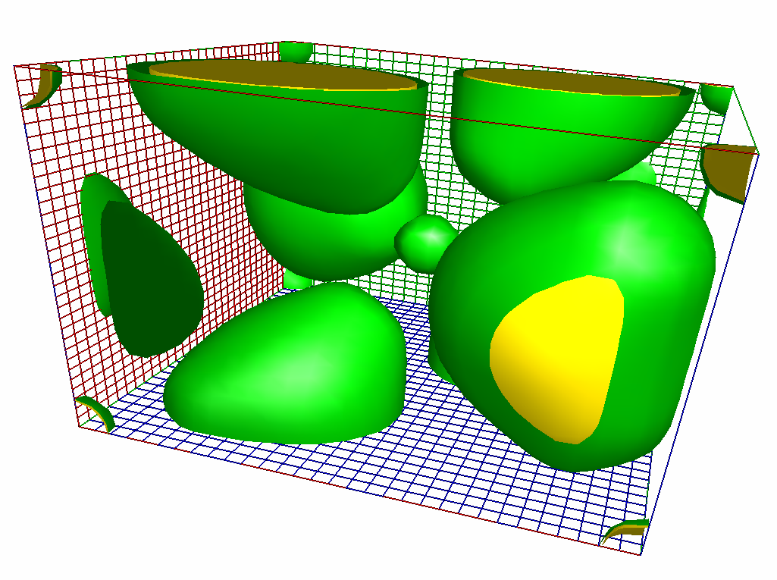
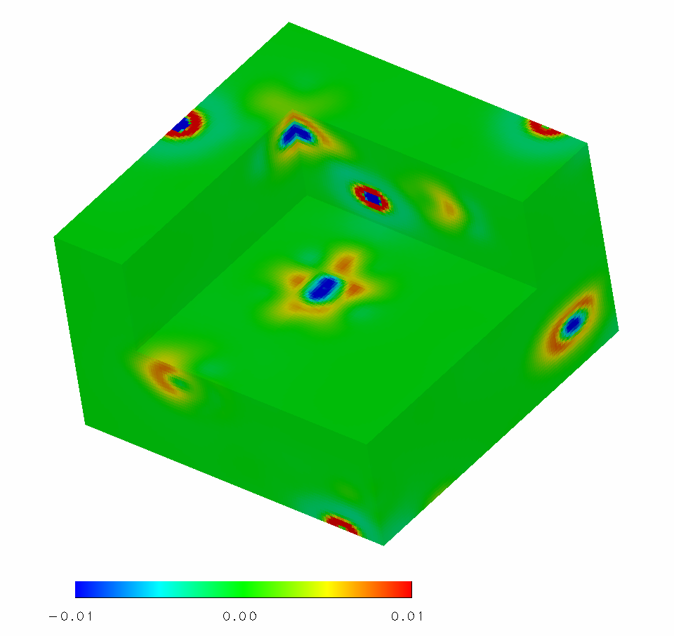
Silica
stishovite valence density
Simple close shelled electronic structure, yet problems with DFT
difference in GGA and LDA valence density
 | LDA | PBE* | WC** | Exp.
ΔE (eV) | -0.05 | 0.5 | 0.2 | 0.5
P_{tr} | <0 | 6.2 | 2.6 | 7.5
V_{qz} | 244 | 266 | 261 | 254
K_{qz} | 35 | 44 | 29 | 38
V_{st} | 155 | 163 | 159 | 157
K_{st} | 303 | 257 | 330 | 313
*Zupan, Blaha, Schwarz, and Perdew, Phys. Rev. B 58, 11266 (1998).
Wu and R. E. Cohen, Phys. Rev. B 73, 235116 (2006).
Notes:
Top figure is valence density of stishovite from LAPW. Right figure is the difference in valence charge density between PBE GGA and LDA for quartz, showing that tiny differences still shift the phase stability (LDA makes stishovite the ground state). The difference plot for stishovite shows similar small differences. The color scale is +/- 0.01 electrons/au .

Slide 13
What is DFT used for in QMC?
In my view, DFT is the first step. It is so fast you should explore the system first with DFT.
DFT is used to relax ground state structures, since QMC relaxation is not yet tractable for crystals.
DFT is used to compute phonons to obtain quasiharmonic estimates of zero point and thermal contributions to the free energy.
DFT is used to generate trial wavefunctions for QMC.
Sometimes DFT is used to estimate finite size corrections to QMC.

Slide 14
Density Functional Theory
Hohenberg-Kohn Theorem
External potential (nuclei)
Exact many-body wavefunction
Charge density
HK1: 1:1
HK2:
Minimum principal for
All ground state properties of a system are functionals of the charge density
Kinetic energy (KE,T)
External potential energy (V)
2 body potential energy (U)

Slide 15
Kohn-Sham Theorem I
Self-consistent equations for the ground state
Non-interacting kinetic energy
Define:
Use a Lagrange multiplier:
Define Hartree potential:
Then:
And if we knew T_{s} and v_{xc} and were simple functions of ρ , we could solve for ρ exactly. In practice we need a good approximation.

Slide 16
Kohn-Sham Theorem II
Self-consistent equations for the ground state
We do know how to solve for a non-interacting system:
For an interacting system we want to solve:
but we do not know . We do know how to solve for the non-interacting system with

Slide 17
Local Density Approximation (LDA)
Parameterized from QMC computations for the uniform electron gas: D. M. Ceperley and B. J. Alder (1980). "Ground State of the Electron Gas by a Stochastic Method". Phys. Rev. Lett. 45 (7): 566–569

Slide 18
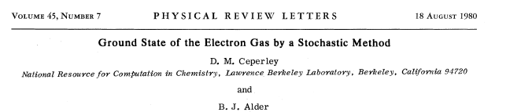
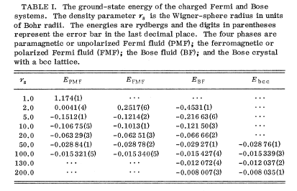
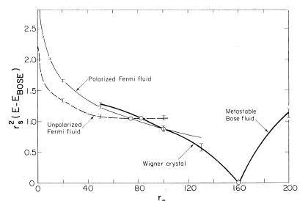
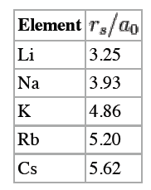
QMC Summer School 2012 UIUC

Slide 19
Total Energy in DFT
The total energy is a functional of the density:
(1)
We know:
Multiply (A) by and sum over occupied states i:
So there are two expressions for the total energy (1) with and:
NB: large negative potential energy and large positive kinetic energy near nuclei in atomic cores

Slide 20
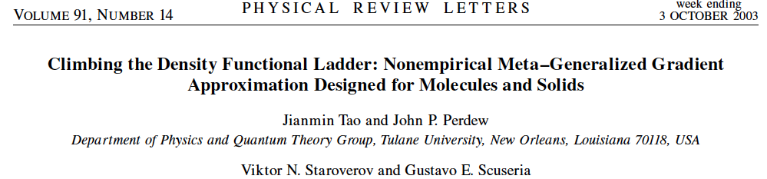
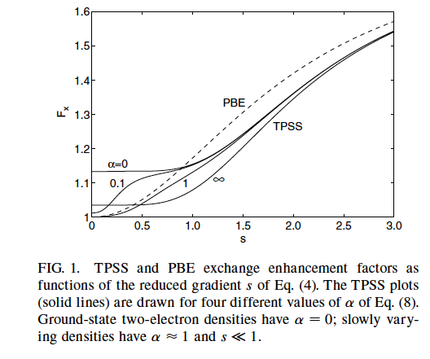




Different density functionals
LDA
LSDA include spin density
GGA, include also gradients
Meta-GGA include kinetic energy density
difference in GGA and LDA valence density for quartz SiO₂

Slide 21





Coupling constant integration
Exchange correlation hole:
g: pair correlation function

Slide 22
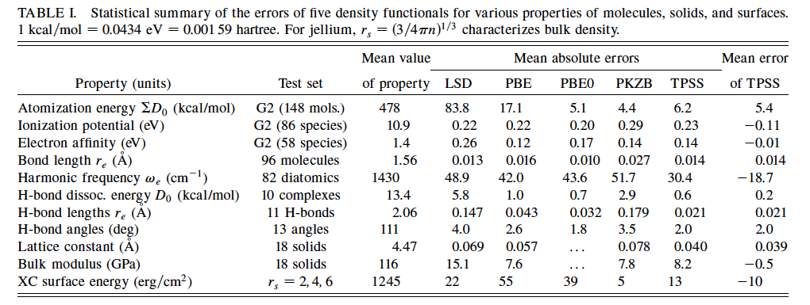

Slide 23
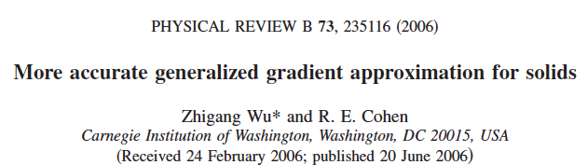
The xc hole in solids can have a diffuse tail, not in atoms or small molecules.
A diffuse cutoff of the exchange hole leads to a smaller than . (Perdew et al., PRB 54, 16533)
For slowly varying density systems, (Svendsen and von Barth, PRB 54, 17402)
Symbols in insert are determined by the real space cutoff procedure [1].
F_{x}^{WC} matches that of TPSS meta-GGA [2] for the slowly varying limit well.
A new based on above observations:
and
[1] Perdew, Burke, and Wang, PRB 54, 16533
[2] Tao et al., PRL 91, 146401

Slide 24
Simple solids
We tested the following 18 solids: Li, Na, K, Al, C, Si, SiC, Ge, GaAs, NaCl, NaF, LiCl, LiF, MgO, Ru, Rh, Pd, Ag.
The new GGA is much better than other approximations.
Mean errors (%) of calculated equilibrium lattice
Constants a₀ and bulk moduli B₀ at 0K.
 | LDA | PBE | WC | TPSS | PKZB
a₀ | 1.74 | 1.30 | 0.29 | 0.83 | 1.65
B₀ | 12.9 | 9.9 | 3.6 | 7.6 | 8.0
TPSS and PKZB results: Staroverov, et al. PRB 69, 075102

Slide 25
More accurate E_{xc} for Ferroelectrics
The new GGA is very accurate for the ground state structure of ferroelectrics.
V_{x}^{WC} differs from V_{x}^{PBE} significantly only in core regions.
In bonding regions, the difference V_{x}^{WC} and V_{x}^{PBE} is much smaller.
P4mm PbTiO₃
R3m BaTiO₃
 | LDA | PBE | WC | Expt
V₀(Å³) | 60.37 | 70.54 | 63.47 | 63.09
c/a | 1.046 | 1.239 | 1.078 | 1.071
u_{z}(Pb) | 0.0000 | 0.0000 | 0.0000 | 0.000
u_{z}(Ti) | 0.5235 | 0.5532 | 0.5324 | 0.538
u_{z}(O_{1,2}) | 0.5886 | 0.6615 | 0.6106 | 0.612
u_{z}(O₃) | 0.0823 | 0.1884 | 0.1083 | 0.112
 | LDA | PBE | WC | Expt
V₀(Å³) | 61.59 | 67.47 | 64.04 | 64.04
α(º) | 89.91 | 89.65 | 89.86 | 89.87
u_{z}(Pb) | 0.0000 | 0.0000 | 0.0000 | 0.0000
u_{z}(Ti) | 0.4901 | 0.4845 | 0.4883 | 0.487
u_{z}(O_{1,2}) | 0.5092 | 0.5172 | 0.5116 | 0.511
u_{z}(O₃) | 0.0150 | 0.0295 | 0.0184 | 0.018
u_{z} are given in terms of the lattice constants

Slide 26
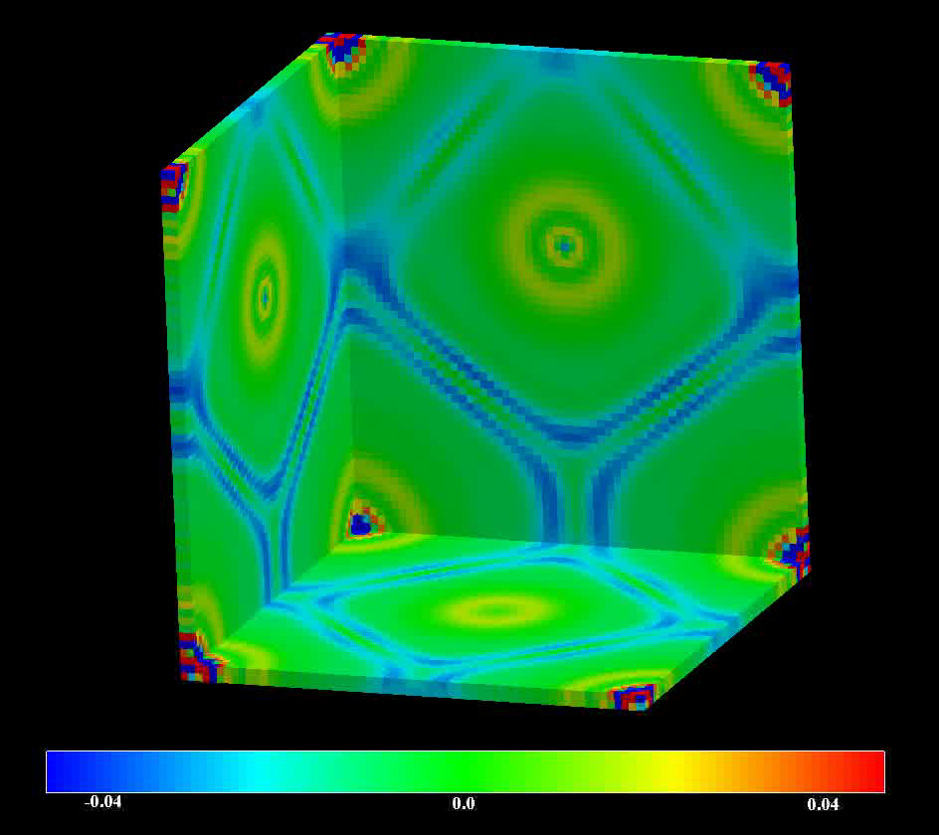
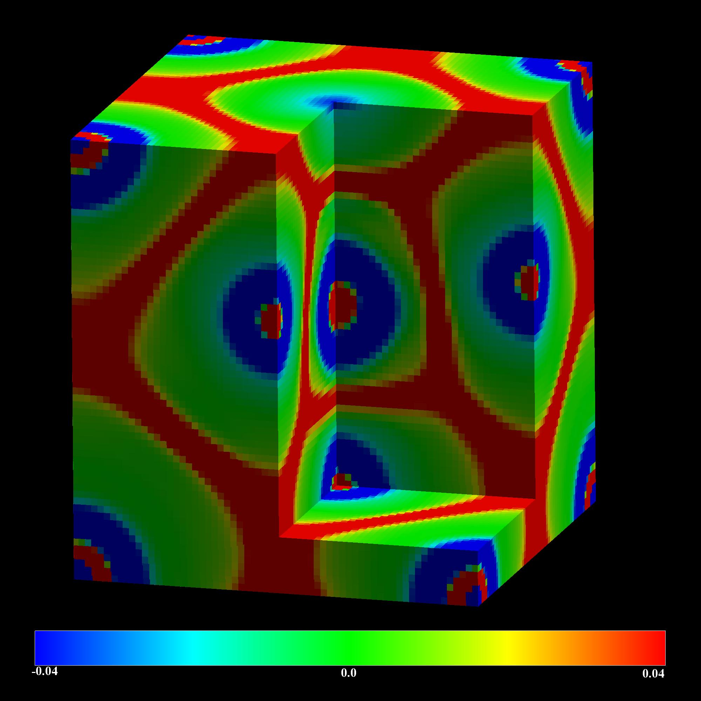
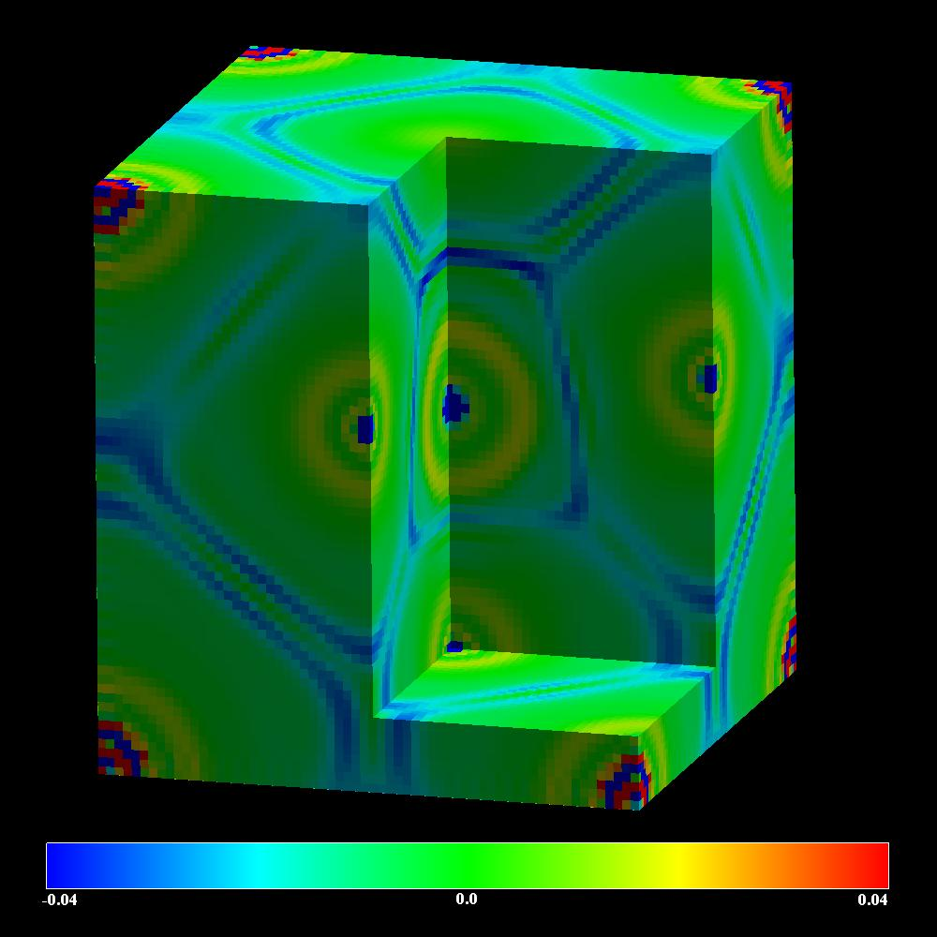
Difference in x-c potentials for PbTiO₃
WC – PBE V_{XC}
-0.04 eV
0.0
0.04 eV
PBE – LDA V_{X}
WC – PBE V_{X}

Slide 27
Functionals in Abinit
001=> XC_LDA_X [PAM Dirac, Proceedings of the Cambridge Philosophical Society 26, 376 (1930); F Bloch, Zeitschrift fuer Physik 57, 545 (1929) ]
002=> XC_LDA_C_WIGNER Wigner parametrization [EP Wigner, Trans. Faraday Soc. 34, 678 (1938) ]
003=> XC_LDA_C_RPA Random Phase Approximation [M Gell-Mann and KA Brueckner, Phys. Rev. 106, 364 (1957) ]
004=> XC_LDA_C_HL Hedin & Lundqvist [L Hedin and BI Lundqvist, J. Phys. C 4, 2064 (1971) ]
005=> XC_LDA_C_GL ! Gunnarson & Lundqvist [O Gunnarsson and BI Lundqvist, PRB 13, 4274 (1976) ]
006=> XC_LDA_C_XALPHA ! Slater's Xalpha ]
007=> XC_LDA_C_VWN ! Vosko, Wilk, & Nussair [SH Vosko, L Wilk, and M Nusair, Can. J. Phys. 58, 1200 (1980) ]
008=> XC_LDA_C_VWN_RPA ! Vosko, Wilk, & Nussair (RPA) [SH Vosko, L Wilk, and M Nusair, Can. J. Phys. 58, 1200 (1980) ]
009=> XC_LDA_C_PZ ! Perdew & Zunger [Perdew and Zunger, Phys. Rev. B 23, 5048 (1981) ]
010=> XC_LDA_C_PZ_MOD ! Perdew & Zunger (Modified) [Perdew and Zunger, Phys. Rev. B 23, 5048 (1981) Modified to improve the matching between the low and high rs part ]
011=> XC_LDA_C_OB_PZ ! Ortiz & Ballone (PZ) [G Ortiz and P Ballone, Phys. Rev. B 50, 1391 (1994) ; G Ortiz and P Ballone, Phys. Rev. B 56, 9970(E) (1997) ; Perdew and Zunger, Phys. Rev. B 23, 5048 (1981) ]
012=> XC_LDA_C_PW ! Perdew & Wang [JP Perdew and Y Wang, Phys. Rev. B 45, 13244 (1992) ]
013=> XC_LDA_C_PW_MOD ! Perdew & Wang (Modified) [JP Perdew and Y Wang, Phys. Rev. B 45, 13244 (1992) ; Added extra digits to some constants as in the PBE routine see http://www.chem.uci.edu/~kieron/dftold2/pbe.php (at some point it was available at http://dft.uci.edu/pbe.php) ]
014=> XC_LDA_C_OB_PW ! Ortiz & Ballone (PW) [G Ortiz and P Ballone, Phys. Rev. B 50, 1391 (1994) ; G Ortiz and P Ballone, Phys. Rev. B 56, 9970(E) (1997) ; JP Perdew and Y Wang, Phys. Rev. B 45, 13244 (1992) ]
017=> XC_LDA_C_vBH ! von Barth & Hedin [U von Barth and L Hedin, J. Phys. C: Solid State Phys. 5, 1629 (1972) ]
020=> XC_LDA_XC_TETER93 ! Teter 93 parametrization [S Goedecker, M Teter, J Hutter, PRB 54, 1703 (1996) ]
GGA functionals (do not forget to add a minus sign, as discussed above)
101=> XC_GGA_X_PBE ! Perdew, Burke & Ernzerhof exchange [JP Perdew, K Burke, and M Ernzerhof, Phys. Rev. Lett. 77, 3865 (1996) ; JP Perdew, K Burke, and M Ernzerhof, Phys. Rev. Lett. 78, 1396(E) (1997) ]
102=> XC_GGA_X_PBE_R ! Perdew, Burke & Ernzerhof exchange (revised) [Y Zhang and W Yang, Phys. Rev. Lett 80, 890 (1998) ]
103=> XC_GGA_X_B86 ! Becke 86 Xalfa,beta,gamma [AD Becke, J. Chem. Phys 84, 4524 (1986) ]
104=> XC_GGA_X_B86_R ! Becke 86 Xalfa,beta,gamma (reoptimized) [AD Becke, J. Chem. Phys 84, 4524 (1986) ; AD Becke, J. Chem. Phys 107, 8554 (1997) ]
105=> XC_GGA_X_B86_MGC ! Becke 86 Xalfa,beta,gamma (with mod. grad. correction) [AD Becke, J. Chem. Phys 84, 4524 (1986) ; AD Becke, J. Chem. Phys 85, 7184 (1986) ]
106=> XC_GGA_X_B88 ! Becke 88 [AD Becke, Phys. Rev. A 38, 3098 (1988) ]
107=> XC_GGA_X_G96 ! Gill 96 [PMW Gill, Mol. Phys. 89, 433 (1996) ]
108=> XC_GGA_X_PW86 ! Perdew & Wang 86 [JP Perdew and Y Wang, Phys. Rev. B 33, 8800 (1986) ]
109=> XC_GGA_X_PW91 ! Perdew & Wang 91 [JP Perdew, in Proceedings of the 21st Annual International Symposium on the Electronic Structure of Solids, ed. by P Ziesche and H Eschrig (Akademie Verlag, Berlin, 1991), p. 11. ; JP Perdew, JA Chevary, SH Vosko, KA Jackson, MR Pederson, DJ Singh, and C Fiolhais, Phys. Rev. B 46, 6671 (1992) ; JP Perdew, JA Chevary, SH Vosko, KA Jackson, MR Pederson, DJ Singh, and C Fiolhais, Phys. Rev. B 48, 4978(E) (1993) ]
110=> XC_GGA_X_OPTX ! Handy & Cohen OPTX 01 [NC Handy and AJ Cohen, Mol. Phys. 99, 403 (2001) ]
111=> XC_GGA_X_DK87_R1 ! dePristo & Kress 87 (version R1) [AE DePristo and JD Kress, J. Chem. Phys. 86, 1425 (1987) ]
112=> XC_GGA_X_DK87_R2 ! dePristo & Kress 87 (version R2) [AE DePristo and JD Kress, J. Chem. Phys. 86, 1425 (1987) ]
113=> XC_GGA_X_LG93 ! Lacks & Gordon 93 [DJ Lacks and RG Gordon, Phys. Rev. A 47, 4681 (1993) ]
114=> XC_GGA_X_FT97_A ! Filatov & Thiel 97 (version A) [M Filatov and W Thiel, Mol. Phys 91, 847 (1997) ]
115=> XC_GGA_X_FT97_B ! Filatov & Thiel 97 (version B) [M Filatov and W Thiel, Mol. Phys 91, 847 (1997) ]
116=> XC_GGA_X_PBE_SOL ! Perdew, Burke & Ernzerhof exchange (solids) [JP Perdew, et al, Phys. Rev. Lett. 100, 136406 (2008) ]
117=> XC_GGA_X_RPBE ! Hammer, Hansen & Norskov (PBE-like) [B Hammer, LB Hansen and JK Norskov, Phys. Rev. B 59, 7413 (1999) ]
118=> XC_GGA_X_WC ! Wu & Cohen [Z Wu and RE Cohen, Phys. Rev. B 73, 235116 (2006) ]
119=> XC_GGA_X_mPW91 ! Modified form of PW91 by Adamo & Barone [C Adamo and V Barone, J. Chem. Phys. 108, 664 (1998) ]
120=> XC_GGA_X_AM05 ! Armiento & Mattsson 05 exchange [R Armiento and AE Mattsson, Phys. Rev. B 72, 085108 (2005) ; AE Mattsson, R Armiento, J Paier, G Kresse, JM Wills, and TR Mattsson, J. Chem. Phys. 128, 084714 (2008) ]
121=> XC_GGA_X_PBEA ! Madsen (PBE-like) [G Madsen, Phys. Rev. B 75, 195108 (2007) ]
122=> XC_GGA_X_MPBE ! Adamo & Barone modification to PBE [C Adamo and V Barone, J. Chem. Phys. 116, 5933 (2002) ]
123=> XC_GGA_X_XPBE ! xPBE reparametrization by Xu & Goddard [X Xu and WA Goddard III, J. Chem. Phys. 121, 4068 (2004) ]
130=> XC_GGA_C_PBE ! Perdew, Burke & Ernzerhof correlation [JP Perdew, K Burke, and M Ernzerhof, Phys. Rev. Lett. 77, 3865 (1996) ; JP Perdew, K Burke, and M Ernzerhof, Phys. Rev. Lett. 78, 1396(E) (1997) ]
131=> XC_GGA_C_LYP ! Lee, Yang & Parr [C Lee, W Yang and RG Parr, Phys. Rev. B 37, 785 (1988) B Miehlich, A Savin, H Stoll and H Preuss, Chem. Phys. Lett. 157, 200 (1989) ]
132=> XC_GGA_C_P86 ! Perdew 86 [JP Perdew, Phys. Rev. B 33, 8822 (1986) ]
133=> XC_GGA_C_PBE_SOL ! Perdew, Burke & Ernzerhof correlation SOL [JP Perdew, et al, Phys. Rev. Lett. 100, 136406 (2008) ]
134=> XC_GGA_C_PW91 ! Perdew & Wang 91 [JP Perdew, JA Chevary, SH Vosko, KA Jackson, MR Pederson, DJ Singh, and C Fiolhais, Phys. Rev. B 46, 6671 (1992) ]
135=> XC_GGA_C_AM05 ! Armiento & Mattsson 05 correlation [ R Armiento and AE Mattsson, Phys. Rev. B 72, 085108 (2005) ; AE Mattsson, R Armiento, J Paier, G Kresse, JM Wills, and TR Mattsson, J. Chem. Phys. 128, 084714 (2008) ]
136=> XC_GGA_C_XPBE ! xPBE reparametrization by Xu & Goddard [X Xu and WA Goddard III, J. Chem. Phys. 121, 4068 (2004) ]
137=> XC_GGA_C_LM ! Langreth and Mehl correlation [DC Langreth and MJ Mehl, Phys. Rev. Lett. 47, 446 (1981) ]
160=> XC_GGA_XC_LB ! van Leeuwen & Baerends [R van Leeuwen and EJ Baerends, Phys. Rev. A. 49, 2421 (1994) ]
161=> XC_GGA_XC_HCTH_93 ! HCTH functional fitted to 93 molecules [FA Hamprecht, AJ Cohen, DJ Tozer, and NC Handy, J. Chem. Phys. 109, 6264 (1998) ]
162=> XC_GGA_XC_HCTH_120 ! HCTH functional fitted to 120 molecules [AD Boese, NL Doltsinis, NC Handy, and M Sprik, J. Chem. Phys. 112, 1670 (2000) ]
163=> XC_GGA_XC_HCTH_147 ! HCTH functional fitted to 147 molecules [AD Boese, NL Doltsinis, NC Handy, and M Sprik, J. Chem. Phys. 112, 1670 (2000) ]
164=> XC_GGA_XC_HCTH_407 ! HCTH functional fitted to 407 molecules [AD Boese, and NC Handy, J. Chem. Phys. 114, 5497 (2001) ]
165=> XC_GGA_XC_EDF1 ! Empirical functionals from Adamson, Gill, and Pople [RD Adamson, PMW Gill, and JA Pople, Chem. Phys. Lett. 284 6 (1998) ]
166=> XC_GGA_XC_XLYP ! XLYP functional [X Xu and WA Goddard, III, PNAS 101, 2673 (2004) ]
167=> XC_GGA_XC_B97 ! Becke 97 [AD Becke, J. Chem. Phys. 107, 8554-8560 (1997) ]
168=> XC_GGA_XC_B97_1 ! Becke 97-1 [FA Hamprecht, AJ Cohen, DJ Tozer, and NC Handy, J. Chem. Phys. 109, 6264 (1998); AD Becke, J. Chem. Phys. 107, 8554-8560 (1997) ]
169=> XC_GGA_XC_B97_2 ! Becke 97-2 [AD Becke, J. Chem. Phys. 107, 8554-8560 (1997) ]
202=> XC_MGGA_X_TPSS ! Tao, Perdew, Staroverov & Scuseria [J Tao, JP Perdew, VN Staroverov, and G Scuseria, Phys. Rev. Lett. 91, 146401 (2003) ; JP Perdew, J Tao, VN Staroverov, and G Scuseria, J. Chem. Phys. 120, 6898 (2004) ]
203=> XC_MGGA_X_M06L ! Zhao, Truhlar exchange [Y Zhao and DG Truhlar, JCP 125, 194101 (2006); Y Zhao and DG Truhlar, Theor. Chem. Account 120, 215 (2008) ]
204=> XC_MGGA_X_GVT4 ! GVT4 (X part of VSXC) from van Voorhis and Scuseria [T Van Voorhis and GE Scuseria, JCP 109, 400 (1998) ]
205=> XC_MGGA_X_TAU_HCTH ! tau-HCTH from Boese and Handy [AD Boese and NC Handy, JCP 116, 9559 (2002) ]
207=> XC_MGGA_X_BJ06 ! Becke & Johnson correction to Becke-Roussel 89 [AD Becke and ER Johnson, J. Chem. Phys. 124, 221101 (2006) ] WARNING : this Vxc-only mGGA can only be used with a LDA correlation, typically Perdew-Wang 92.
208=> XC_MGGA_X_TB09 ! Tran-blaha - correction to Becke & Johnson correction to Becke-Roussel 89 [F Tran and P Blaha, Phys. Rev. Lett. 102, 226401 (2009) ] WARNING : this Vxc-only mGGA can only be used with a LDA correlation, typically Perdew-Wang 92.
209=> XC_MGGA_X_RPP09 ! Rasanen, Pittalis, and Proetto correction to Becke & Johnson [E Rasanen, S Pittalis & C Proetto, arXiv:0909.1477 (2009) ] WARNING : this Vxc-only mGGA can only be used with a LDA correlation, typically Perdew-Wang 92.
232=> XC_MGGA_C_VSXC ! VSxc from Van Voorhis and Scuseria (correlation part) [T Van Voorhis and GE Scuseria, JCP 109, 400 (1998) ]

Slide 28
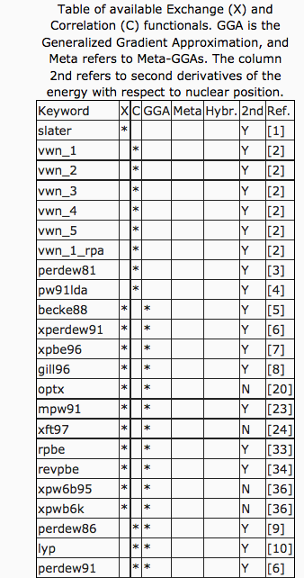
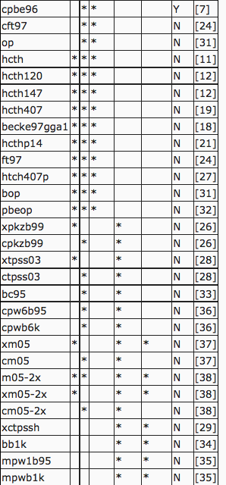
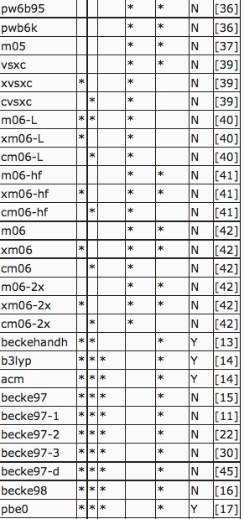
Available DFT E_{xc} functionals in NWCHEM > 100!!
http://www.nwchem-sw.org/index.php/Density_Functional_Theory_for_Molecules#Combined_Exchange_and_Correlation_Functionals

Slide 29
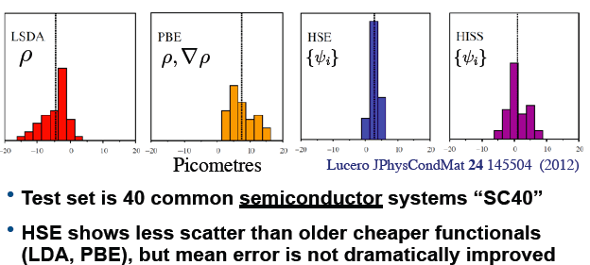


Slide 30
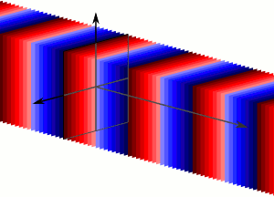
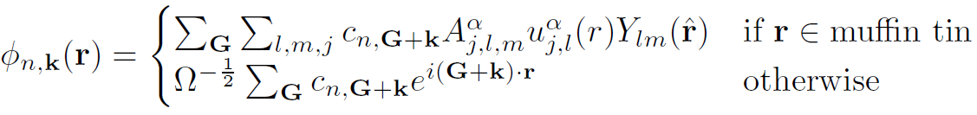
Basis Sets
Plane Waves (pseudopotentials)
Wavelets and grids
Exponentials (“Slater type orbitals” STO)
Gaussians
APW (all-electron)
FLAPW (Linearized Augmented Plane Wave) (all-electron, full-potential)
FLMTO (Linearized Muffin Tin Orbitals) (all-electron, full-potential)
…

Slide 31
Solution
We have:
Solve by diagonalization (generalized Hermitian eigenproblem, LAPACK), compact basis, LAPW, LMTO
Iterative diagonalization
Conjugate gradient
Car-Parrinello molecular dynamics (CPMD)

Slide 32
Self-consistency
Initial guess for ρ
Compute v_{KS}(ρ)
Solve for new ρ, compute E
Converged?
Done, compute properties
no
Mix old and new

Slide 33
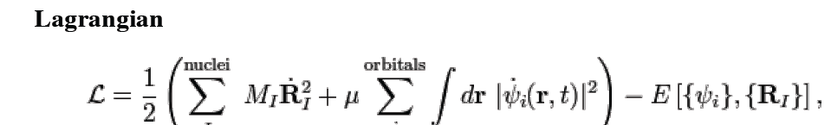
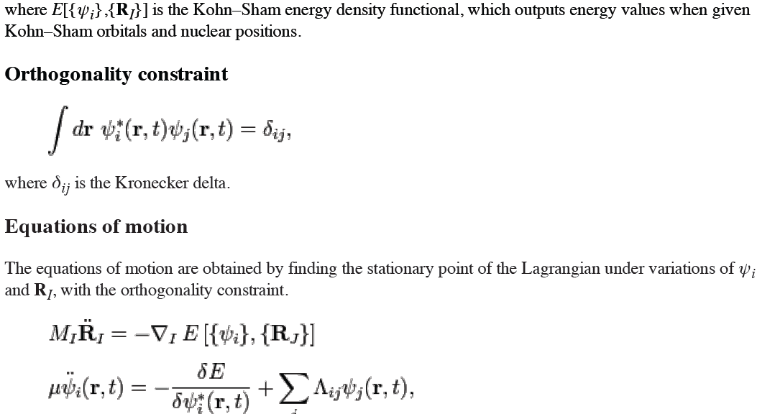
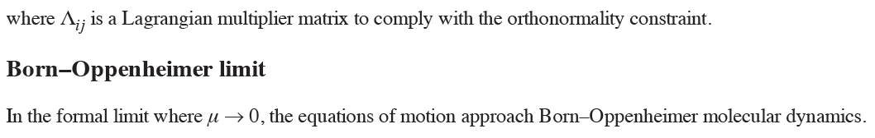
Car-Parrinello Molecular Dynamics

Slide 34
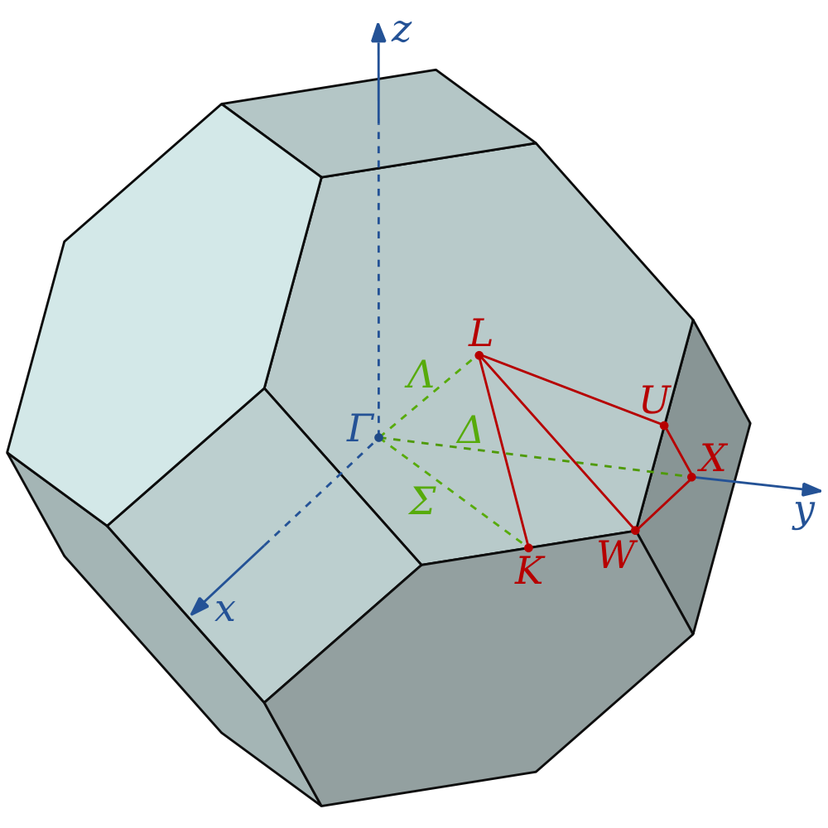
k-point sampling
Finite set of k-points
Care is needed for proper symmetry
Regular grid centered at Γ(0,0,0)
Offset grid (Monkhorst-Pack (1976))
In DFT usually smear states for convergence

Slide 35
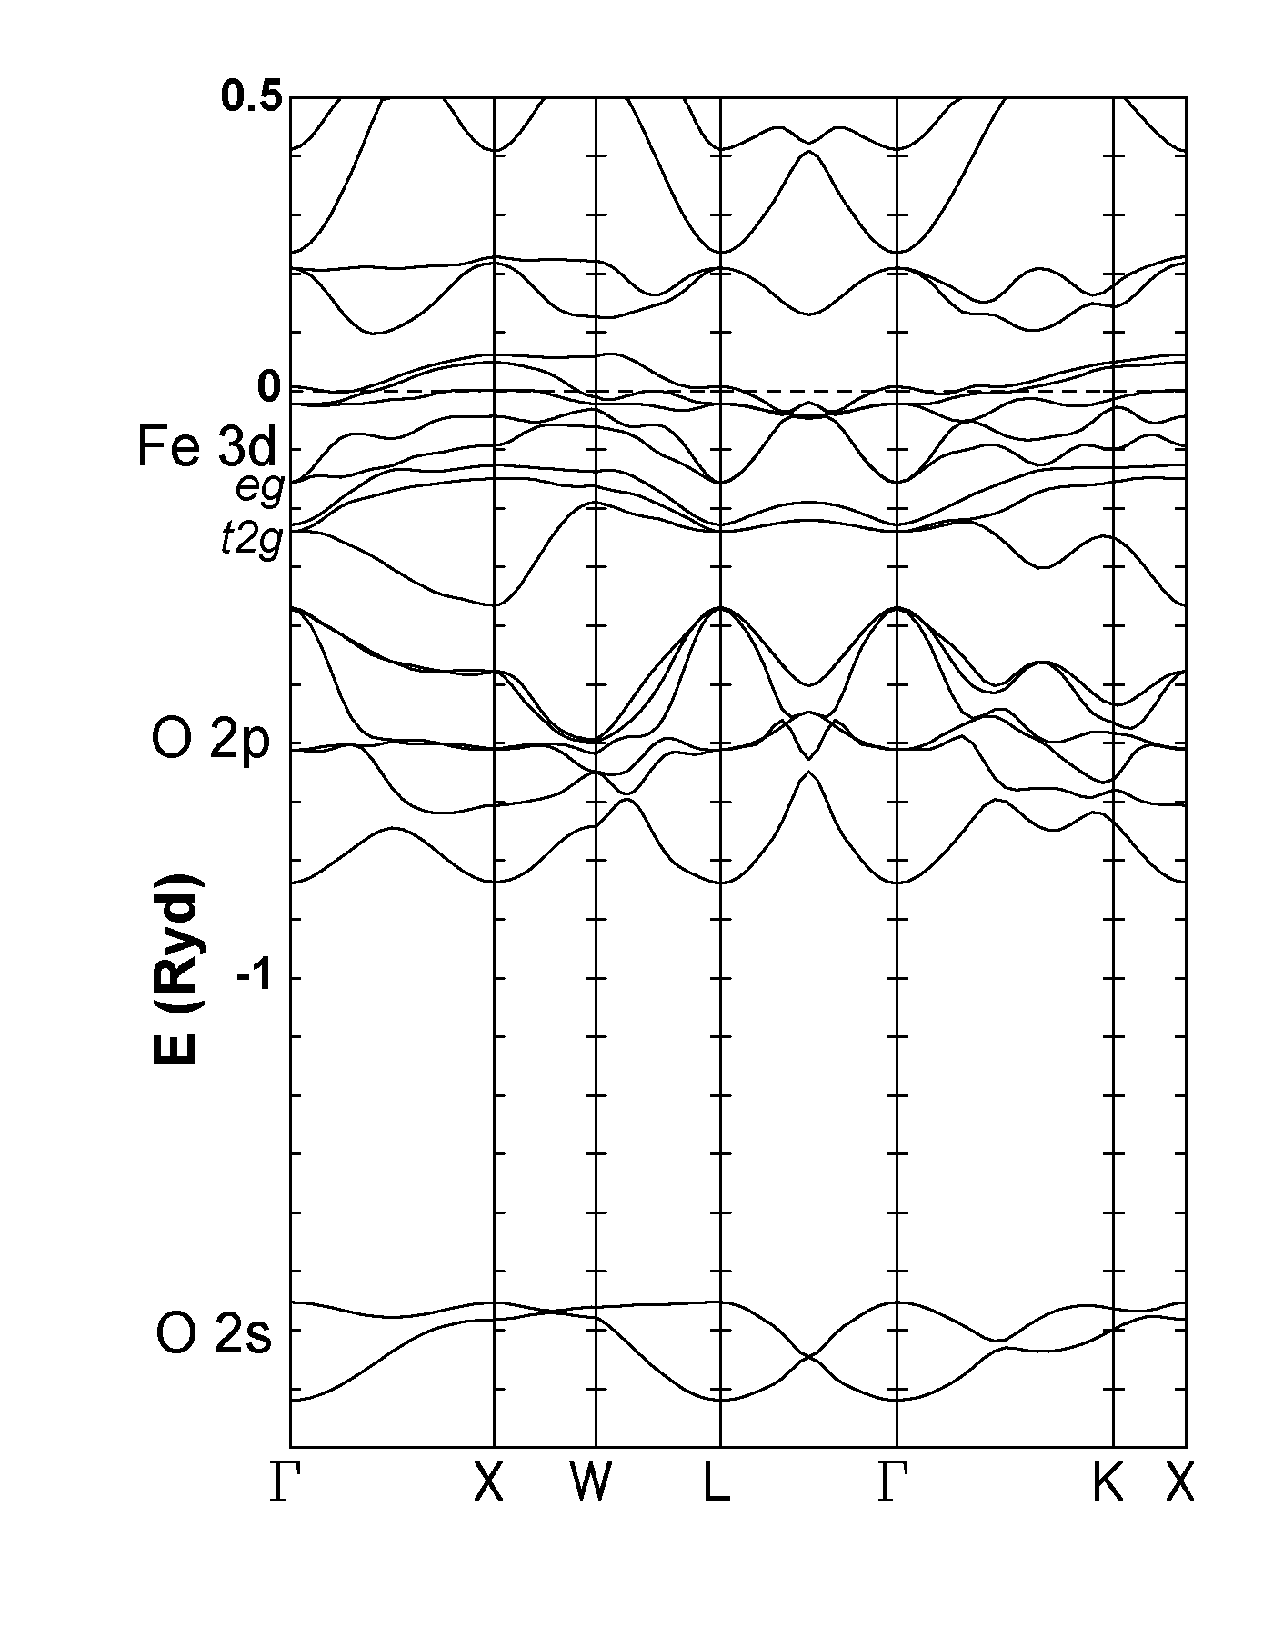
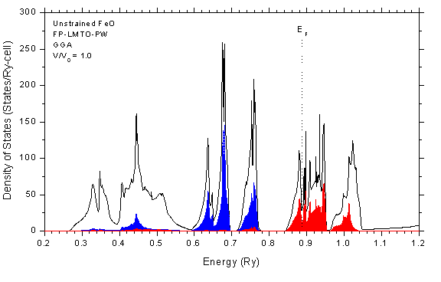
Band structure and density of states
Band structure—plot ε_{i} (k)
Density of states
Partial density of states

Slide 36
Density Functional Perturbation Theory
Take derivative(s) of Schrödinger equation
Gonze & Lee, PRB 55, 10355; Hamann et al., PRB 71, 035117
method | e₃₁ | e₃₃ | e₁₅ | c₁₁ | c₁₂ | c₁₃ | c₃₃ | c₄₄ | c₆₆
DFPT | 2.06 | 4.41 | 6.63 | 230 | 96.2 | 65.2 | 41.9 | 46.6 | 98.8
FS | 2.07 | 4.48 | 6.66 | 229 | 95.6 | 64.3 | 41.2 | 47.2 | 98.6
exp | 2.1 | 5.0 | 4.4 | 237 | 90 | 70 | 66 | 69 | 104
Ζ. Ωυ, ανδ Ρ. Χοηεν, Πηψσ. Ρεϖ. Λεττ., 95, 37601 (2005).

Slide 37
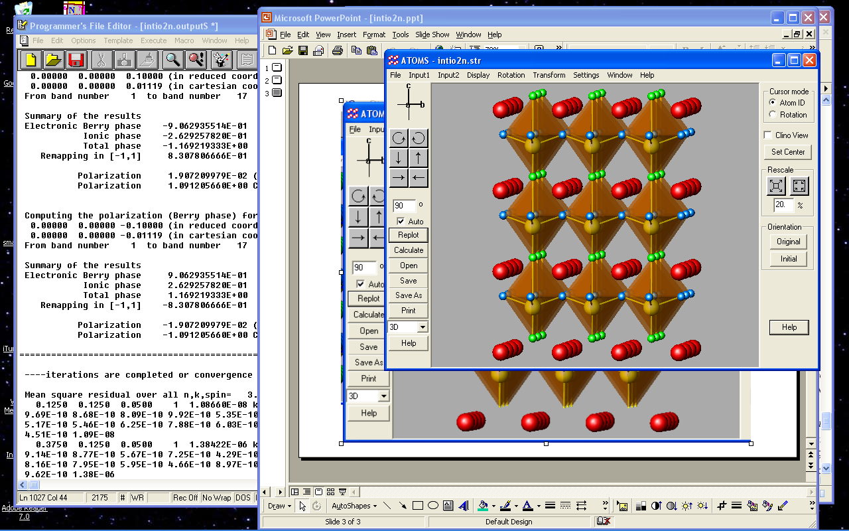
Materials by Design
Razvan Caracas, CIW, Univ. Lyon
  What happens if replace one O per cell by N?
  Tried large range of compositions.
  Looked for
    Stable
    Insulators
    High polarization
O
Si
N
Y
Caracas and Cohen, APL 91, 092902 (2007).

Slide 38
YGeO₂N
YSiO₂N
Electronic dielectric tensor - ε∞
[4.598 4.598 5.008]
[4.377 4.377 4.494]
Dielectric constant ε⁰
[16.485 16.485 9.769]
[13.441 13.441 9.705]
Spontaneous polarization, P_{s}
102.63 μC/cm²
129.56 μC/cm²
Effective Charges
Other materials:
NaNbO₃ 12
PMN 24
PZN 24
Bi_{.5}Na_{.5}TiO 36
LiNbO₃ 71
LiTaO₃ 50
SbSI 25
LiH₃(SeO₃)₂ 15
KDP 4.75
KNO₃ 6.3
Caracas and Cohen, APL 91, 092902 (2007).

Slide 39
Caracas and Cohen, APL 91, 092902 (2007).
YGeO₂N
YSiO₂N
d₁₂₁ = -20.494
d₃₃₃ = -5.509
d₁₁₃ = -0.502
d₁₂₁ = -12.532
d₃₃₃ = -8.330
d₁₁₃ = 0.395
Piezoelectric constants tensor d (pC/N)
Other materials: BaTiO₃ ceramics d₃₃=350
KDP d₃₃=21
ADP d₃₃=48
Non-linear optical coefficients d (pm/V)
d₁₅ = 2.631
d₃₃ = -4.508
d₁₅ = 2.034
d₃₃ = -5.503
Other materials: AANP (organic) d₃₁=d₁₅=80
KDP 0.6 – 0.7
ADP 0.8
Electro-optic tensor (pm/V)
c₁₅ = -0.841
c₃₃ = 1.058
c₅₁ = -1.772
c₁₅ = -1.427
c₃₃ = 0.637
c₅₁ = -1.321
Caracas and Cohen, APL 91, 092902 (2007).

Slide 40
Pseudopotentials
Large negative potential and high kinetic energy in nucleus would require very small time step and very long-runs, scales approximately as Z⁶ for nuclear charge Z
All electron QMC has been done: cBN: Esler, K. P., Cohen, R. E., Militzer, B., Kim, J., Needs, R. J. & Towler, M. D., Fundamental High-Pressure Calibration from All-Electron Quantum Monte Carlo Calculations. Phys. Rev. Lett. 104, 185702, doi:10.1103/PhysRevLett.104.185702 (2010).
Up to Z=54:
Many reviews and short course notes on pseudopotentials on the web.
Here follow mostly Pickett, W. E. Pseudopotential methods in condensed matter applications. Computer Physics Reports 9, 115-198 (1989).

Slide 42
Generates the pseudoorbitals

Slide 43
Takes out valence electron interactions

Slide 44
Pseudopotential Generation
Solve all-electron atom or ion
Decide which states to pseudize
Pick rcut for each state
Different generation methods
Good norm conserving ps generation code: Opium
  Cut off singularity at nucleus
  Enforce norm conservation
  Smooth
  Unscreen
Plot pseudopotential
Test transferability
Test plane wave cutoff

Slide 45
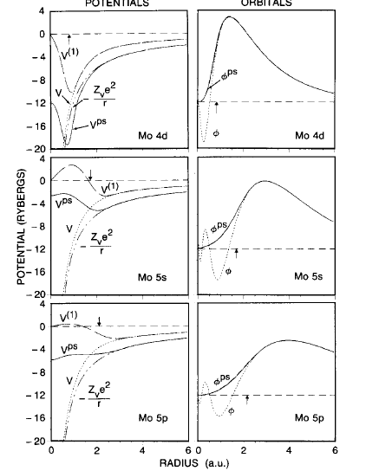
Example of steps for Mo (Pickett 1989)

Slide 46
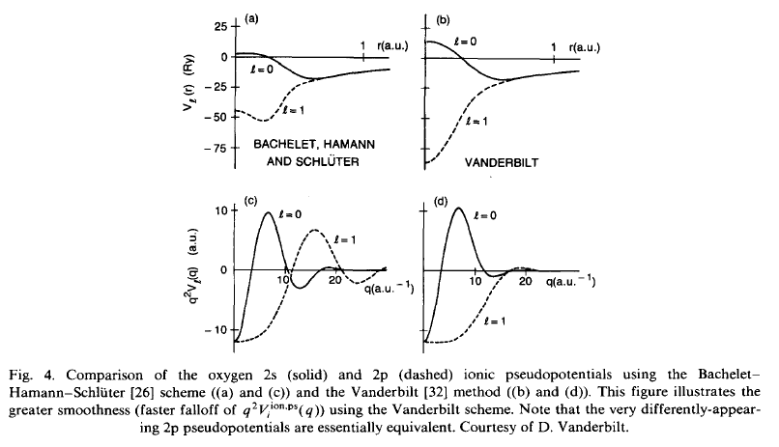

Slide 47
Non-locality
local
“semilocal”
Kleinman and Bylander (KB)
“truly non-local”

Slide 48



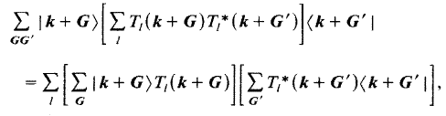
Kleinman and Bylander (KB) non-local pseudopotentials
For planewave basis, standard form:
KB form:
T=FT of δV

Slide 49
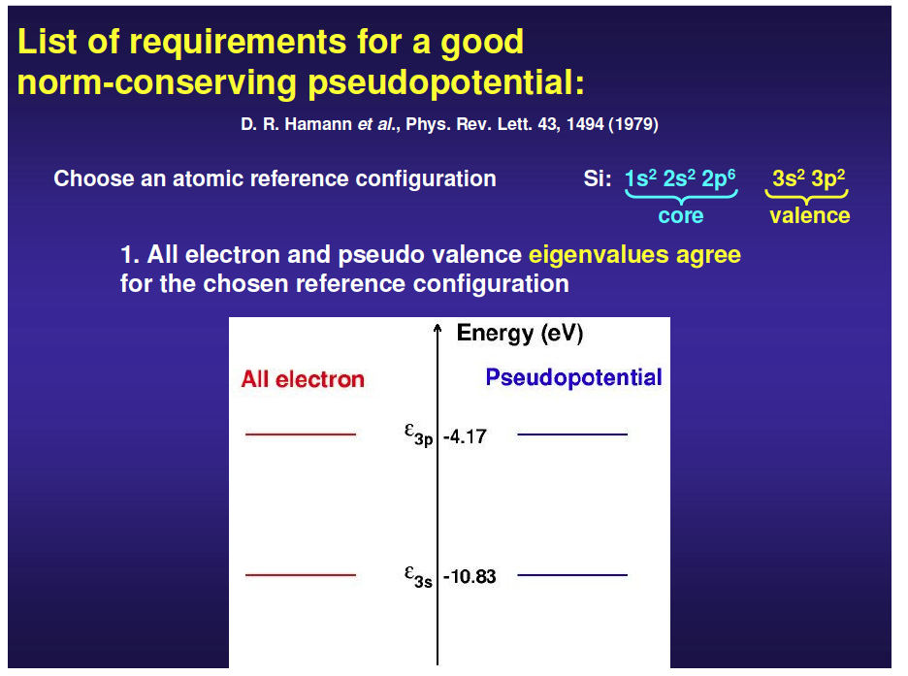


Slide 50
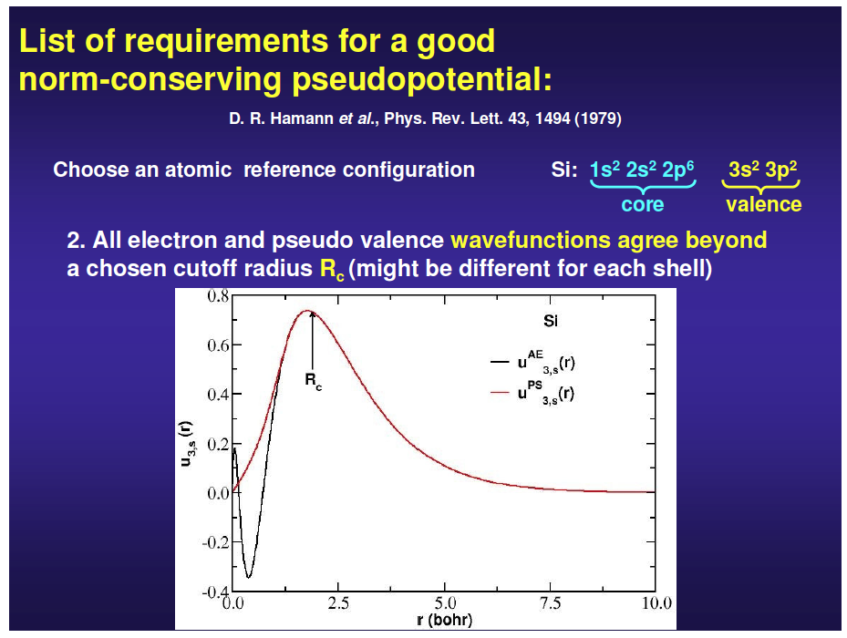

Slide 51
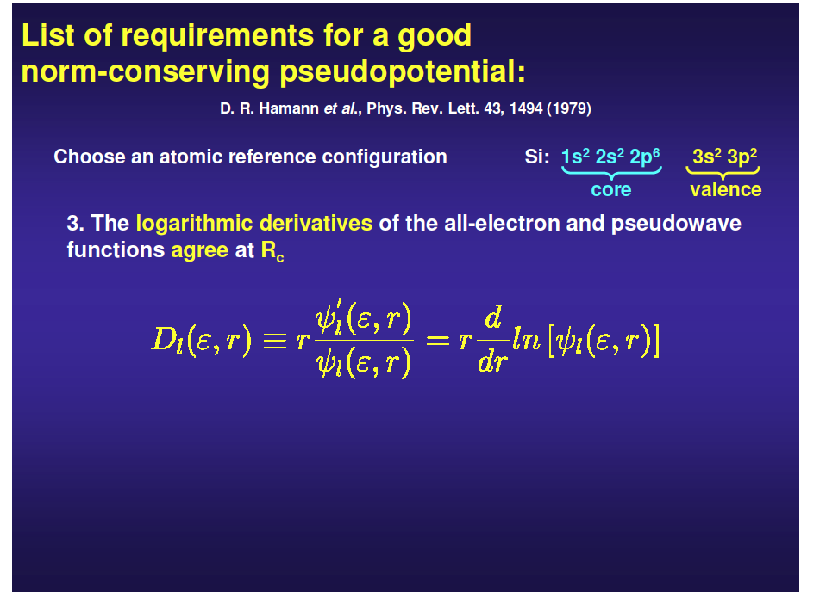

Slide 52
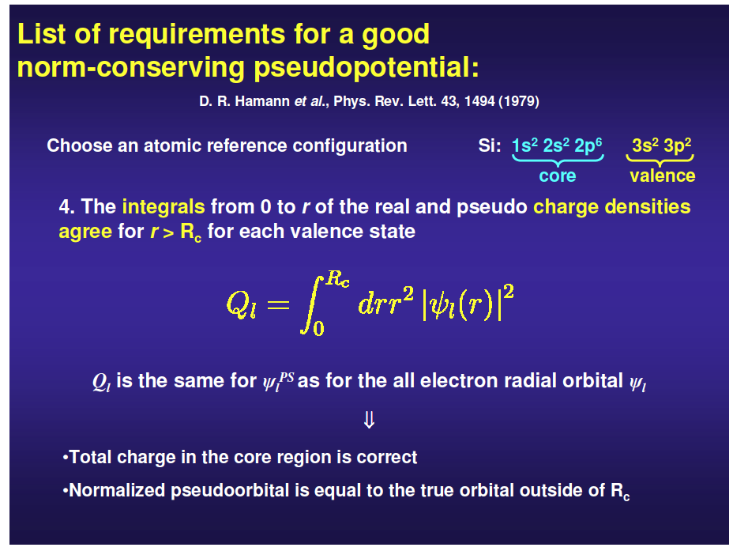

Slide 53
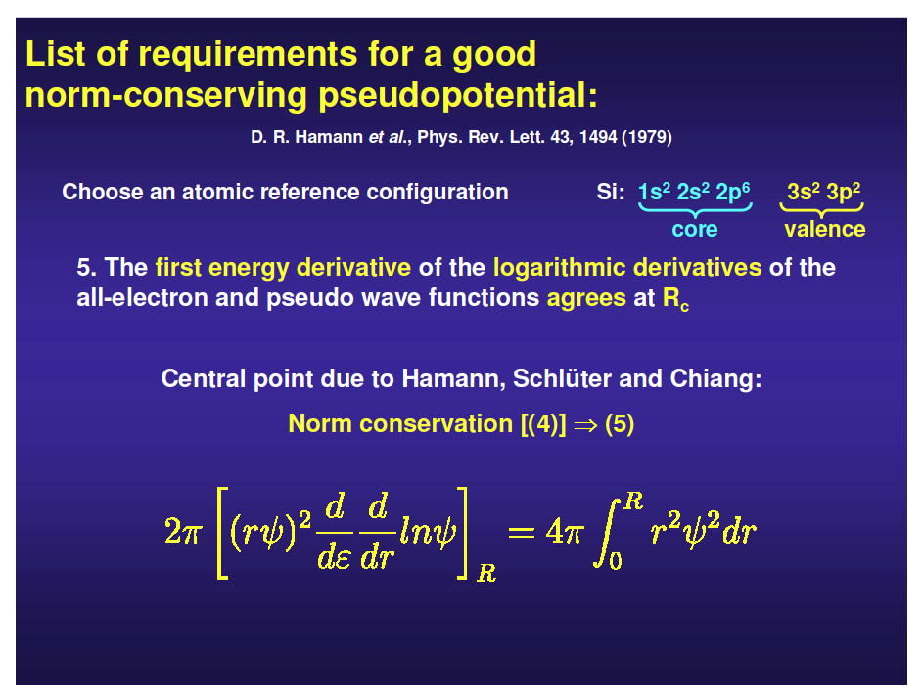

Slide 54
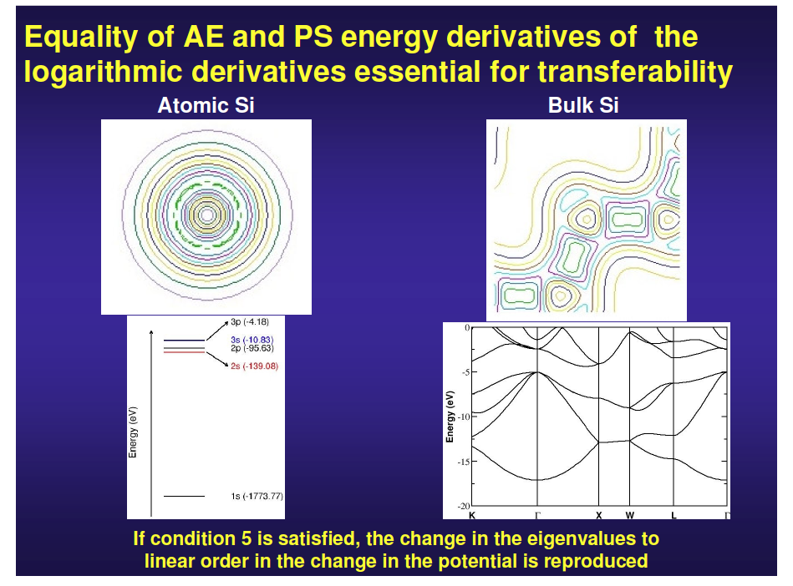

Slide 55



Pseudopotentials in QMC
Problems with non-local (or semi-local) pseudopotentials in DMC, locality approximation, or fancy methods to solve
Locality approximation
Adds new sign changes, so need fixed node approximation, adds error

Slide 56
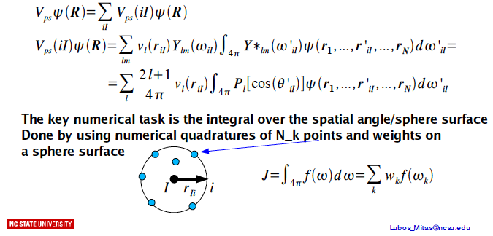
Using non-local pseudopotentials in DMC

Slide 57




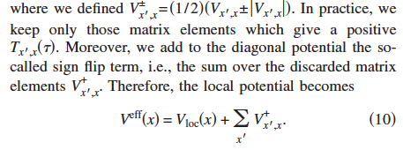
Beyond the Locality Approximation
Casula, tmoves, PRB 74, 161102, 2006;
See: Casula, M., Moroni, S., Sorella, S. & Filippi, C. Size-consistent variational approaches to nonlocal pseudopotentials: Standard and lattice regularized diffusion Monte Carlo methods revisited. J. Chem. Phys. 132, 154113, doi:10.1063/1.3380831 (2010).

Slide 58
All-electron QMC for solids
Current QMC calculations on solids use pseudopotentials (PPs) from Hartree-Fock or DFT
When different PPs give different results, how do we know which to use?
In DFT, decide based on agreement with all-electron calculation
We would like to do the same in QMC. Has only been done for hydrogen and helium.
LAPW is generally gold standard for DFT.
Use orbitals from LAPW calculation in QMC simulation.
Requires efficient evaluation methods and careful numerics
Use atomic-like representation near nuclei, plane-wave or B-splines in interstitial region:

Slide 59
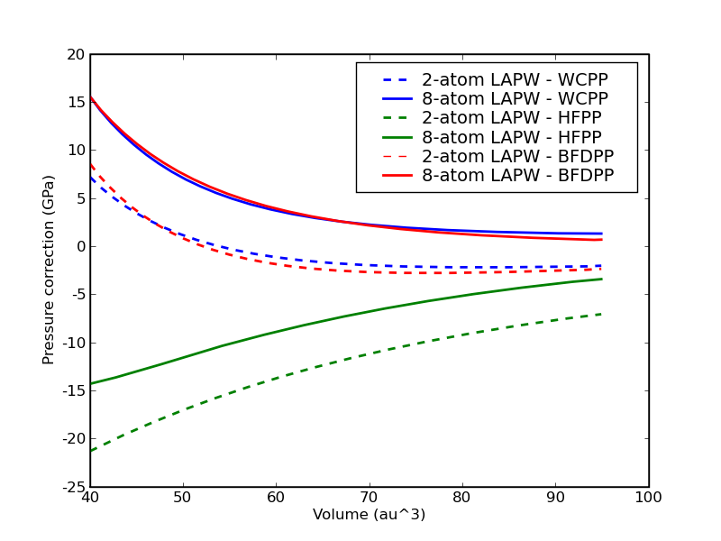
All-electron QMC for solids
Cannot afford to do a large
supercell with all-electron
Therefore, compute pseudo-
potential corrections in small
supercells and extrapolate
to bulk limit
Did comparison for 3 PPs:
  Wu-Cohen GGA
  Trail-Needs Hartree-Fock
  Burkatzki et al Hartree-Fock
Computed pressure corrections
by taking (LAPW EOS – PP EOS)‏
Two supercells: 2-atom and 8-atom

Slide 60
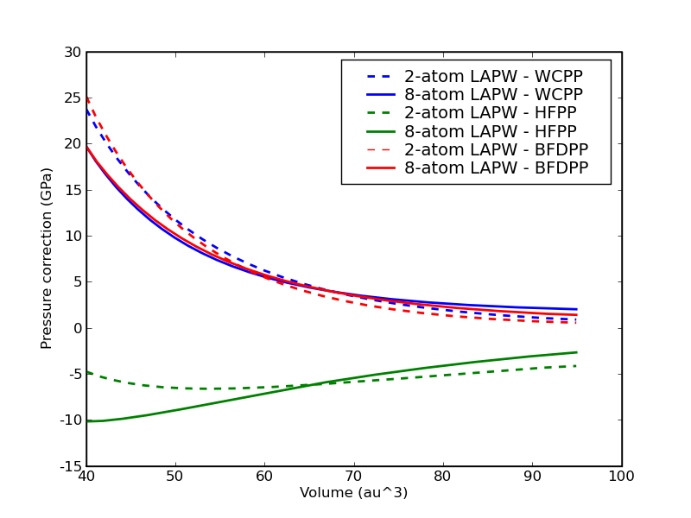
All-electron QMC for solids
2-atom and 8-atom corrections disagree somewhat because core-electrons contribute small finite-size error
We can fit a 1/V correction to the data, and extrapolate to bulk limit:

Slide 61




cBN equation of state
uncorrected
corrected
64 atom supercell, qmcPACK

Slide 62
Codes
I recommend public license, open source codes:
  Plane Wave codes
    ABINIT
    Quantum Espresso (PWSCF)
    QBOX (FPMD)
  Pseudopotential generation
    OPIUM
    Don’t trust pseudopotential libraries

Slide 63
Summary
Density Functional Theory (DFT): 1:1 correspondence between ground state charge density and external potential
DFT is an exact many-body theory in principle, but we do not have a practical exact functional
Reasonably accurate for many systems, but fails for others
DFT is used to generate trial functions, optimize structures, compute phonons, approximate finite size corrections, etc.
Pseudopotentials are usually used to approximately remove core states.
A good working knowledge of DFT methods is useful for practical QMC.
Many freely available codes, tutorials, etc. on the web.

